Slide 1
8. Cache
Rocky K. C. Chang
27 November 2017

Slide 2
Goals of this lecture
Understand the tradeoff among size, cost and performance of NRAM, DRAM, Flash and secondary storages.
Understand the two principles of locality: temporal and spatial.
Understand how cache provides the illusion of accessing a fast and vast memory.
Understand the Direct Mapped, Set Associativity and Fully Associative methods to find block in cache using Tag field and Valid bit for Hit.
Understand how Write-Through vs. Write-Back support the memory store operations.

Slide 3
The memory hierarchy

Slide 4
Semiconductor memories
Source: https://github.com/PatternAgents/Electronics_One_Workshop/wiki/Memory-Circuits

Slide 5
memory performance and cost

Slide 6
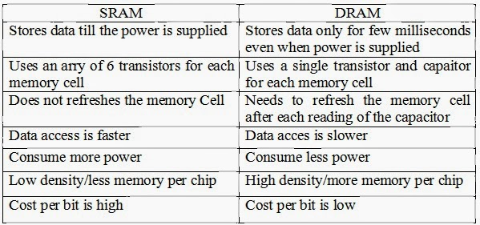
SRAM vs DRAM

Slide 7
Processor-DRAM Gap (latency)
µProc 60%/year
1000
CPU
Processor-Memory
Performance Gap: (growing 50%/yr)
100
Performance
10
DRAM
7%/year
DRAM
1
1986
1988
1987
1989
1990
1991
1992
1993
1994
1995
1980
1996
1981
1982
1983
1984
1985
1997
1998
1999
2000
Time
1980 microprocessor executes ~one instruction in same time as DRAM access
2015 microprocessor executes ~1000 instructions in same time as DRAM access

Slide 8
Big Idea: Memory Hierarchy
Processor
Inner
Increasing distance from processor, decreasing speed
Levels in memory hierarchy
Level 1
Level 2
Level 3
Outer
. . .
Level n
Size of memory at each level
As we move to outer levels the latency goes up and price per bit goes down. Why?

Slide 9
A Library Analogy
Writing a report based on books on reserve.
E.g., works of Shakespeare
Go to library to get reserved book and place on desk in library.
If need more, check them out and keep on desk.
But don’t return earlier books since might need them
You hope this collection of ~10 books on desk enough to write report, despite 10 being only a small percent of all the books in a library.

Slide 10
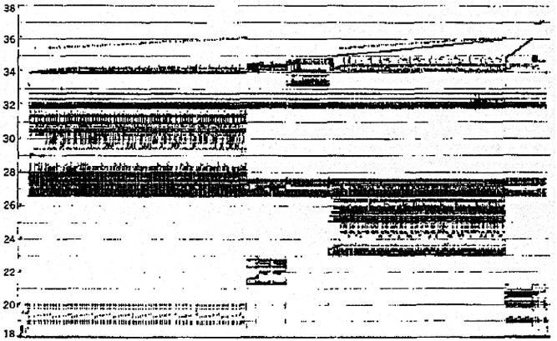
Real Memory Reference Patterns
Memory Address (one dot per access)
Time
Donald J. Hatfield, Jeanette Gerald: Program Restructuring for Virtual Memory. IBM Systems Journal 10(3): 168-192 (1971)

Slide 11
Big Idea: Locality
Temporal Locality (locality in time)
Go back to the same book on desktop multiple times.
If a memory location is referenced, then it will tend to be referenced again soon.
Spatial Locality (locality in space)
When go to book shelf, pick up multiple books by Shakespeare since library stores related books together.
If a memory location is referenced, the locations with nearby addresses will tend to be referenced soon.

Slide 12
Temporal
Locality
Memory Address (one dot per access)
Spatial
Locality
Time
Donald J. Hatfield, Jeanette Gerald: Program Restructuring for Virtual Memory. IBM Systems Journal 10(3): 168-192 (1971)

Slide 13
Principle of Locality
Principle of Locality: Programs access small portion of address space at any instant of time.
What program structures lead to temporal and spatial locality in instruction accesses?
In data accesses?

Slide 14
Memory Reference Patterns
Address
n loop iterations
Instruction
fetches
subroutine call
subroutine return
Stack
accesses
argument access
vector access
Data
accesses
scalar accesses
Time

Slide 15
Cache Philosophy
Programmer-invisible hardware mechanism to give illusion of speed of fastest memory with size of largest memory.
Works fine even if programmer has no idea what a cache is.
However, performance-oriented programmers today sometimes “reverse engineer” cache design to design data structures to match cache.

Slide 16
Memory Access without Cache
Load word instruction: lw $t0,0($t1)
$t1 contains 1022_{ten,} Memory[1022] = 99
Processor issues address 1022_{ten} to memory
Memory reads word at address 1022_{ten} (99)
Memory sends 99 to processor
Processor loads 99 into register $t0

Slide 17
Adding Cache to Computer
Processor
Memory
Enable?
Read/Write
Input
Control
Program
Cache
Datapath
Address
Bytes
PC
Write Data
Registers
Data
Arithmetic & Logic Unit
(ALU)
ReadData
Output
Processor-Memory Interface
I/O-Memory Interfaces
Source: Slides by K. Asanovic & V. Stojanovic for CS61C at UC/Berlekey

Slide 18
Memory Access with Cache
Load word instruction: lw $t0,0($t1)
$t1 contains 1022_{ten,} Memory[1022] = 99
With cache (similar to a hash)
Processor issues address 1022_{ten} to cache.
Cache checks to see if has copy of data at address 1022_{ten}.
2a. If finds a match (Hit): cache reads 99, sends to processor.
2b. No match (Miss): cache sends address 1022 to memory
Memory reads 99 at address 1022_{ten}.
Memory sends 99 to cache.
Cache replaces word with new 99.
Cache sends 99 to processor.
Processor loads 99 into register $t0.

Slide 19
Cache “Tags”
Need way to tell if have copy of location in memory so that can decide on hit or miss.
On cache miss, put memory address of block in “tag address” of cache block.
1022 placed in tag next to data from memory (99)
Tag | Data
252 | 12
1022 | 99
131 | 7
2041 | 20
From earlier
instructions

Slide 20
Anatomy of a 16 Byte Cache, 4 Byte Block
Processor
32-bit
Address
32-bit
Data
Operations:
Cache Hit
Cache Miss
Refill cache from memory
Cache needs Address Tags to decide if Processor Address is a Cache Hit or Cache Miss
Compares all 4 tags
252
12
1022
99
131
7
2041
20
Cache
32-bit
Address
32-bit
Data
Memory

Slide 21
Cache Replacement
Suppose processor now requests location 511, which contains 11.
Doesn’t match any cache block, so must “evict” one resident block to make room.
Which block to evict?
Replace “victim” with new memory block at address 511.
Tag | Data
252 | 12
1022 | 99
511 | 11
2041 | 20
Tag | Data
252 | 12
1022 | 99
131 | 7
2041 | 20

Slide 22
Cache Terms
Hit rate: fraction of accesses that hit in the cache
Miss rate: 1 – Hit rate
Miss penalty: time to replace a block from lower level in memory hierarchy to cache
Hit time: time to access cache memory (including tag comparison)

Slide 23
Average Memory Access Time (AMAT)
Average Memory Access Time (AMAT) is the average to access memory considering both hits and misses in the cache.
AMAT = Time for a hit + Miss rate x Miss penalty
Time for a hit = hit detection + data transfer
Miss penalty = the time required to fetch the block from the next lower level of the hierarchy and load it into the cache.
Example:
A processor with a 1 ns clock cycle time
A miss penalty of 20 clock cycles
A miss rate of 0.05 misses per instruction
A cache access time (including hit detection) of 1 clock cycle.
AMAT = 1 + 0.05 × 20 = 2 clock cycles (i.e., 2 ns)

Slide 24
Block Must be Aligned in Memory
Word blocks are aligned, so binary address of all words in cache always ends in 00_{two}.
Word alignment: data are stored at an address that is divisible by 4.
Don’t need to compare last 2 bits of 32-bit byte address (comparator can be narrower)
=> Don’t need to store last 2 bits of 32-bit byte address in Cache Tag (Tag can be narrower)

Slide 25
Anatomy of a 32B Cache, 8B Block
Processor
32-bit
Address
32-bit
Data
Blocks must be aligned in pairs, otherwise could get same word twice in cache
Tags only have even-numbered words
Last 3 bits of address always 000_{two}
Tags, comparators can be narrower
Can get hit for either word in block
252
12
-10
1022
99
1000
130
42
7
2040
1947
20
Cache
32-bit
Address
32-bit
Data
Memory

Slide 26
Hardware Cost of Cache
Processor
32-bit
Address
32-bit
Data
Need to compare every tag to the Processor address.
Comparators are expensive.
Optimization: 2 sets => ½ comparators
1 address bit selects which set.
Set 0
Tag
Data
Set 1
Tag
Data
Cache
32-bit
Address
32-bit
Data
Memory
26

Slide 27
Processor Address Fields used by Cache Controller
Block Offset: Byte address within block
Set Index: Selects which set
Tag: Remaining portion of processor address
Size of Index = log₂ (number of sets)
Size of Tag = Address size – size of Index – log₂ (number of bytes per block)
Processor Address (32-bits total)
Tag
Set Index
Block offset

Slide 28
limit to number of sets
Can save more comparators if have more than 2 sets.
Limit: As many sets as cache blocks – only needs one comparator!
This is called “Direct-Mapped” Design
Tag
Index
Block offset

Slide 29
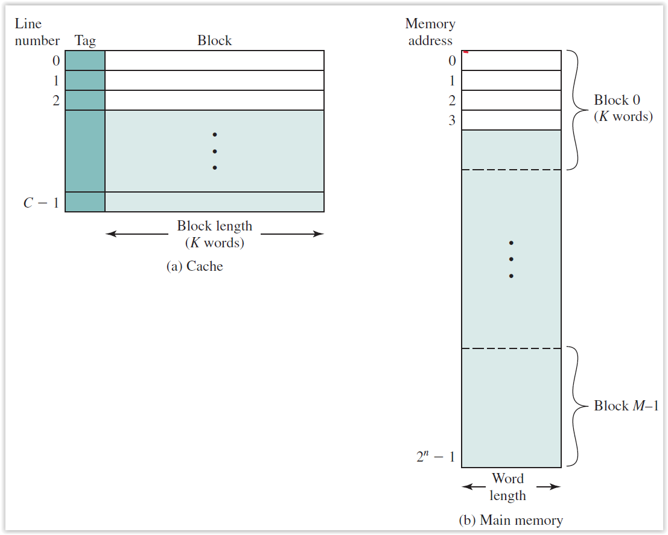
Source: Stallings, Computer organization and architecture: Designing for performance, 9th edition, Prentice Hall, 2013.

Slide 30
Mapping a 6-bit Memory Address 1/2
5
4
3
2
1
0
Mem Block within cache Block
Tag
Block within cache
Index
Byte Offset Within Block (e.g., 1 word)
Block size is 4 bytes (1 word). It could be multi-word.
Memory and cache blocks are of the same size, unit of transfer between memory and cache
# Memory blocks >> # Cache blocks
16 Memory blocks/16 words/64 bytes/6 bits to address all bytes
4 cache blocks, 4 bytes (1 word) per block
4 memory blocks map to each cache block

Slide 31
Mapping a 6-bit Memory Address 2/2
5
4
3
2
1
0
Mem Block within cache Block
Tag
Block within cache
Index
Byte Offset Within Block (e.g., Word)
Byte within block: low order two bits, ignore! (nothing smaller than a block)
Memory block to cache block, aka index: middle two bits
Which memory block is in a given cache block, aka tag: top two bits

Slide 32
One More Detail: Valid Bit
When start a new program, cache does not have valid information for this program.
Need an indicator whether this tag entry is valid for this program.
Add a “valid bit” to the cache tag entry.
0 => cache miss, even if by chance, address = tag
1 => cache hit, if processor address = tag

Slide 33
Caching: A Simple First Example
Main Memory
0000xx
0001xx
0010xx
0011xx
0100xx
0101xx
0110xx
0111xx
1000xx
1001xx
1010xx
1011xx
1100xx
1101xx
1110xx
1111xx
One word blocks
Two low order bits (xx) define the byte in the block (32b words)
Cache
Index
Valid
Tag
Data
00
01
10
11
Q: Where in the cache is the mem block?
Use next 2 low-order memory address bits – the index – to determine which cache block (i.e., modulo the number of blocks in the cache)
Q: Is the memory block in cache?
Compare the cache tag to the high-order 2 memory address bits to tell if the memory block is in the cache (provided valid bit is set)

Slide 34
Direct-Mapped Cache Example
One word blocks, cache size = 1K words (or 4KB)
Block offset
31 30 . . . 13 12 11 . . . 2 1 0
Hit
Tag
20
10
Data
Valid bit ensures something useful in cache for this index
Index
Read data from cache instead of memory if a Hit
Index
Valid
Tag
Data
0
1
2
.
.
.
1021
1022
1023
Compare Tag with upper part of Address to see if a Hit
20
32
Comparator
What kind of locality are we taking advantage of?

Slide 35
Multiword-Block Direct-Mapped Cache
Byte offset
Hit
31 30 . . . 13 12 11 . . . 4 3 2 1 0
Data
Tag
20
8
Block offset
Index
Four words/block, cache size = 1K words
Index
Valid
Tag
Data
0
1
2
.
.
.
253
254
255
20
32
What kind of locality are we taking advantage of?

Slide 36
Example: Direct-Mapped cache with 4 Single-Word Lines
Consider the main memory address reference string
0 4 0 4 0 4 0 4
Start with an empty cache - all blocks initially marked as not valid
0
4
0
4
0
4
0
4

Slide 37
Example: Direct-Mapped cache with 4 Single-Word Lines
Start with an empty cache - all blocks initially marked as not valid
0
miss
01
4
miss
00
0
miss
01
4
miss
4
4
0
00 Mem(0)
00 Mem(0)
01 Mem(4)
00 Mem(0)
00
0
miss
0
01
4
miss
4
00
0
miss
0
01
4
miss
4
01 Mem(4)
00 Mem(0)
01 Mem(4)
00 Mem(0)
8 requests, 8 misses
Ping-pong effect due to conflict misses - two memory locations that map into the same cache block

Slide 38
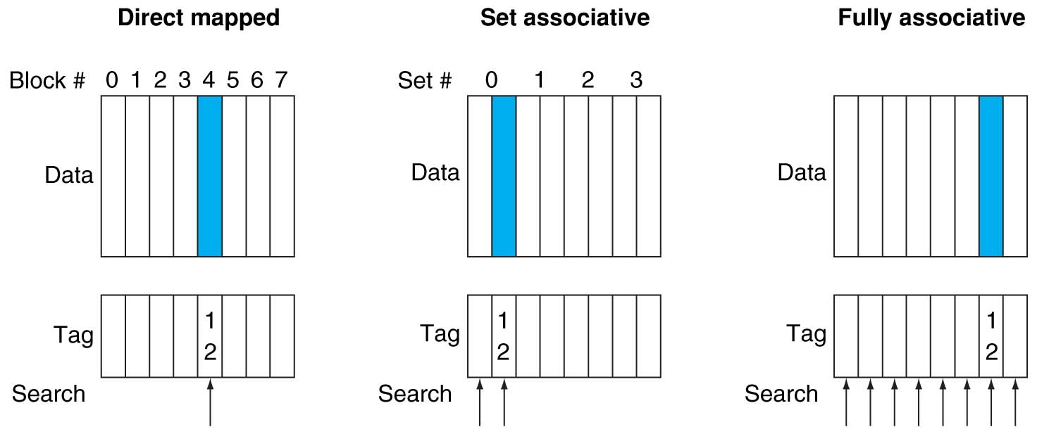
Alternative Block Placement Schemes 1/2
Direct mapped placement: mem block 12 in 8 block cache: only one cache block where mem block 12 can be found—(12 modulo 8) = 4.
Set associative placement: four sets × 2-ways (8 cache blocks), memory block 12 in set (12 mod 4) = 0; either element of the set.
Full associative placement: mem block 12 can appear in any cache blocks.

Slide 39
Alternative Block Placement Schemes 2/2
“Fully Associative”: Block can go anywhere
First design on slide 19
Note: No Index field, but 1 comparator/block
“Direct Mapped”: Block goes to one place
Note: Only 1 comparator
Number of sets = number blocks
“N-way Set Associative”: N places for a block
Number of sets = number of blocks / N
Fully Associative: N = number of blocks
Direct Mapped: N = 1

Slide 40
Example: 2-Way Set Associative cache (4 words = 2 sets x 2 ways per set)
Main Memory
0000xx
0001xx
0010xx
0011xx
0100xx
0101xx
0110xx
0111xx
1000xx
1001xx
1010xx
1011xx
1100xx
1101xx
1110xx
1111xx
One word blocks
Two low order bits define the byte in the word (32b words)
Cache
Way
Set
V
Tag
Data
0
0
1
0
1
1
Q: How do we find it?
Use next 1 low order memory address bit to determine which cache set (i.e., modulo the number of sets in the cache)
Q: Is it there?
Compare all the cache tags in the set to the high order 3 memory address bits to tell if the memory block is in the cache
Notes:
This picture is as opposed to
Way 0
both red Set 0
Way 1
------------------------------------
Way 0
both green Set 1
Way 1

Slide 41
Example: 4-Word 2-Way SA cache
Consider the main memory word reference string
0 4 0 4 0 4 0 4
Start with an empty cache - all blocks initially marked as not valid
0
4
0
4

Slide 42
Example: 4-Word 2-Way SA cache
Start with an empty cache - all blocks initially marked as not valid
0
miss
4
miss
0
hit
4
hit
000 Mem(0)
000 Mem(0)
000 Mem(0)
000 Mem(0)
010 Mem(4)
010 Mem(4)
010 Mem(4)
8 requests, 2 misses
Solves the ping-pong effect in a direct-mapped cache due to conflict misses since now two memory locations that map into the same cache set can co-exist!
Notes:
Another sample string to try 0 1 2 3 0 8 11 0 3

Slide 43
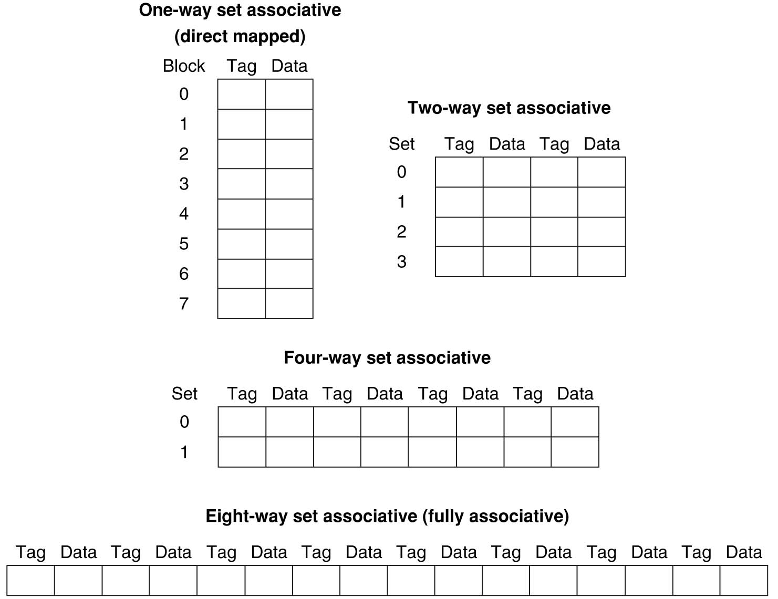
Different Organizations of an Eight-Block Cache
Total size of cache in blocks = number of sets × associativity.
For a fixed cache size, increasing associativity decreases number of sets while increasing number of elements per set.
With eight blocks, an 8-way set-associative cache is same as a fully associative cache.

Slide 44
Four-Way Set-Associative Cache
31 30 . . . 13 12 11 . . . 2 1 0
Byte offset
Tag
22
8
Index
Index
V
Tag
Data
V
Tag
Data
V
Tag
Data
V
Tag
Data
0
1
2
.
.
.
253
254
255
0
1
2
.
.
.
253
254
255
0
1
2
.
.
.
253
254
255
0
1
2
.
.
.
253
254
255
Way 0
Way 1
Way 2
Way 3
32
4x1 select
Hit
Data

Slide 45
Range of Set-Associative Caches
For a fixed-size cache, each increase by a factor of 2 in associativity doubles the number of blocks per set (i.e., the number of “ways”) and halves the number of sets –
decreases the size of the index by 1 bit and increases the size of the tag by 1 bit
More Associativity (more ways)
Tag
Index
Block offset

Slide 46
Costs of Set-Associative Caches
N-way set-associative cache costs
N comparators (delay and area)
MUX delay (set selection) before data is available
Data available after set selection (and Hit/Miss decision). DM cache: block is available before the Hit/Miss decision
In Set-Associative, not possible to just assume a hit and continue and recover later if it was a miss
When miss occurs, which way’s block selected for replacement?
Least Recently Used (LRU): one that has been unused the longest (principle of temporal locality)
Must track when each way’s block was used relative to other blocks in the set
For 2-way SA cache, one bit per set → set to 1 when a block is referenced; reset the other way’s bit (i.e., “last used”)

Slide 47
Cache Replacement Policies
Entry 0
Entry 1
Replacement
Random Replacement
Hardware randomly selects a cache evict
Least-Recently Used
Hardware keeps track of access history
Replace the entry that has not been used for the longest time
For 2-way set-associative cache, need one bit for LRU replacement
Example of a Simple “Pseudo” LRU Implementation
Assume 64 Fully Associative entries
Hardware replacement pointer points to one cache entry
Whenever access is made to the entry the pointer points to:
Move the pointer to the next entry
Otherwise: do not move the pointer
(example of “not-most-recently used” replacement policy)
:
Pointer
Entry 63

Slide 48
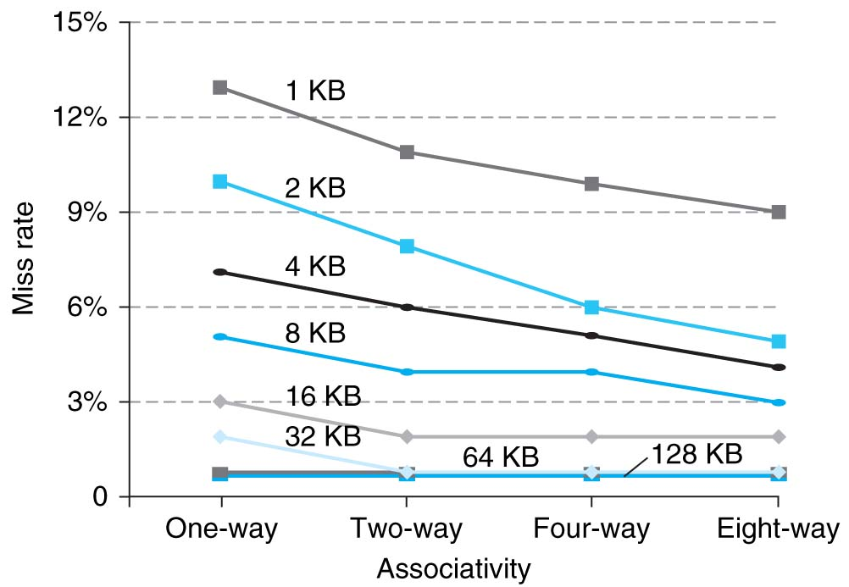
Benefits of Set-Associative Caches
Choice of DM cache or SA cache depends on the cost of a miss versus the cost of implementation.
Largest gains are in going from direct mapped to 2-way (20%+ reduction in miss rate).

Slide 49
Typical Memory Hierarchy
Principle of locality + memory hierarchy presents programmer with ≈ as much memory as is available in the cheapest technology at the ≈ speed offered by the fastest technology.
On-Chip Components
Control
Third-Level
Cache
(SRAM)
Instr
Cache
Second-Level
Cache
(SRAM)
Main
Memory
(DRAM)
Secondary
Memory
(Disk
Or Flash)
Datapath
RegFile
Data
Cache
Speed (cycles): ½’s 1’s 10’s 100’s 1,000,000’s
Size (bytes): 100’s 10K’s M’s G’s T’s
Cost/bit: highest lowest

Slide 50
Handling Stores with Write-Through
Store instructions write to memory, changing values
Need to make sure cache and memory have same values on writes: 2 policies
1) Write-Through Policy: (a) write cache and (b) write through the cache to memory
Every write eventually gets to memory.
Too slow, so include a Write Buffer to allow processor to continue once data in the Buffer.
Buffer updates memory in parallel to processor.

Slide 51
Write-Through Cache
Processor
32-bit
Address
32-bit
Data
Write both values in cache and in memory.
Write buffer stops CPU from stalling if memory cannot keep up.
Write buffer may have multiple entries to absorb bursts of writes.
What if store misses in cache?
Cache
252
12
1022
99
Write Buffer
7
131
2041
20
Addr
Data
32-bit
Address
32-bit
Data
Memory

Slide 52
Handling Stores with Write-Back
2) Write-Back Policy: write only to cache and then write cache block back to memory when it is evicted from the cache.
Writes collected in cache, only single write to memory per block.
Include a bit to see if wrote to block or not, and then only write back if bit is set
Called “dirty” bit (writing makes it “dirty”)

Slide 53
Write-Back Cache
Processor
32-bit
Address
32-bit
Data
Store/cache hit, write data in cache only and set dirty bit
Memory has stale value
Store/cache miss, read data from memory, then update and set dirty bit
“Write-allocate” policy
Load/cache hit, use value from cache
On any miss, write back evicted block, only if dirty. Update cache with new block and clear dirty bit.
Cache
252
D
12
1022
Dirty Bits
D
99
131
D
7
2041
D
20
32-bit
Address
32-bit
Data
Memory

Slide 54
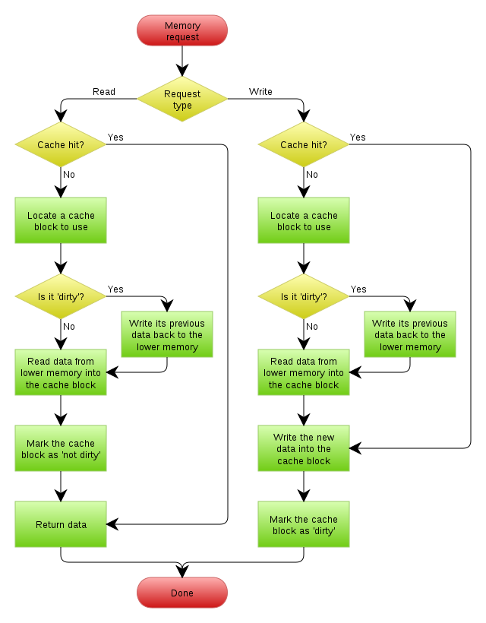
https://en.wikipedia.org/wiki/Cache_(computing)

Slide 55
Write-Through vs. Write-Back
Write-Through:
Simpler control logic
More predictable timing simplifies processor control logic
Easier to make reliable, since memory always has copy of data (big idea: Redundancy!)
Write-Back
More complex control logic
More variable timing (0,1,2 memory accesses per cache access)
Usually reduces write traffic
Harder to make reliable, sometimes cache has only copy of data.

Slide 56
Conclusions
Principle of Locality for Libraries /Computer Memory
Hierarchy of memories (speed/size/cost per bit) to exploit locality
Cache – copy of data at the lower level in memory hierarchy
Direct Mapped, Set Associative and Fully Associative to find block in cache using Tag field and Valid bit for Hit
Cache design choice:
Write-Through vs. Write-Back

Slide 57
Reading
Read 5.1-5.3 in David Patterson and John Hennessy, Computer Organization and Design, 5th edition, Morgan Kaufmann, 2014.

Slide 58
Acknowledgements
This set of slides are prepared largely based on
The slides prepared by K. Asanovic & V. Stojanovic for CS61C at UC/Berkeley (http://inst.eecs.Berkeley.edu/~cs61c/sp15)

