Slide 1
7. Building datapath
Rocky K. C. Chang 6 November 2017

Slide 2
Goals of this lecture
We will implement a subset of MIPS instructions using single clock cycle.
Simple subset, shows most aspects
Memory reference: lw, sw
Arithmetic/logical: add, sub, and, or, slt
Control transfer: beq, j

Slide 3
Instruction Processing
Fetch instruction from memory
Decode instruction
Evaluate address
Fetch operands from memory
Execute operation
Store result

Slide 4
Instruction Execution
The first two steps are the same for all instructions:
PC → instruction memory, fetch instruction
PC ← PC + 4
Decode the instruction: The operation and operands (register numbers, immediate, target address)
Depending on the instruction class
Use ALU to calculate
Arithmetic-logical result
Memory address for load/store
Branch target address
Access data memory for load/store
PC ← target address

Slide 5
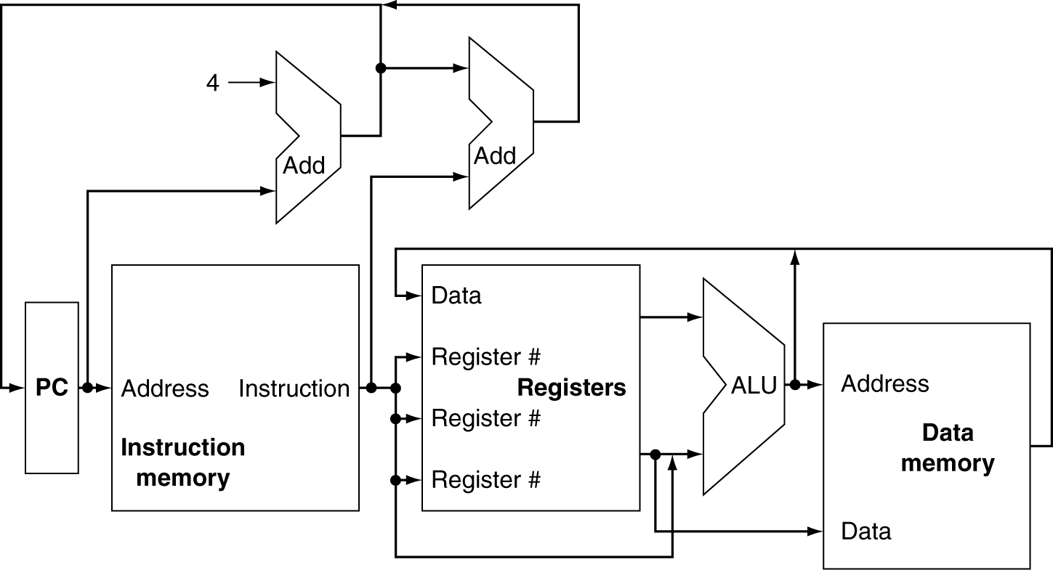
CPU Overview

Slide 6
Multiplexers
Can’t just join wires together
Use multiplexers

Slide 7
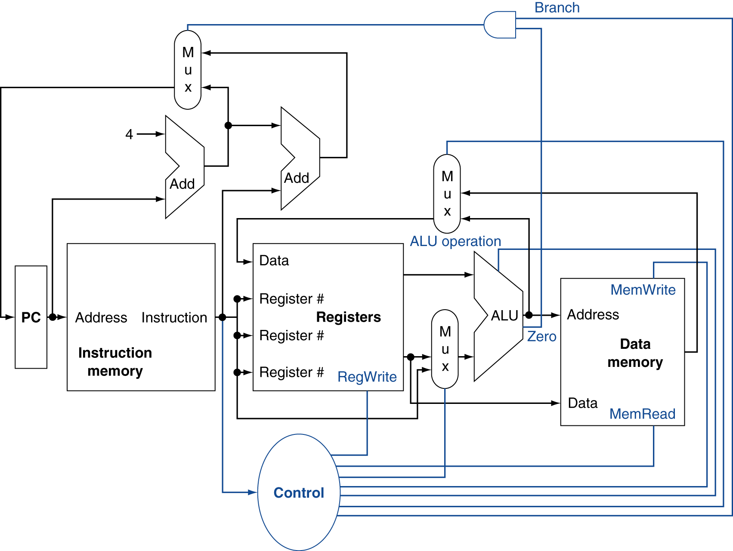
Control

Slide 8
Building a Datapath
Datapath
Elements that process data and addresses in the CPU
Registers, ALUs, mux’s, memories, …
We will build a MIPS datapath incrementally
Refining the overview design

Slide 9
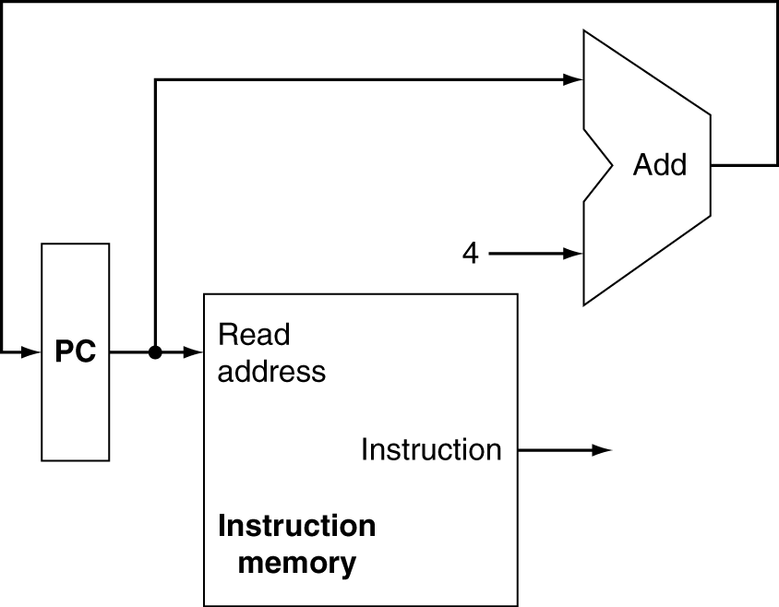
Instruction Fetching
Program counter
Adder
Instruction memory
Which one(s) is combinational / sequential circuit?
Do they need control signal?
Increment by 4 for next instruction
32-bit register

Slide 10
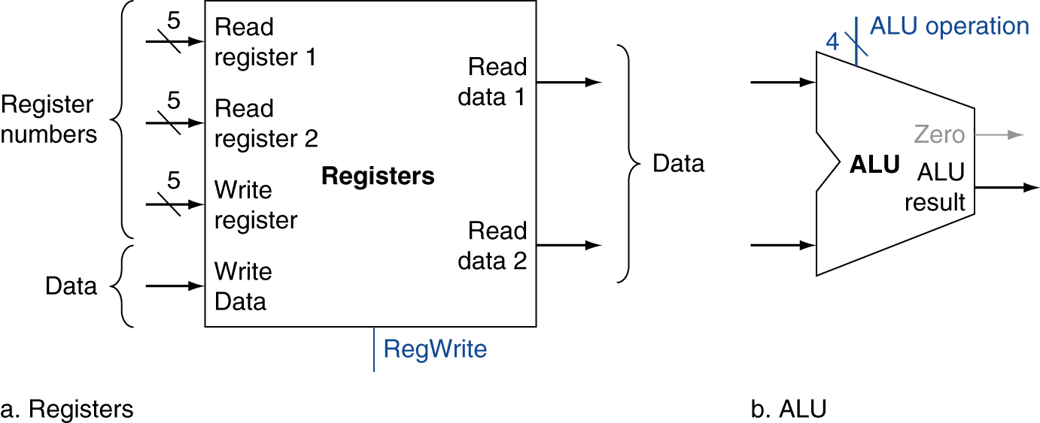
R-Format Instructions
E.g., add $s0,$s1,$s2
Read two register operands
Perform arithmetic/logical operation
Write register result
Controlled by a write control signal

Slide 11
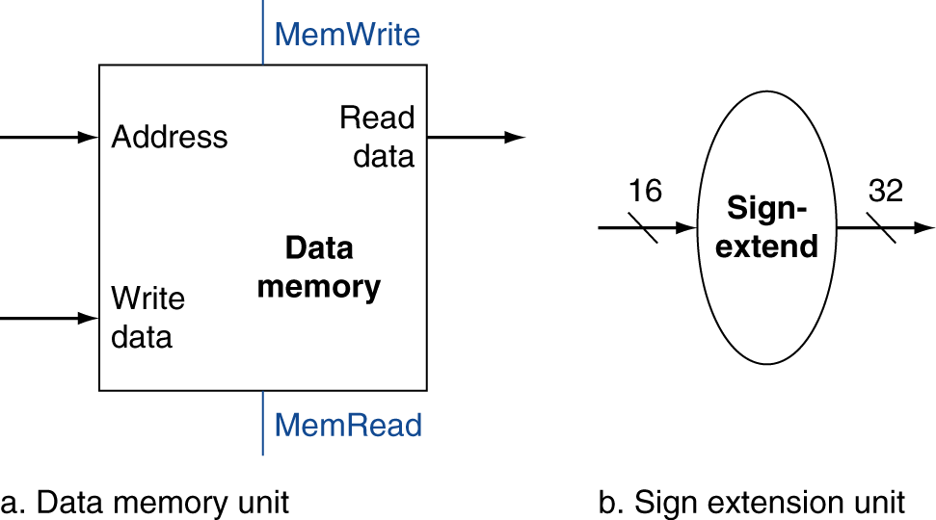
Load/Store Instructions (I format)
lw/sw $t1, offset_value($t2)
Read register operands
Calculate address using 16-bit offset
Use ALU, but sign-extend offset
Load: Read memory and update register
Store: Write register value to memory

Slide 12
Branch Instructions (I format) 1/2
beq $t1, $t2, offset
Read register operands
Compare operands
Use ALU, subtract and check Zero output
Calculate target address
Sign-extend displacement
Shift left 2 places (word displacement)
Add to PC + 4
Already calculated by instruction fetch

Slide 13
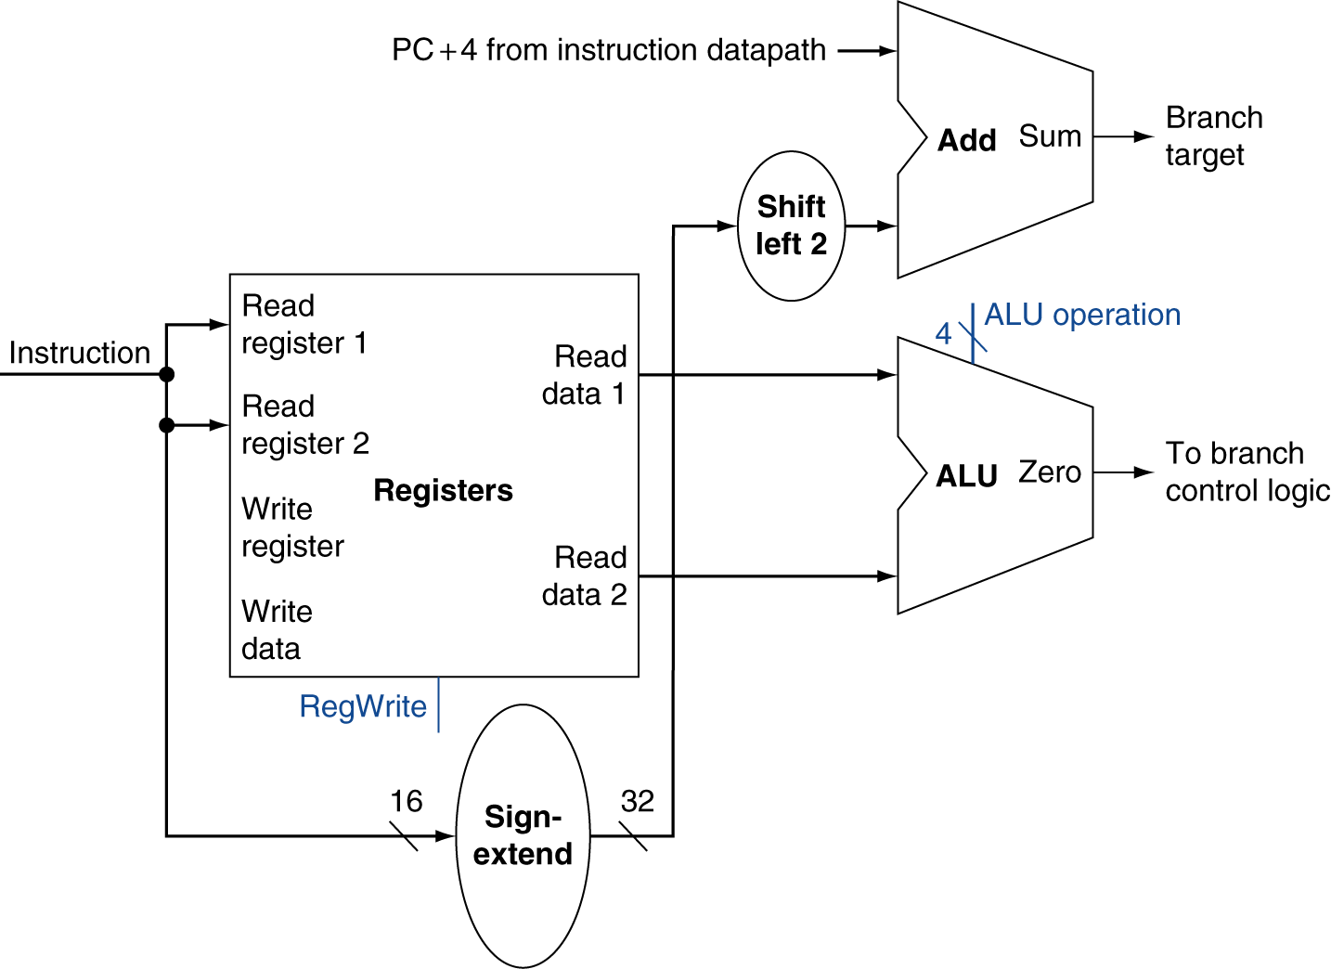
Branch Instructions 2/2
Just re-routes wires
Sign-bit wire replicated

Slide 14
Composing the Elements
The data path does an instruction in one clock cycle.
Each datapath element can only do one function at a time.
Hence, we need separate instruction and data memories.
Use multiplexers where alternate data sources are used for different instructions.

Slide 15
R-format/Load/Store Datapath 1/2
Problem: Building a datapath for R-format instructions and load/store instructions.
Their main differences:
One of the inputs to the ALU is different: a register for R-format instructions and a sign-extended 16-bit offset from the load/store instructions.
The value stored in the destination register: the ALU for R-format and the memory for the load instruction.
Solution:
Allow two different sources for the input to the ALU.
Allow two different sources for the data stored into the register file.

Slide 16
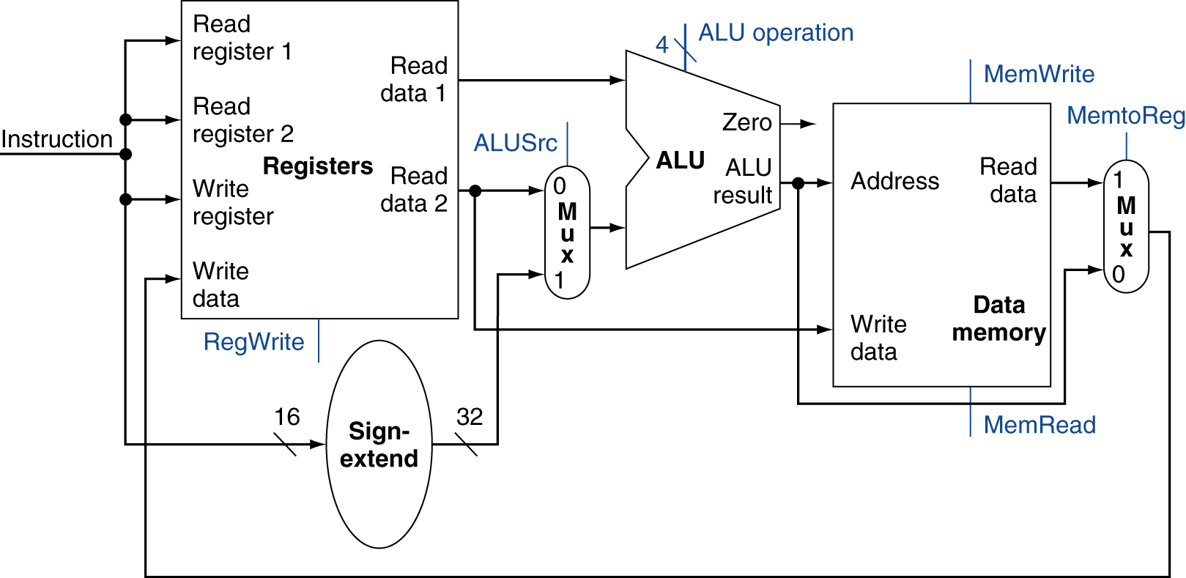
R-format/Load/Store Datapath 2/2

Slide 17
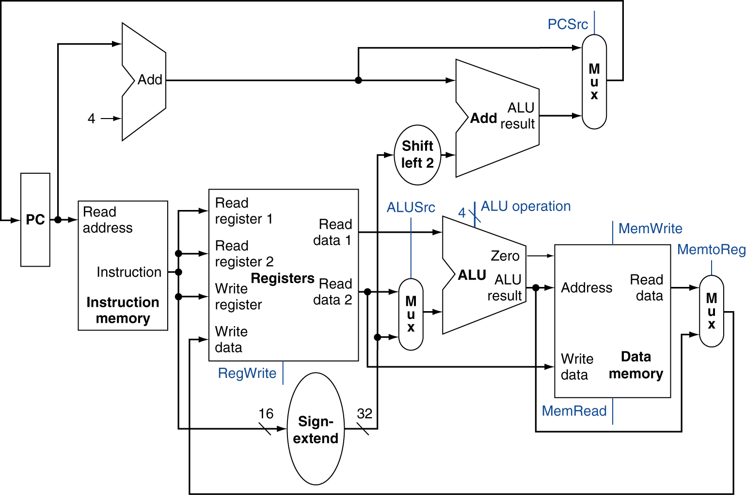
Full Datapath for R-format, load/store and branch

Slide 18
A simple implementation scheme
Implement a subset of MIPS32 using the datapath from the last slide and a control function.
This subset includes
add, sub, AND, OR, set on less than
lw, sw, beq, and
j

Slide 19
ALU Control (from a Simple ALU) 1/4
The four-bit ALU control: 1-bit Ainvert, 1-bit Binvert and 2-bit Operation
2-bit Operation: 00 (AND), 01 (OR), 10 (add), 11 (set-on-less-than)
ALU control | Function
0000 | AND
0001 | OR
0010 | add
0110 | subtract
0111 | set-on-less-than
1100 | NOR

Slide 20
ALU Control 2/4
AND: R-format
OR: R-format
Add: R-format and load/store
Subtract: R-format and branch equal
Set-on-less-than: R-format
NOR: for other instructions

Slide 21
ALU Control 3/4
Design a combinational logic circuit for generating the 4-bit ALU control bits
Input: 2-bit ALUOp (derived from opcode) and the 6-bit function field in R-format instructions.
opcode | ALUOp | Operation | Funct | ALU function | ALU control
lw | 00 | load word | XXXXXX | add | 0010
sw | 00 | store word | XXXXXX | add | 0010
beq | 01 | branch equal | XXXXXX | subtract | 0110
R-type | 10 | Add | 100000 | add | 0010
 |  | Subtract | 100010 | subtract | 0110
 |  | AND | 100100 | AND | 0000
 |  | OR | 100101 | OR | 0001
 |  | set-on-less-than | 101010 | set-on-less-than | 0111

Slide 22
ALU control 4/4
Main control
2-bit ALUOp
Opcode
ALU control
Funct field for R-format instructions

Slide 23
Review question
Design the combinational circuit for the ALU control unit on slide 21.

Slide 24
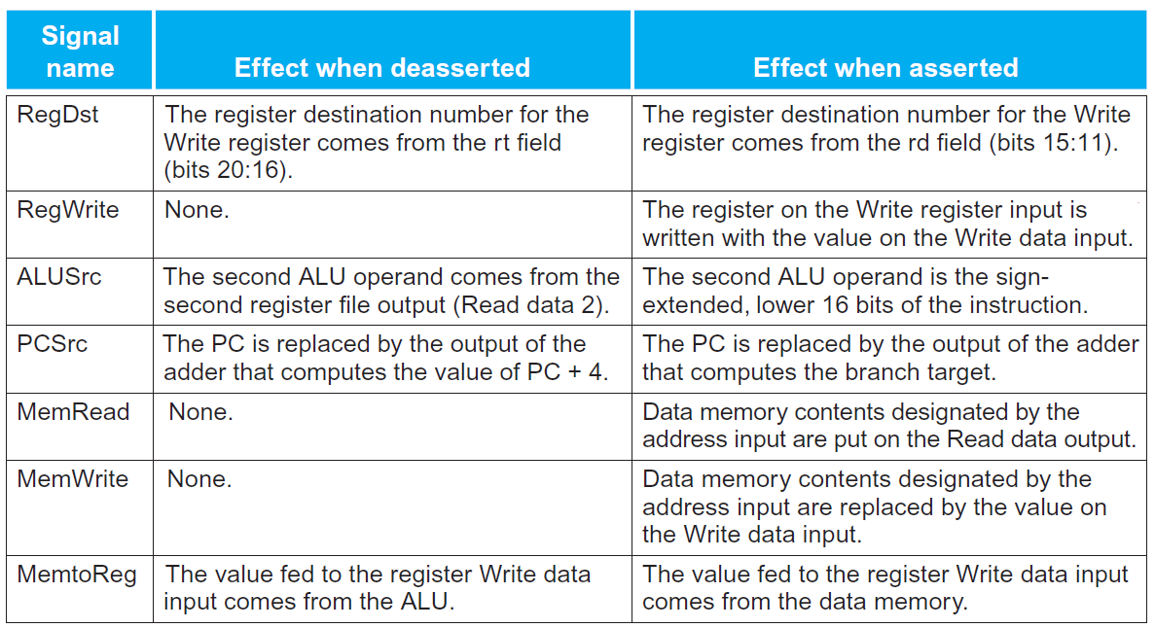
Other seven control signals

Slide 25
Instruction decoding
Identify the fields of an instruction and the control lines needed for slide 17.
R-type
0
rs
rt
rd
shamt
funct
31:26
25:21
20:16
15:11
10:6
5:0
Load/ Store
35 or 43
rs
rt
address
31:26
25:21
20:16
15:0
Branch
4
rs
rt
address
31:26
25:21
20:16
15:0
opcode
always read
read, except for load
write for R-format and load
sign-extend and add

Slide 26
Instruction decoding
op[5:0]: inputs to the main control unit for generating control signals for all instructions
rs[25:21] and rt[20:16]: registers to be read for the R-format instructions, branch equal, and store.
rs[25:21]: base register for load and store instructions.
The destination register: rt[20:16] for load and rd[15:11] for R-format instructions.
Need a multiplexer to select between the two.
funct[5:0]: inputs to the ALU control

Slide 27
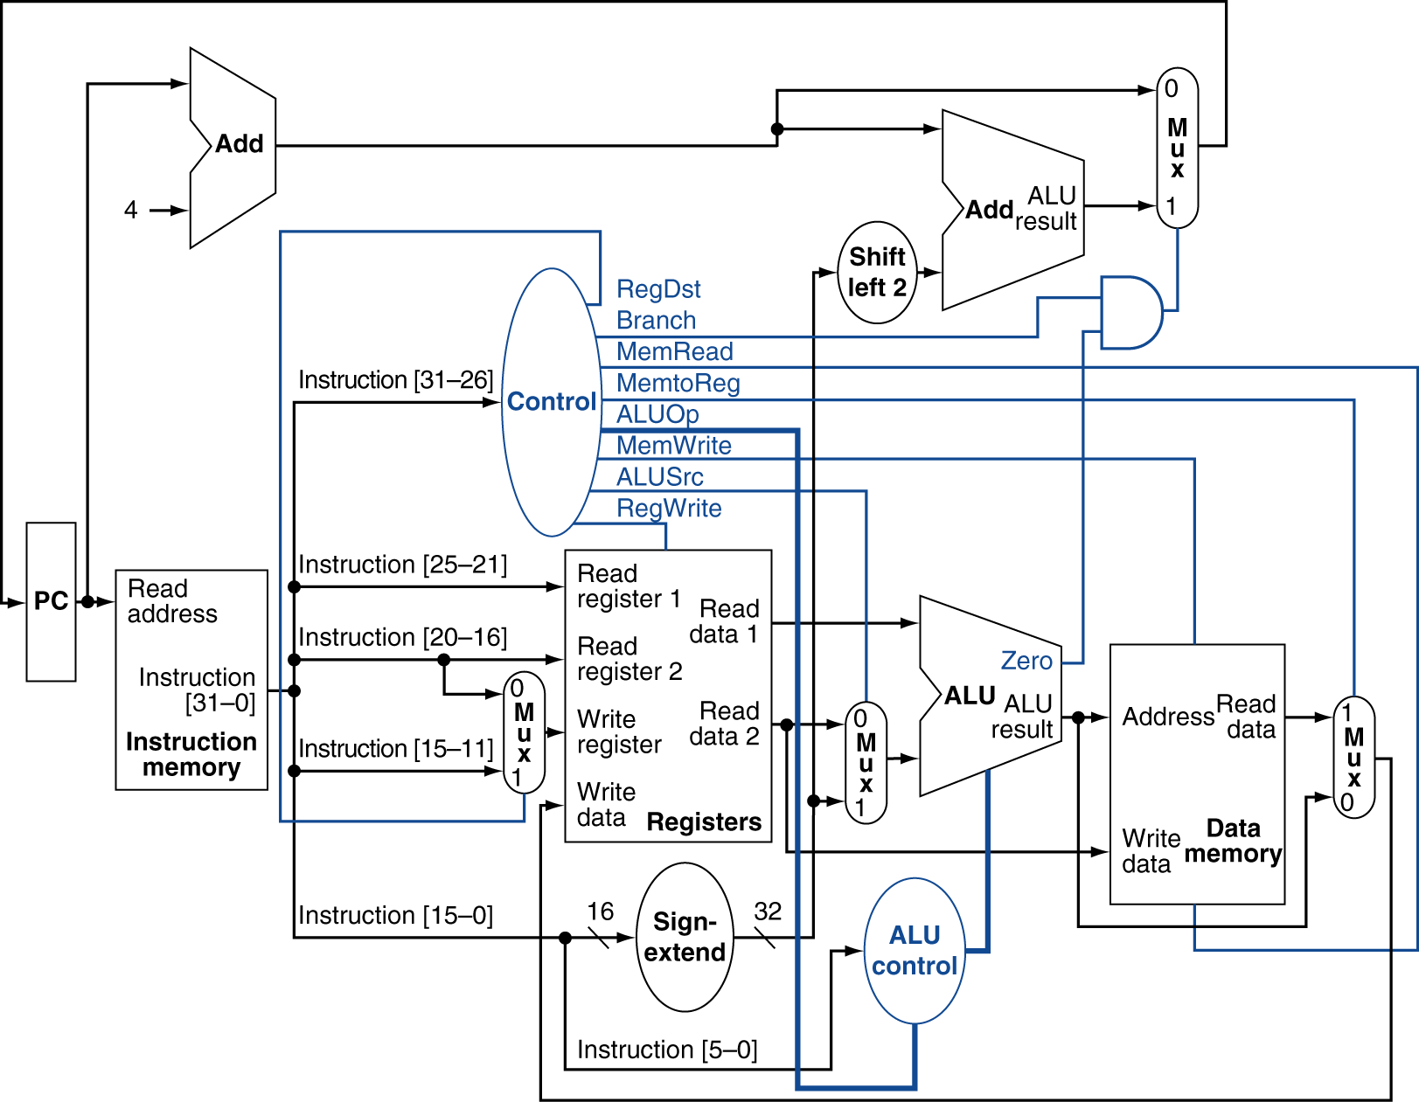

Slide 28
Data path for R-format instructions
For example, add $t1,$t2,$t3.
Three steps:
The instruction fetched and the PC incremented
Two registers, $t2 and $t3, read from the register file; the main control unit computes the setting of the control lines.
The ALU operates on the data read from the register file, using the function code to generate the ALU function.
These steps will be completed in one clock cycle.

Slide 29
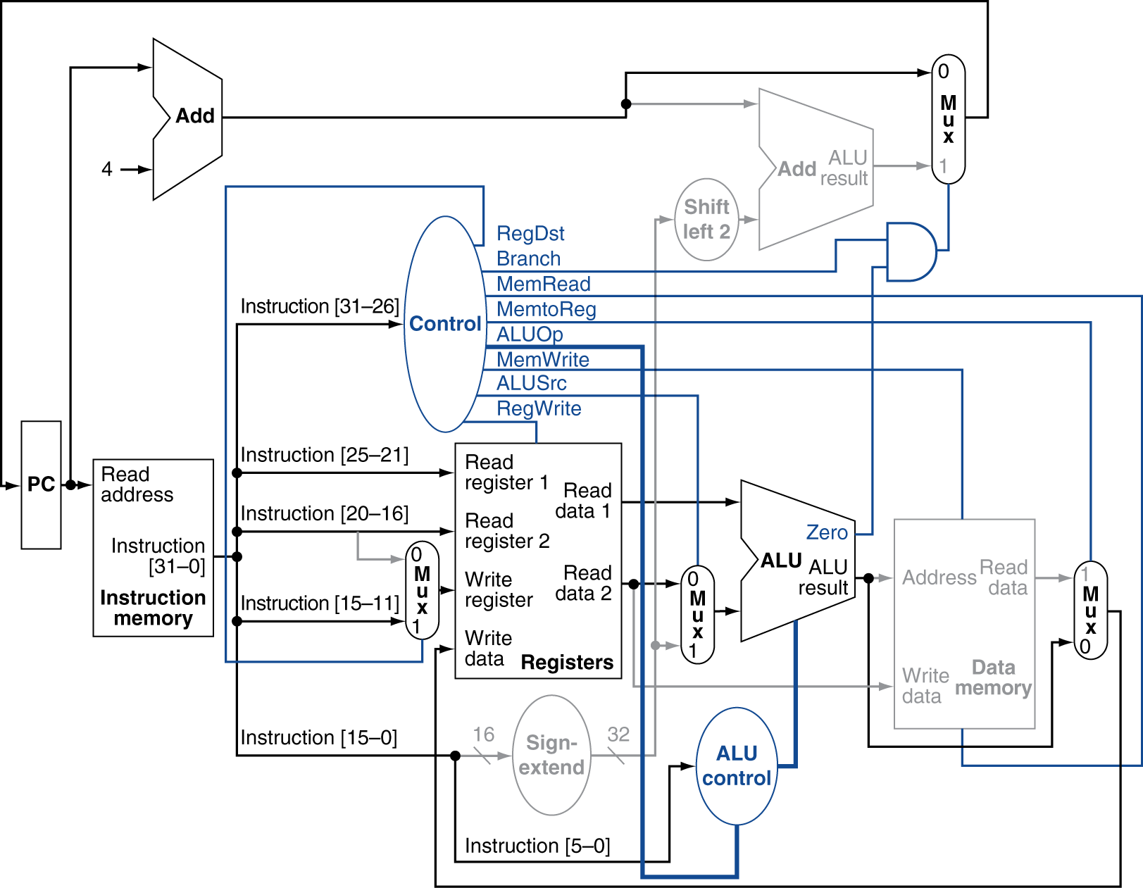
Which control lines should be active?

Slide 30
Data path for load instruction
For example, lw $t1, offset($t2)
Five steps:
An instruction fetched and the PC incremented
A register ($t2) value read from the register file
The ALU computes the sum of the value read from the register file and the sign-extended, lower 16 bits of the instruction.
The sum from the ALU is used as the address for the data memory.
The data from the memory unit is written into the register file; the register destination is given by bits 20:16 of the instruction ($t1).

Slide 31
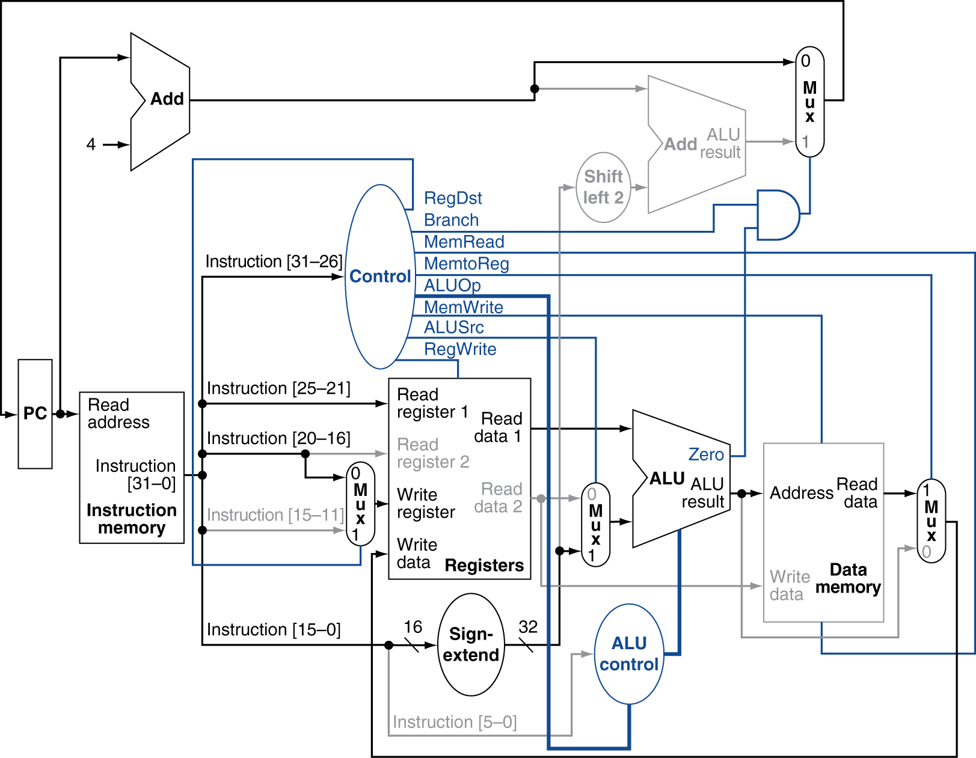
Which control lines should be active?

Slide 32
Data path for Branch-on-Equal Instruction
For example, beq $t1, $t2, offset
Four steps:
An instruction fetched and the PC incremented.
Two registers, $t1 and $t2, read from the register file.
The ALU performs a subtract on the data values read from the register file. Also, the value of PC + 4 is added to the sign-extended, lower 16 bits of the instruction shifted left by two; the result is the branch target address.
The Zero result from the ALU is used to decide which adder result to store into the PC.

Slide 33
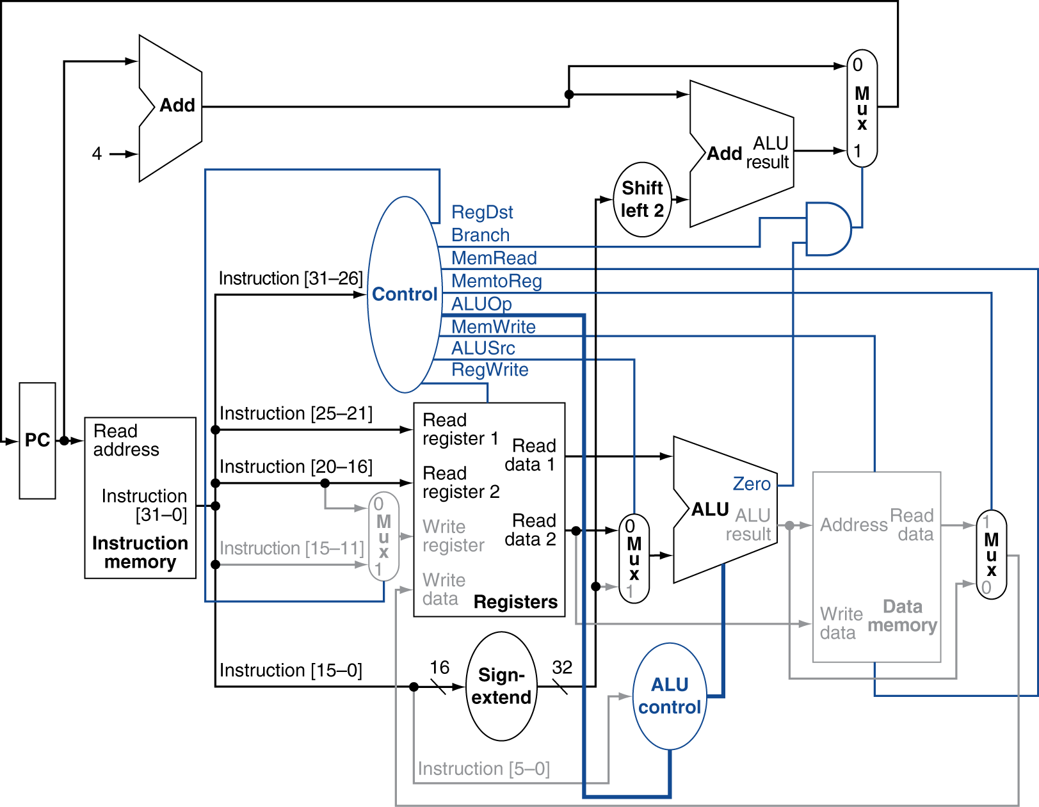
Which control lines should be active?

Slide 34
Review question
Fill in the table below.
Instruction | RegDst | ALUSrc | Memto- Reg | Reg- Write | Mem- Read | Mem- Write | Branch | ALUOp1 | ALUOp0
R-format
lw
sw
beq

Slide 35
Review question
Design the digital logic circuit for the main control unit.

Slide 36
Performance Issues
Longest delay determines clock period
Critical path: load instruction
Instruction memory → register file → ALU → data memory → register file
Not feasible to vary period for different instructions
Violates design principle
Making the common case fast
Pipelining can improve performance.

Slide 37
Conclusions
We have implemented R-format, store/load, and bne MIPS instructions using a single clock cycle.
The main control unit
The ALU control unit
The ALU unit
Two adders
The memory (instruction and data)
Register file
4 MUXes
Sign extend
Bit shifter
AND gate
PC

Slide 38
Reading
Read B.7-B.8 in David Patterson and John Hennessy, Computer Organization and Design, 5th edition, Morgan Kaufmann, 2014.

Slide 39
Acknowledgements
This set of slides are prepared mainly based on
The slides prepared by K. Asanovic & V. Stojanovic for CS61C at UC/Berkeley (http://inst.eecs.Berkeley.edu/~cs61c/sp15)

