Slide 1
6. Sequential circuits
Rocky K. C. Chang 17 October 2017

Slide 2
Goals of this lecture
Understand how individual bit can be remembered and updated in a S-R latch.
Understand how S-R flip-flop and D flip-flops are used to memorize bits.
Understand how finite state machine is used to describe all the state transitions in a synchronized digital system.

Slide 3
Sequential circuit
Combinational logic circuits has no memory and the outputs always follow the inputs.
Sequential logic circuits are circuits that have memory and behave differently (next state) depending upon their previous state.
As the number of previous states is finite (predetermined at design stage) in sequential logic circuits, they are referred to as finite state machines (FSM)
  A FSM is composed of a combinational logic unit and delay elements (called flip-flops) in feedback paths, which maintain state information.

Slide 4
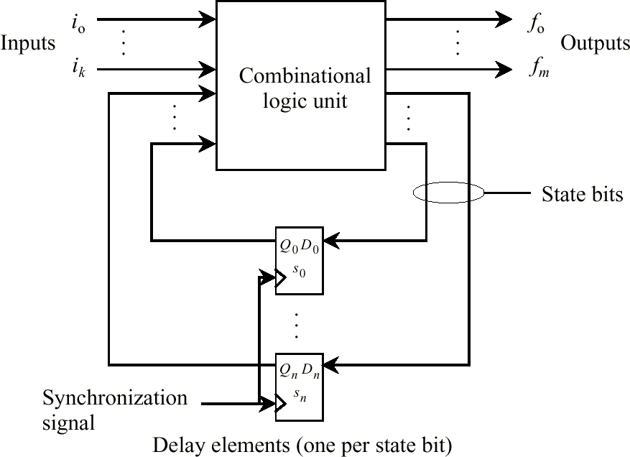
Finite state machine

Slide 5
Uses for State Elements
Place to store values for later re-use:
  Register files (like $1-$31 in MIPS)
  Memory (caches and main memory)
Help control flow of information between combinational logic blocks
  State elements hold up the movement of information at input to combinational logic blocks to allow for orderly passage.

Slide 6
Accumulator Example
Q. Why do we need to control the flow of information?
SUM
X_{i}
S
Want: S=0;
for (i=0;i<n;i++)
S = S + X_{i}
Assume:
  Each X value is applied in succession, one per clock cycle
  After n cycles the sum is present on S.

Slide 7
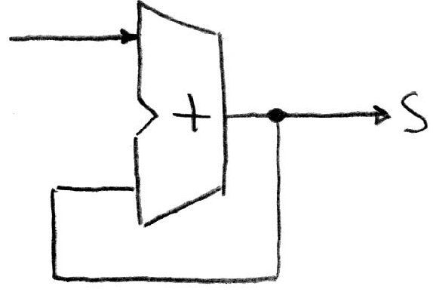
First attempt
Adder
Feedback
Assume that S begins at 0.
Applying X₀: after a short delay (τ_{add}) S will change to X₀.
After another τ_{add}, S becomes X₀ + X₀ and the next one, X₀ + X₀ + X₀ and so on.
Since τ_{add} is typically less than the clock period, some of these adds of X₀ will happen before X₁ is applied.

Slide 8
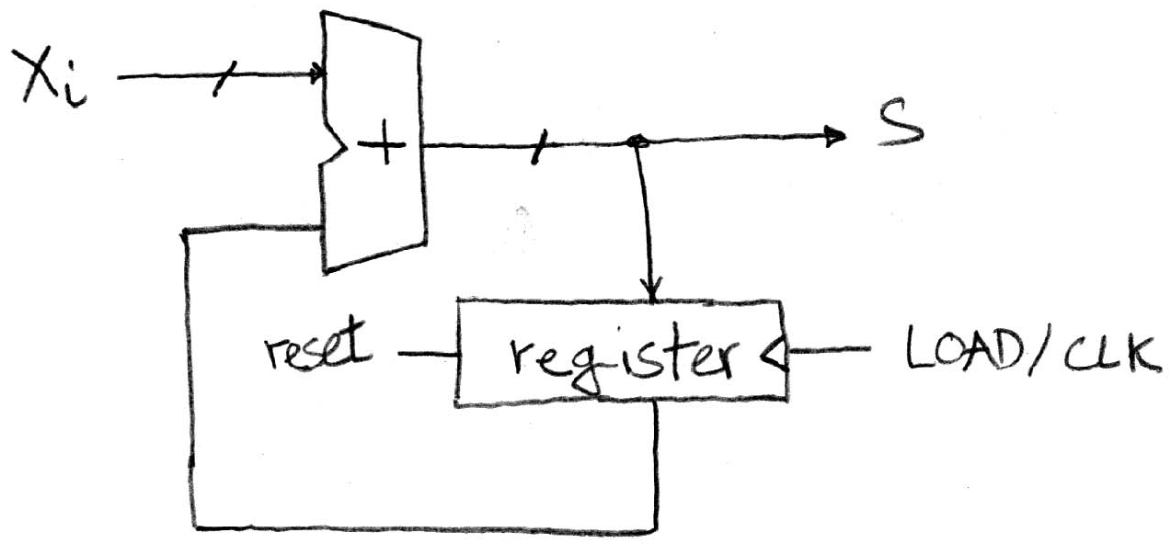
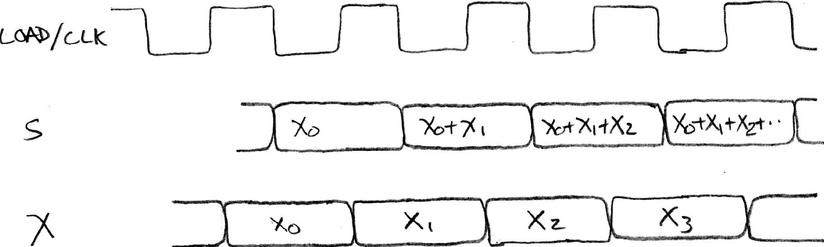
Second attempt?
Register is used to hold up the transfer of data to the adder.
Square wave clock sets when things change
Rounded Rectangle per clock means could be 1 or 0
Rough
timing …
Xi must be ready before clock edge due to adder delay
Time

Slide 9
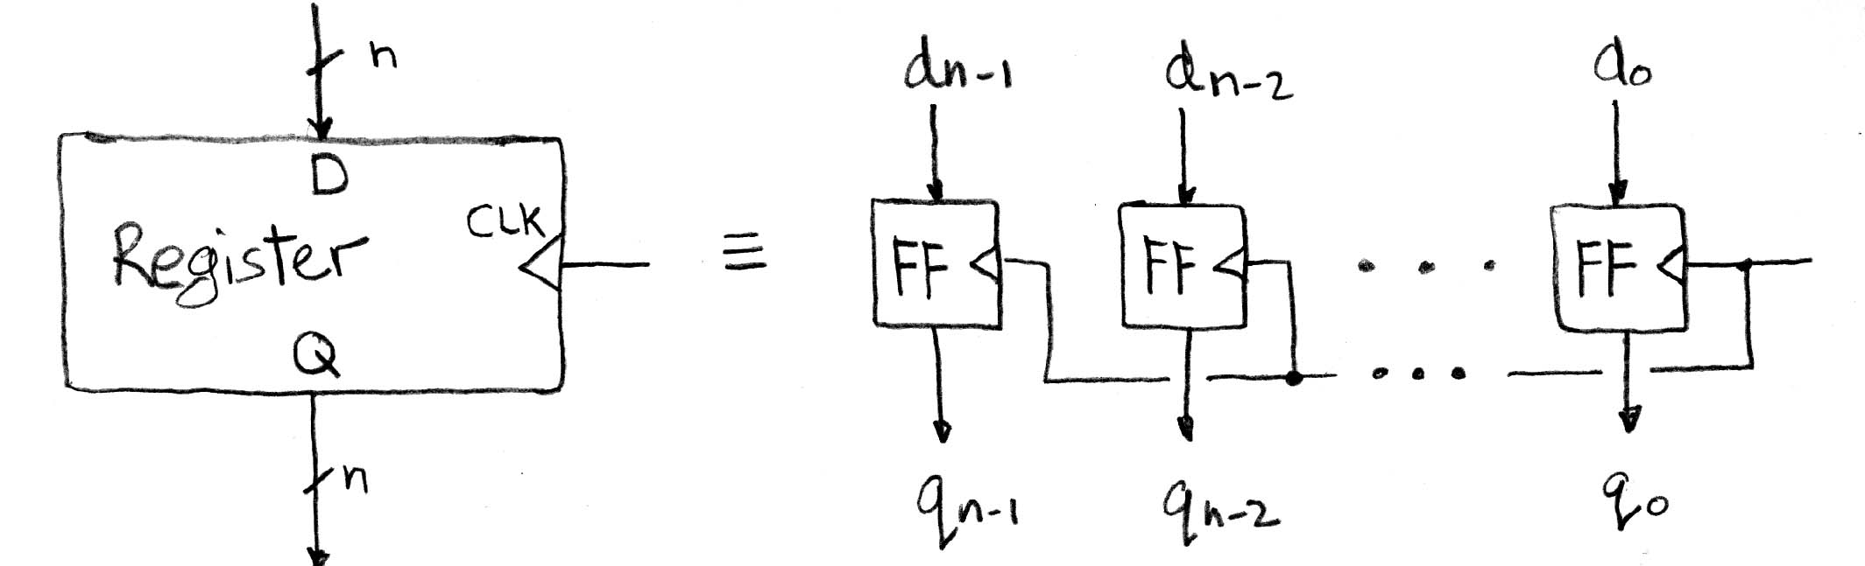
Register Internals
n instances of a “Flip-Flop” (the output flips/flops between 0 and 1)
D is “data input”, Q is “data output”
Also called “D-type Flip-Flop”

Slide 10
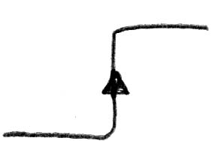
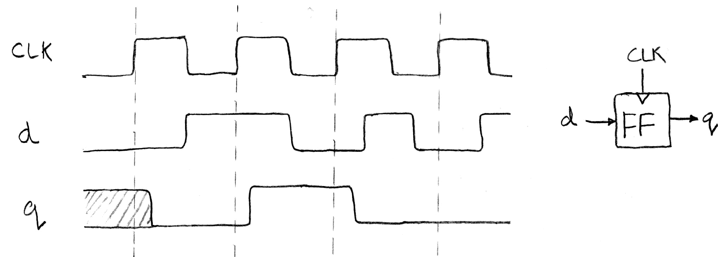
Flip-Flop Operation
Edge-triggered d-type flip-flop, e.g., “positive edge-triggered.”
“On the rising edge of the clock, the input d is sampled and transferred to the output. At all other times, the input d is ignored.”

Slide 11
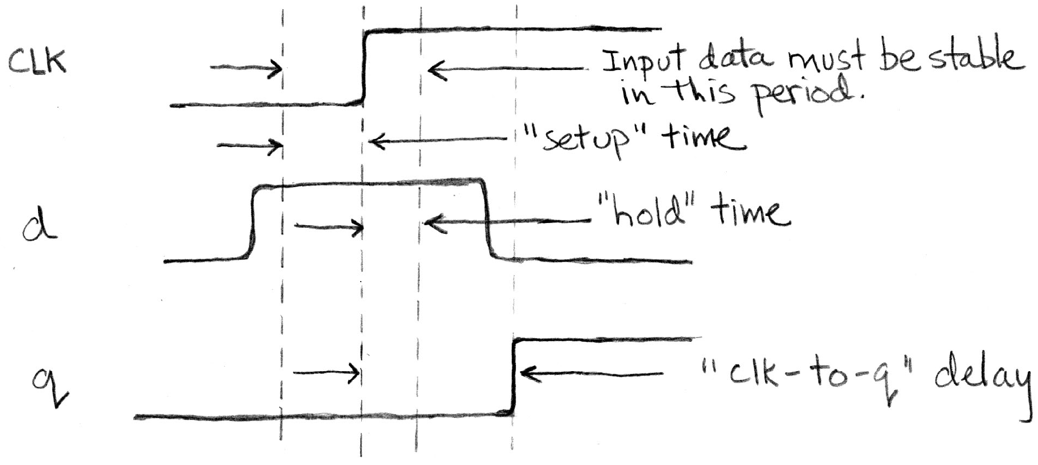
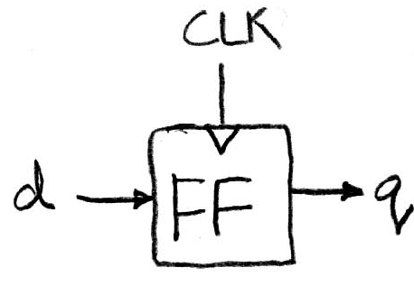
Flip-Flop Timing
The input d must be stable for a short amount of time before and after the rising edge of the clock.
A small amount of time to transfer the new value to the output.

Slide 12
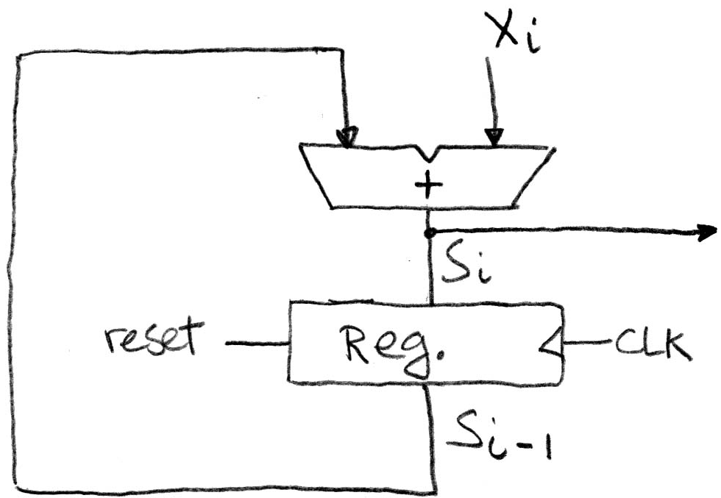
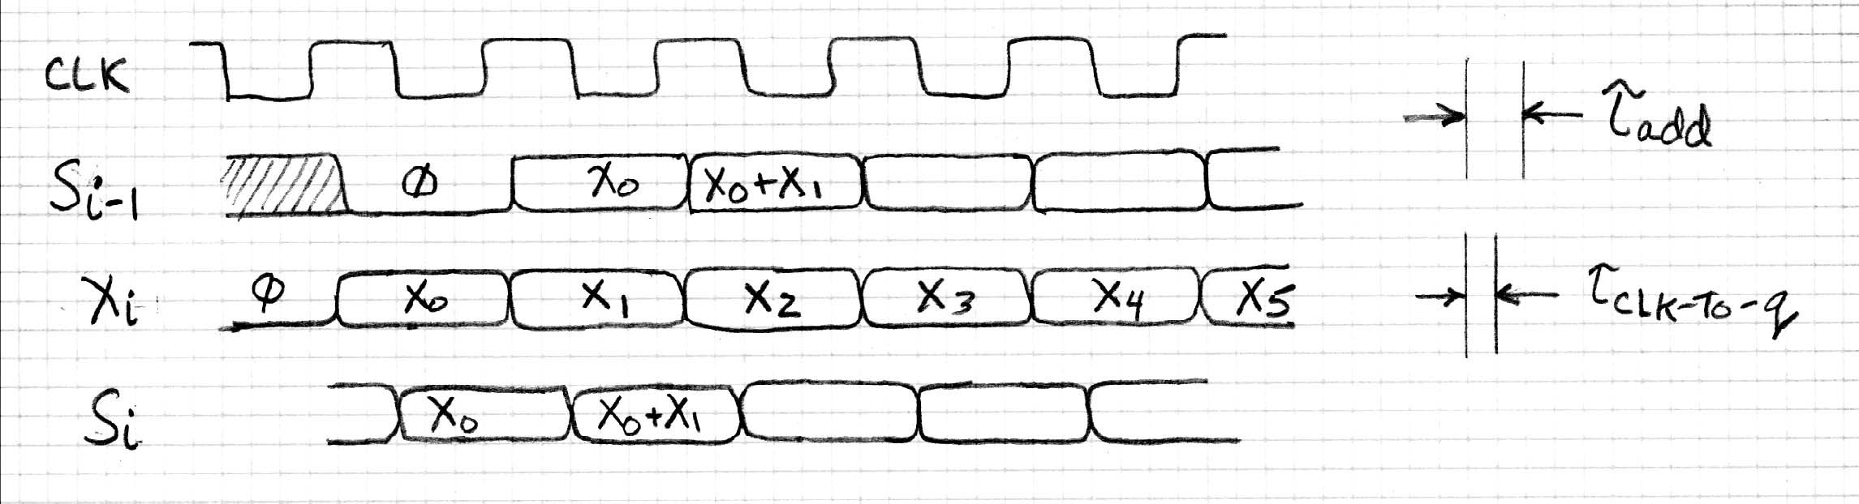
Accumulator Timing (1/2)
Reset input to register is used to force it to all 0 (takes priority over d input).
S_{i-1} follows the positive-edge of the clock after a small delay.
  Assuming the input X_{i} is applied at precisely the same time, it goes into the adder with S_{i-1} to produce S_{i}.

Slide 13
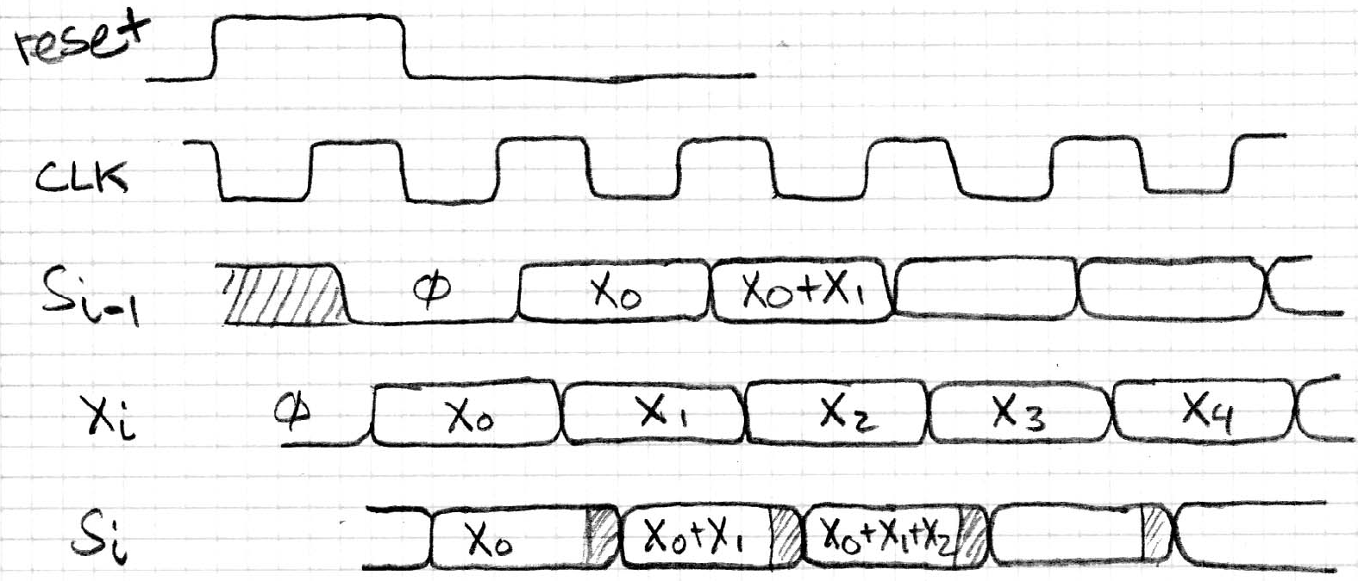
Accumulator Timing (2/2)
In practice X_{i} might not arrive to the adder at the same time as S_{i-1}.
  S_{i} temporarily is wrong, but register always captures correct value.
  In good circuits, instability never happens around rising edge of clk.

Slide 14
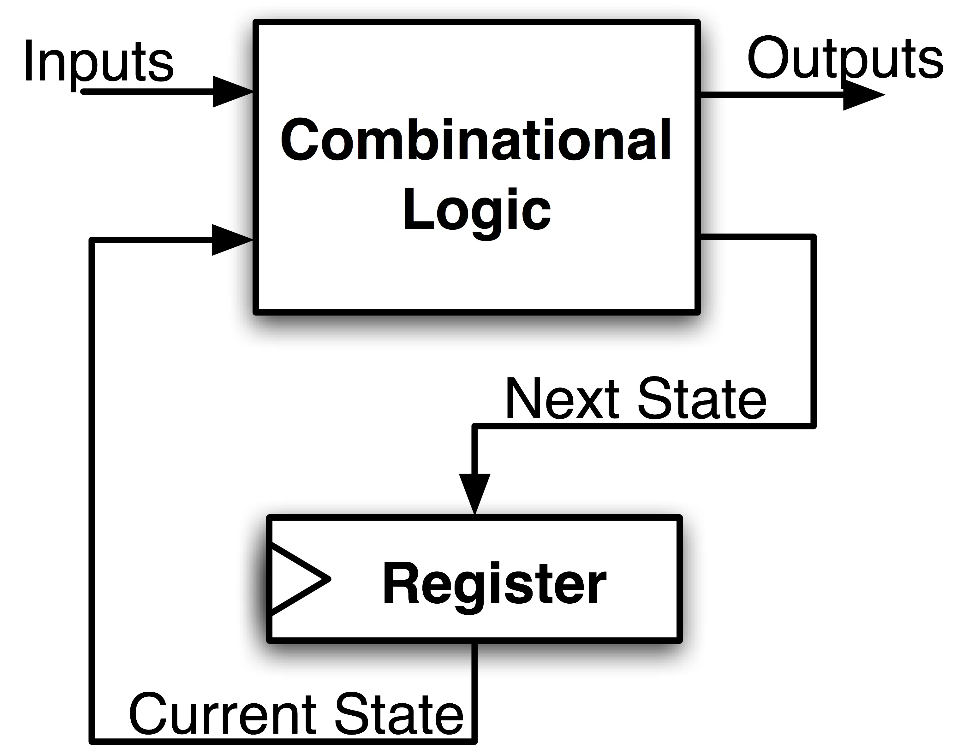
Maximum Clock Frequency
What is the maximum frequency of this circuit?
Frequency = 1/Period
Min Delay = CL Delay (e.g., adder) + (Setup Time + CLK-to-Q Delay)

Slide 15


The simplest sequential circuit
Two inverters and a feedback loop form a “static” storage cell
  The cell will hold value as long as it has power applied.
How to get a new value into the storage cell?
  selectively break feedback path
  load new value into cell
"1"
bistable cell
"stored value"
(= state)
"0"
"remember"
D latch
"load"
"stored value"
"data"

Slide 16
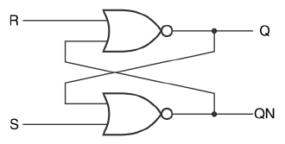

Latches and Flip-Flops
The two most popular varieties of storage cells used to build sequential circuits are: latches and flip-flops.
  Latch: level sensitive storage element
  Flip-Flop: edge triggered storage element
S-R latch: similar to inverter pair, with capability to force output to 0 (reset=1) or 1 (set=1)
Q
R
QN
S

Slide 17
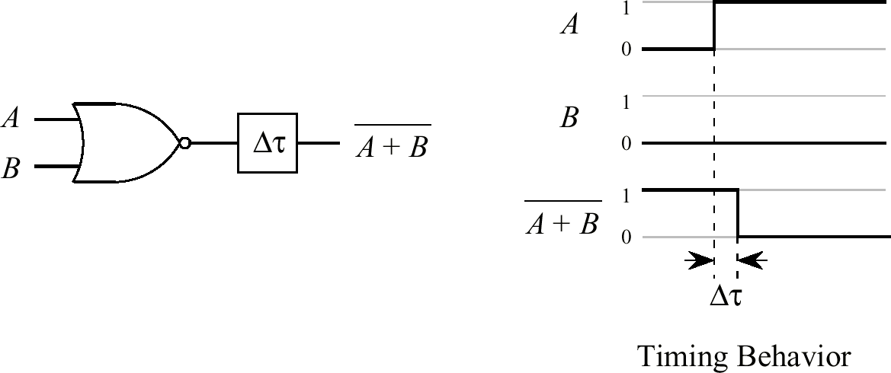
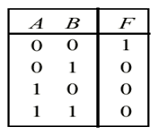
NOR Gate with Lumped Delay
  The delay between input and output is lumped at the output for the purpose of analysis.
Notes:
The NOR gate will have 1 if both of them are negative.
When the data comes in, the change will happen with a delay of delta Δτ. This delay of one simple component may not be significant, but with more logical circuits(components) to be connected, the delay can add up. If the add up goes beyond the clock pulse length, there may be problems with the output since all computer uses the same clocks to control everything.

Slide 18
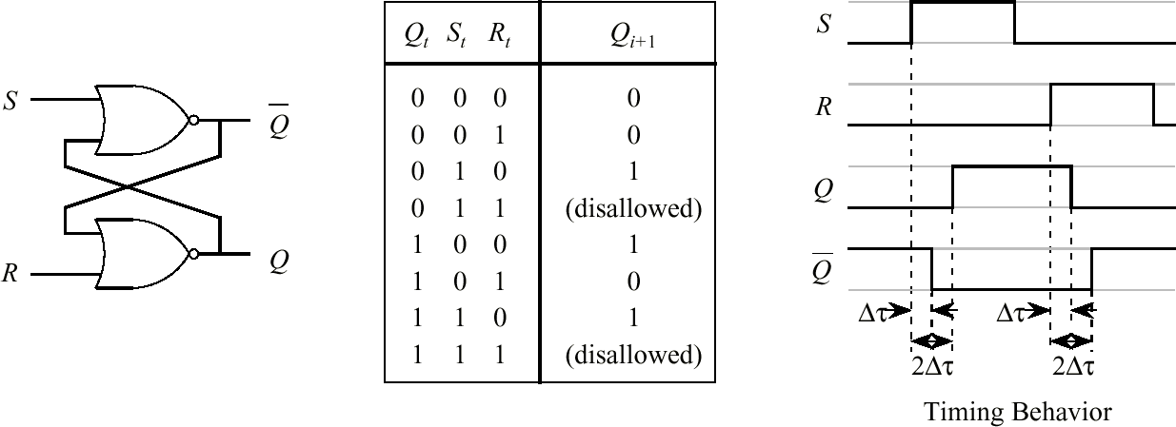
S-R Latch
Characteristic Table
Notes:
S-R stands for “set” and “reset”. In this circuit, S and R are allowed to have only three value, 01, 10, or 00. That is, logically we do not allow the system to both set and reset at the same time. You can imagine that both the set and reset input are pulse triggers. In normal state, they have the value of 00. In this case, the output of Q(and thus Q’) is dependent on the previous state. If it is set:10, the system’s output will be 1(even if later it become idle again, 00). If it is reset:01, the system’s output will be 0. If you look close, you will see that it takes two Δτ delay to have the state changed(yet, Q’ takes only one Δτ ). When it is reset, it takes Δτ to change the state of Q, but it takes two Δτ to change the state of Q’ .
Note: For simplicity, negation of Q can be written as Q’. (or you can also use Q_ )
The name Flip-flop comes from the fact that the two NOR gates are crisscrossed like the flip-flop slippers. It is also called a latch, because it will not change unless you explicitly change them. Sometimes, we also call this bi-stable circuit as it uses the crisscross to make a stable output on its own(with power on). It works only for one bit of data. If you have group of data, you need a group of latches.

Slide 19
S-R latch in operation (1/2)
QN
=1
S
0
0
0=
R
Q
0=
QN
=0
S
1
0
0=
R
Q
=1
QN
=0
S
0
0
=1
R
Q
=1
QN
=1
S
0
1
=1
R
Q
=0

Slide 20
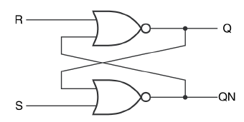
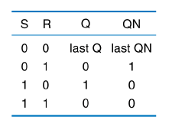
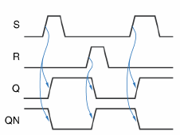
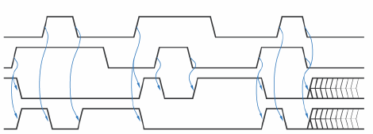




















S-R latch operation (2/2)
(hold)
(reset)
(set)
(forbidden)
Race
Both Q and QN are 0 at the same time

Slide 21
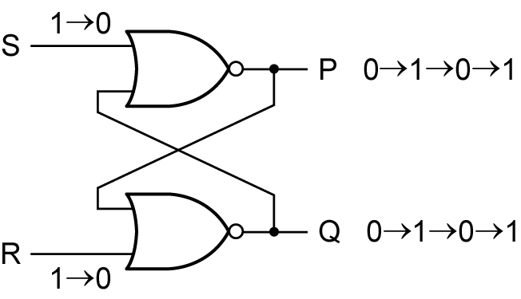
Improper S-R latch operation
QN
Theoretically the circuit
starts to oscillate
Reset
Hold
Set
Reset
Set
Race
R
S
Q
QN

Slide 22

R-S latch analysis
S(t)
S(t) R(t) Q(t) Q(t+Δ)
0 0 0 0
0 0 1 1
0 1 0 0
0 1 1 0
1 0 0 1
1 0 1 1
1 1 0 X
1 1 1 X
R
0 0
1 0
X 1
X 1
Q
hold
Q(t)
reset
R(t)
QN
set
next state equation:
Q(t+Δ) = S(t) + R’(t) Q(t)
S
not allowed
Q⁺ = Q* = S + R’ Q
a.k.a. characteristic equation

Slide 23
Theoretical R-S latch behavior
R
Q
S
QN
SR=10
SR=00
SR=01
SR=00
SR=10
Q QN
0 1
SR=01
Q QN
1 0
SR=01
SR=10
SR=11
State diagram
  states: possible values
  transitions: changes
  based on inputs
Q QN
0 0
SR=11
SR=11
SR=00
SR=11
SR=00
SR=01
SR=10
possible oscillation
between states 00 and 11
Q QN
1 1

Slide 24

Observed R-S latch behavior
R
Q
S
QN
Very difficult to observe R-S latch in the 1-1 state
  one of R or S usually changes first
Ambiguously returns to state 0-1 or 1-0
  a so-called "race condition"
  or non-deterministic transition
SR=10
SR=00
SR=01
SR=00
SR=10
Q QN
0 1
SR=01
Q QN
1 0
SR=01
SR=10
SR=11
Q QN
0 0
SR=11
SR=11
SR=00
SR=00

Slide 25
Review question
An alternative form of the S–R latch is to replace NOR gates with NAND gates. What is its characteristic table?

Slide 26
Problems with Simple Latch Circuits
Latch circuits are not suitable for synchronous logic circuits
  There is no timing control over when the output can change.
The problem is solved by using a clock signal to restrict the times at which the states of the memory elements may change.
This leads us to the edge-triggered memory elements called flip-flops.
Notes:
The problem with the simple SR FF is that the output will change after either one or two Δτ delay. In other words, there is no timing control over when the output can change. This makes difficult to be used directly unless it is collect direct input(like the program assignment to collect input signal).

Slide 27
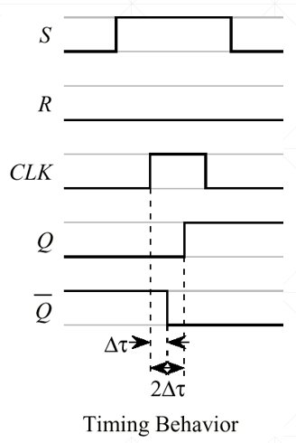
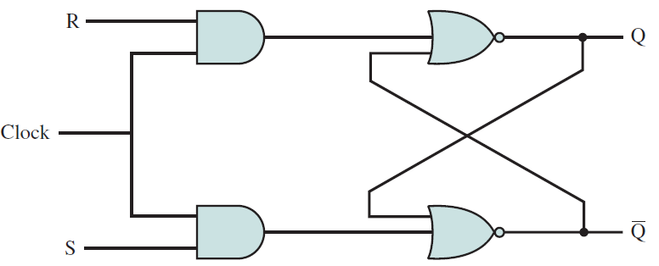
Clocked S-R Flip-Flop
  The clock signal, CLK, enables the S and R inputs to the flip-flop.
  Change of state values Q can then be temporally controlled by CLK.
Notes:
Supposedly, the change will happen after three Δτ delays if you count the AND gate. If this and gate delay is ignored(consider it only for synchronization purpose), you can still approximate it using two Δτ delays.

Slide 28
Clocked D Flip-Flop (1/2)
The clocked D flip-flop avoid the disallowed input S = 1 and R = 1.
Notes:
In practice, we may have a data line that is either 0 or 1. In this case, we don’t have two input data. Rather it is one input data which is either 0 or 1, say for writing the data into a register. In this case, we can have a so called clocked D Flip-flop (stands for data latch). Since the D FF has both the and gate and Negation, it is normally considered a full gate delay. So, a D FF is considered to have either two Δτ or three Δτ delay.

Slide 29
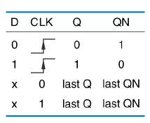
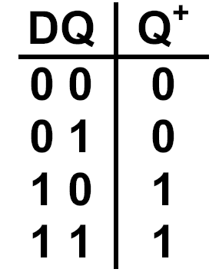

Clocked D Flip-Flop (2/2)
Functional Table
Truth Table
More compact
Truth Table
D Q⁺
0 0
1 1
Next state equation:
CLK
D
Q

Slide 30
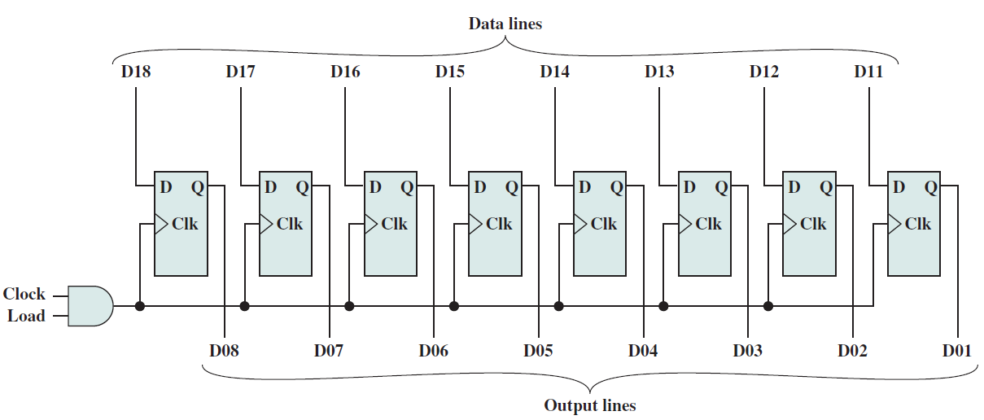
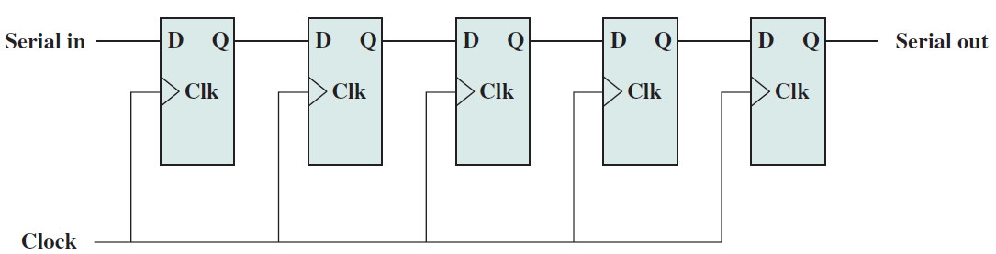
Parallel and serial registers
8-bit parallel register
4-bit serial register

Slide 31
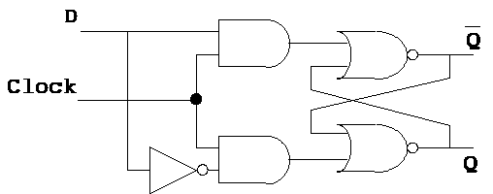
Conclusions

Slide 32
Acknowledgements
This set of slides are prepared mainly based on
  The slides prepared by K. Asanovic & V. Stojanovic for CS61C at UC/Berkeley (http://inst.eecs.Berkeley.edu/~cs61c/sp15)
  Prof. Qin Lu’s slides from http://www4.comp.polyu.edu.hk/~csluqin/comp2421/
  J.F. Wakerly, Digital Design, 4/e, Prentice Hall, 2006
  C.H. Roth, Fundamentals of Logic Design, 5/e, Thomson, 2004
  A.B. Marcovitz, Intro. to Logic and Computer Design, McGraw Hill, 2008
  R.H. Katz, G. Borriello, Contemporary Logic Design, 2/e, Prentice-Hall, 2005

