Slide 1
5. Combinational circuits
Rocky K. C. Chang 17 October 2017

Slide 2
Goals of this lecture
Understand how multiplexers, decoders, and demultiplexers, which are basic building blocks for digital circuits are implemented.
Understand how different arithmetic and logic functions are implemented in an ALU.
Understand the circuit delay and its relation to sequential circuit.

Slide 3
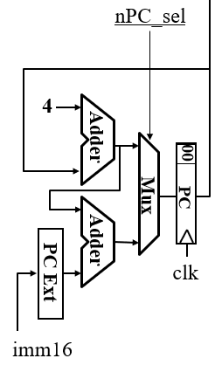
Multiplexer: use case
Update the PC either from PC + 4 or PC + 4 + immediate

Slide 4
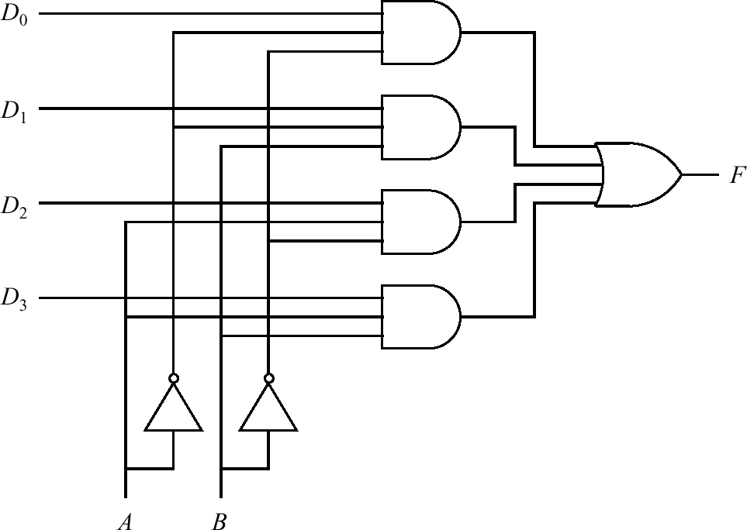
Multiplexer: logic circuit
Component
Symbol
Truth Table
Implementation

Slide 5
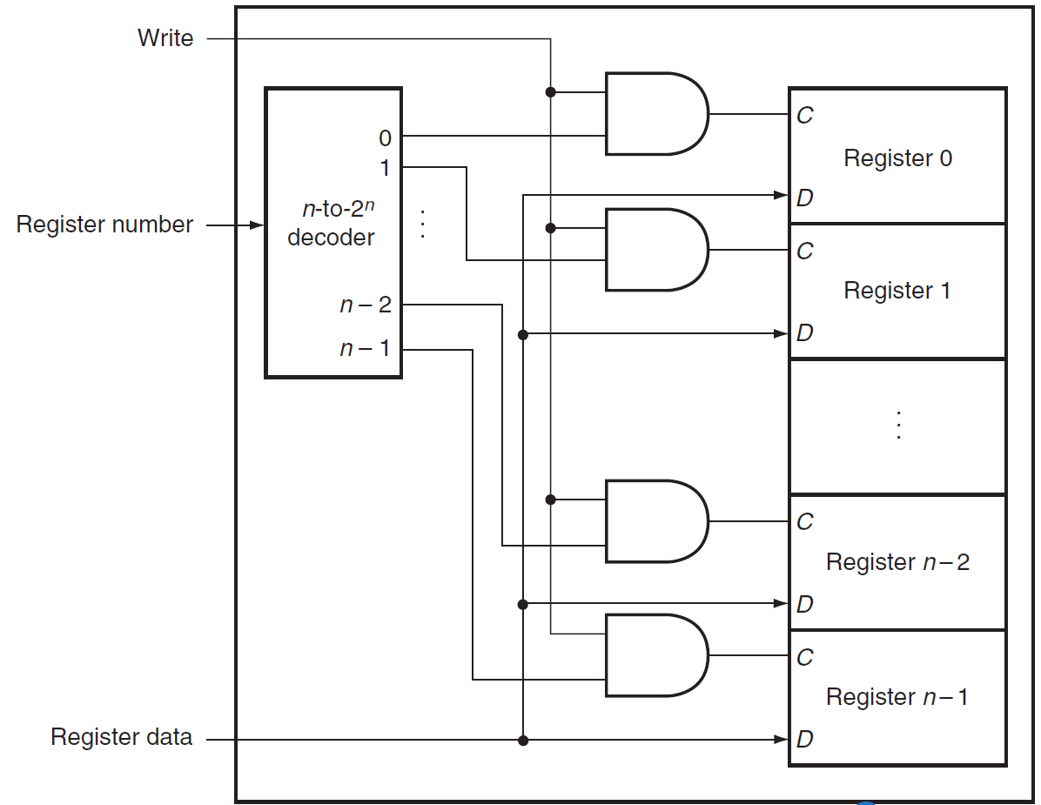
Decoder: use case
A decoder is a combinational circuit with a number of output lines, only one of which is asserted at any time.
For example, it can be used to implement the write port for a register file.

Slide 6
Decoder: logic circuit
In general, a decoder has n inputs and 2^{n} outputs.
For a 2-to-4 decoder:
A₀ | A₁ | D₀ | D₁ | D₂ | D₃
0 | 0 | 1 | 0 | 0 | 0
0 | 1 | 0 | 1 | 0 | 0
1 | 0 | 0 | 0 | 1 | 0
1 | 1 | 0 | 0 | 0 | 1
2-to-4
Decoder
D₀
A₀
D₁
A₁
D₂
D₃

Slide 7
For a 3-to-8 decoder

Slide 8
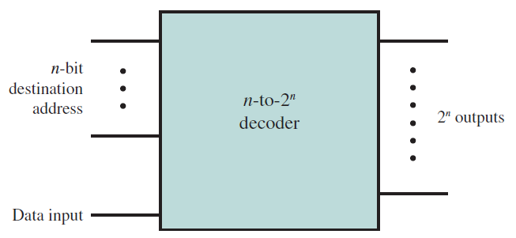
Demultiplexer
With an additional input line, a decoder can be used as a demultiplexer.
The demultiplexer connects a single input to one of several outputs.
The n inputs act as an address to select a particular output line.
The value on the data input line (0 or 1) is routed to that output line.
The data input could be viewed as an Enabled.

Slide 9
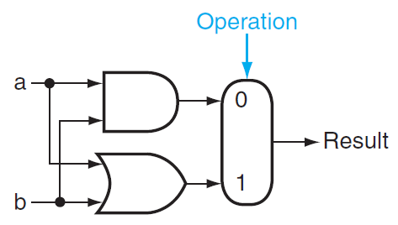
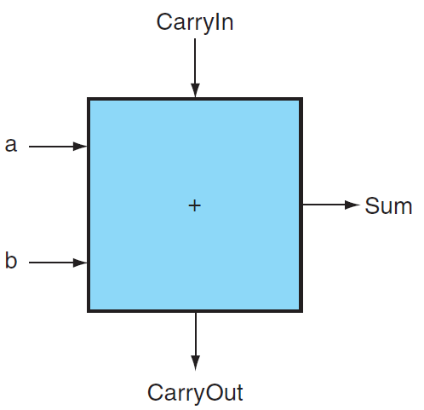
A basic ALU
1-bit logic unit
One AND, one OR and one multiplexer
Operation (0/1) controls the output.
1-bit adder
Inputs a and b are two bits to be added.
CarryIn: a carry bit from another adder
CarryOut: a carry bit generated from this adder

Slide 10
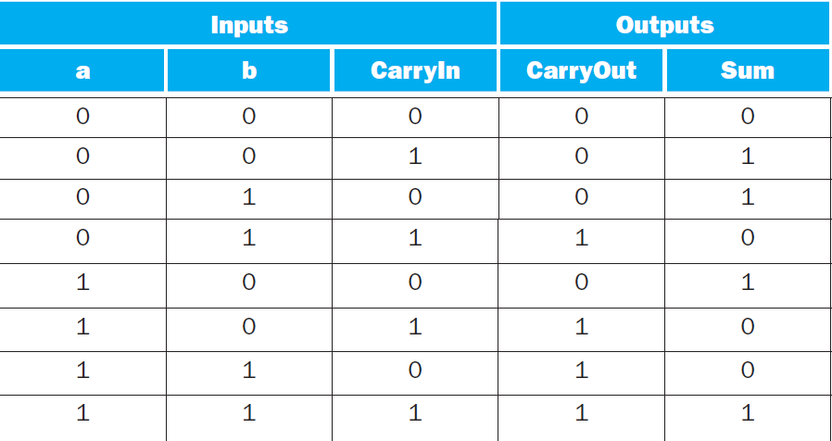
1-bit adder (full adder)

Slide 11
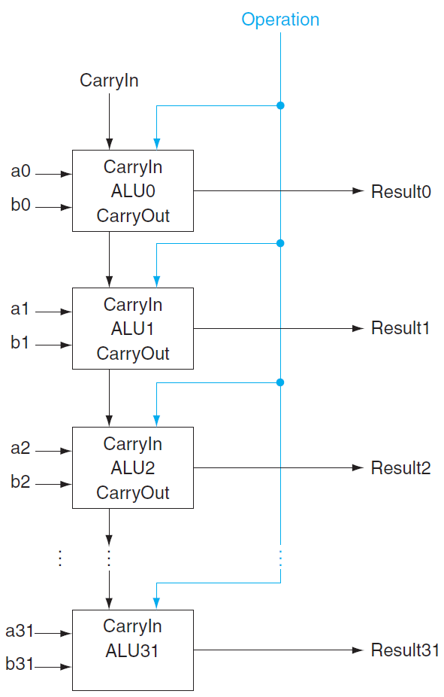
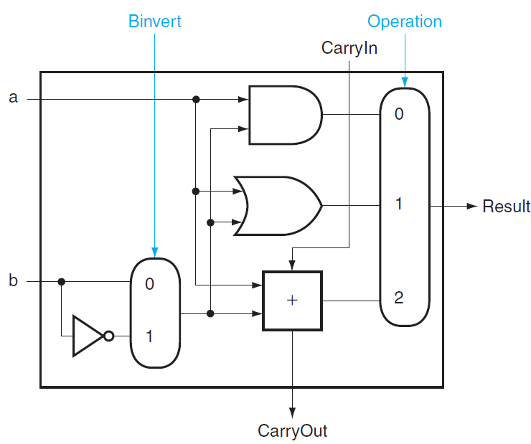
A 32-bit ALU
The 32-bit ALU is created by chaining 32 1-bit ALU.
Subtraction is supported by setting Binvert and CarryIn to 1 for ALU0.
1-bit a +/OR/AND b
1-bit a +/OR/AND b and a + $\overline{b}$ for subtraction

Slide 12
Review questions
Verify the fuller adder’s Boolean functions for Sum and CarryOut using Karnaugh map.
How many AND and OR gates do you need to implement the full adder, assuming that you could use multi-input gates?
How do you reduce the number of gates for Sum?

Slide 13
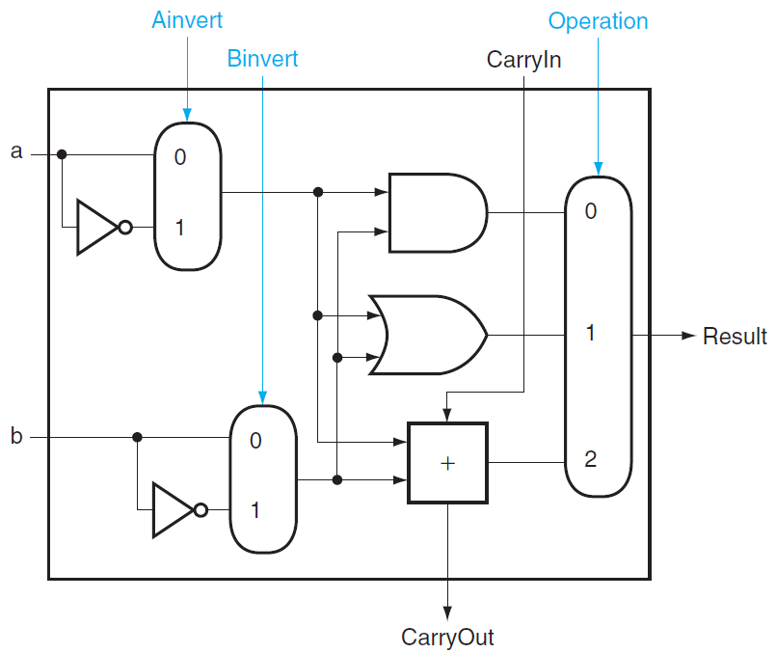
Adding NOR and NAND to the ALU
This enhanced ALU supports also NOR and NAND.
These different operations are controlled by setting Ainvert, Binvert, and Operation.

Slide 14
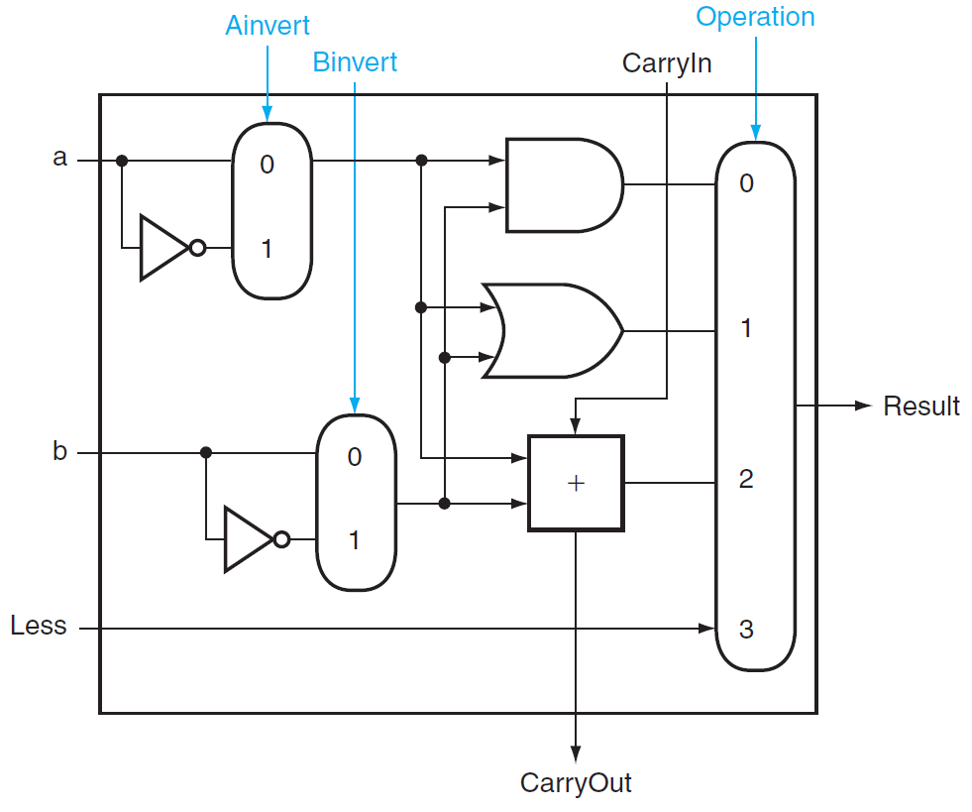
Adding support for SLT (1/3)
Test a < b or a – b < 0.
Expand the 3-input multiplexer by one more input called Less.
Connect 0 to the Less input for the upper 31 bits of the ALU.
The least significant bit (LSB) should be set to 1 for a – b < 0 and 0 otherwise.
Connect the sign bit from the adder output to the LSB.

Slide 15
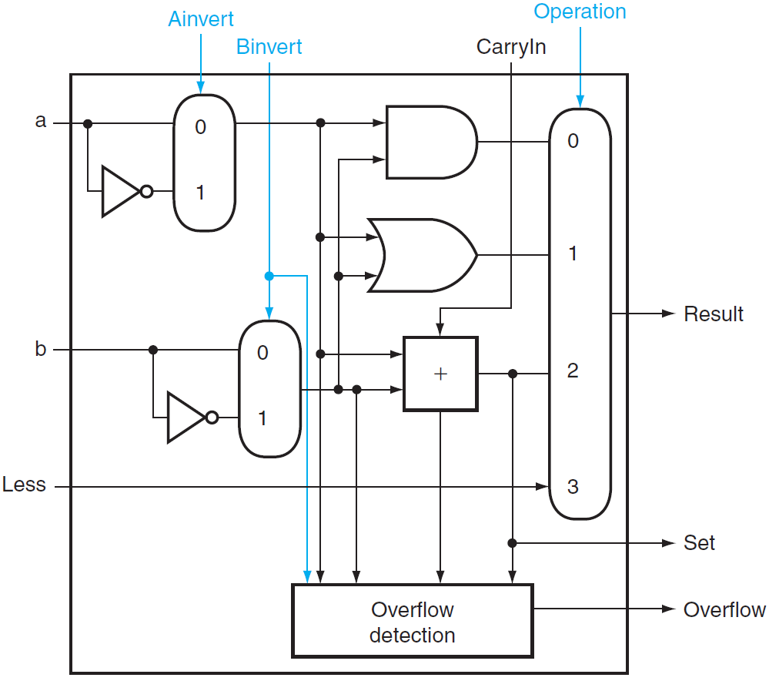
Adding support for SLT (2/3)
But the ALU output for the slt operation is the input value Less, instead of the adder’s.
Need a new 1-bit ALU for the MSB that has an extra output bit called Set: the adder output.
Also add the overflow detection logic since it is also associated with that bit.
Only for block 31

Slide 16
Adding support for SLT (3/3)
Block 31 is different from blocks 0 – 30.
Block 31 also supports overflow detection.

Slide 17
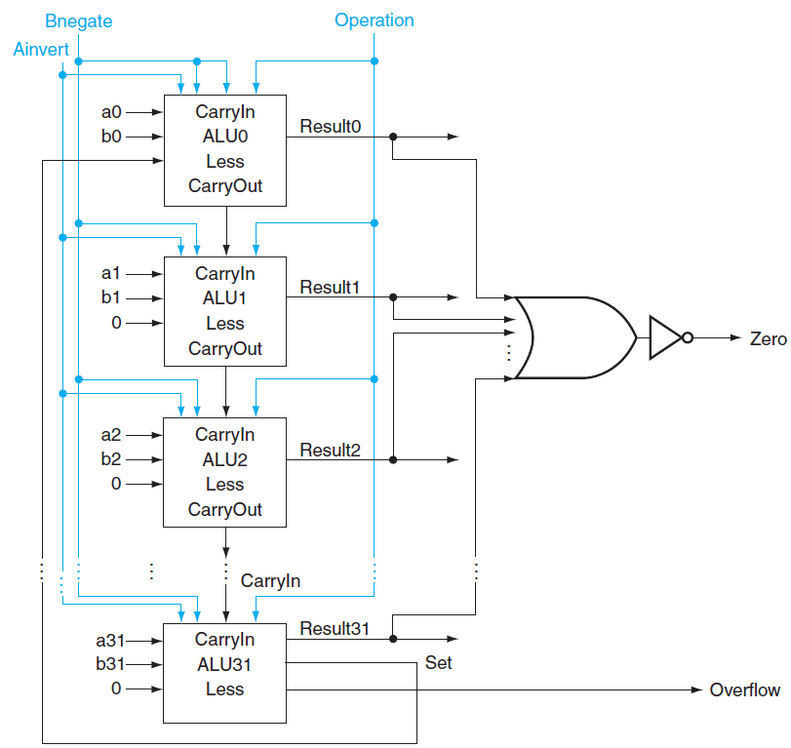
Adding support for conditional branching
Test a = b, or a - b = 0.
Add hardware to test if the result is 0:
Zero = NOT Result0 AND
NOT Result1 AND
…
NOT Result30 AND
NOT Result31

Slide 18
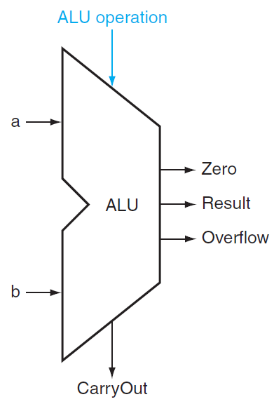
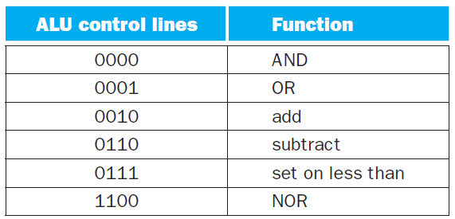
Controlling the ALU’s output
Use the 1-bit Ainvert line, the 1-bit Binvert line, and the 2-bit Operation lines as 4-bit control lines for the ALU.

Slide 19
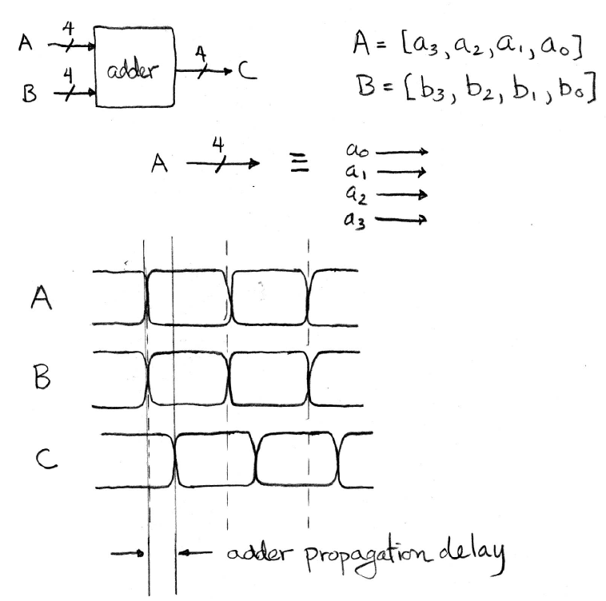
Circuit delay
A measure of the delay from input to output is called propagation delay.
The propagation delay of a circuit, like the adder, is always less than the clock period.
CS61c: Introduction to Synchronous Digital Systems by J. Wawrzynek

Slide 20
Clock
All operations coordinated by a central clock (“heartbeat” of the system!)
Edge-triggered clocking
Either the rising edge or the falling edge of the clock is active and causes state changes to occur.

Slide 21
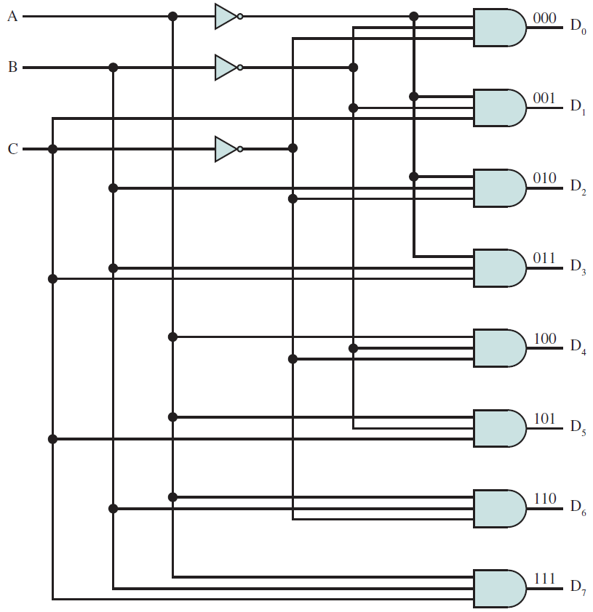
conclusions

Slide 22
Acknowledgements
This set of slides is mainly based on Appendix B5 of David Patterson and John Hennessy, Computer Organization and Design, 5th edition, Morgan Kaufmann, 2014.

