Slide 1
4. Transistors and logic gates
Rocky K. C. Chang
Version 0.1, 14 October 2017

Slide 2
Goals of this lecture
Have a basic understanding of how transistors are used to implement the basic logic gates.
Know how to obtain Boolean function and logic circuit for a given truth table.
Know how to simplify a Boolean function by applying various Boolean laws.
Know how to simplify a Boolean function by the Karnaugh map.

Slide 3


Levels of Representation/Interpretation
High Level Language
Program (e.g., C)
temp = v[k];
v[k] = v[k+1];
v[k+1] = temp;
Compiler
Anything can be represented
as a number,
i.e., data or instructions
lw $t0, 0($2)
lw $t1, 4($2)
sw $t1, 0($2)
sw $t0, 4($2)
Assembly Language Program (e.g., MIPS)
Assembler
0000 1001 1100 0110 1010 1111 0101 1000
1010 1111 0101 1000 0000 1001 1100 0110
1100 0110 1010 1111 0101 1000 0000 1001
0101 1000 0000 1001 1100 0110 1010 1111
Machine Language Program (MIPS)
Machine Interpretation
Hardware Architecture Description
(e.g., block diagrams)
Architecture Implementation
Logic Circuit Description
(Circuit Schematic Diagrams)

Slide 4
Why study hardware design?
Every CS student should understand how a computer (not only a program) works.
  But it is not necessary to know Verilog to design hardware and the nitty-gritty electronic stuff.
Every CS student should also understand the capabilities and limitations of hardware in general and processors in particular.
Every CS student should be able to evaluate the tradeoffs of different computing systems.

Slide 5
Synchronous Digital Systems
Hardware of a processor, such as the MIPS, is an example of a Synchronous Digital System
Synchronous: All operations coordinated by a central clock (“heartbeat” of the system!)
Digital:
  Represent all values by discrete values
  Two binary digits: 1 and 0
  Electrical signals are treated as 1’s and 0’s (high/low voltage for 1/0)

Slide 6
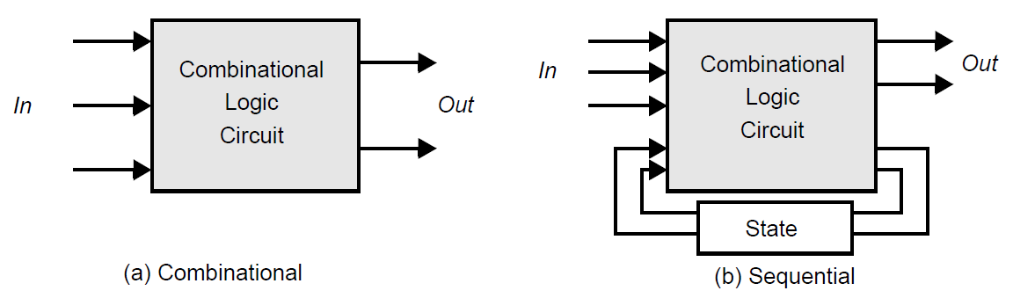
Two types of logic circuits
Combinational
  At any point in time, the output of the circuit is related to its current input signals by some Boolean expression (e.g., multiplexer, ROM, adder, etc).
Sequential
  Its output is not only a function of the current input data, but also of previous values of the input signals (e.g., registers, counters and memory).

Slide 7
Switches
Implementing a simple circuit (arrow shows action if wire changes to “1” or is asserted):
A
Z
Open switch (if A is “0” or
unasserted) and turn off light
bulb (Z)
Z
A
Close switch (if A is “1” or asserted)
and turn on light bulb (Z)
Z ≡ A

Slide 8
Switches (cont’d)
Compose switches into more complex ones (Boolean functions):
A
B
A
AND
Z ≡ A and B
AND
C
B
A
A
OR
OR
C
Z ≡ A or B
B
B

Slide 9
How to make electronic switches?
Idea: Use voltage to represent 0 and 1
  High voltage (V_{dd}) represents 1 (V_{dd} ~ 1.0 Volt).
  Low voltage (0 Volt or Ground) represents 0.
Pick a midpoint voltage to decide if a 0 or a 1
  Voltage greater than midpoint = 1
  Voltage less than midpoint = 0
  This removes noise as signals propagate – a big advantage of digital systems over analog systems

Slide 10
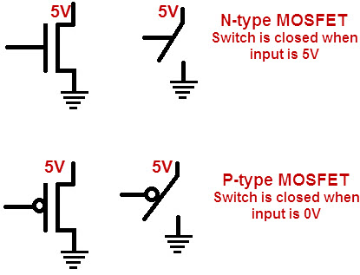
CMOS Transistors
Modern digital systems designed in CMOS
  MOS: Metal-Oxide on Semiconductor
  C for complementary: use pairs of normally-open and normally-closed switches
  CMOS transistors act as voltage-controlled switches.
NMOS transistors
  Switch closed (open) for a high (low) voltage
PMOS transistors
  Switch closed (open) for a low (high) voltage

Slide 11
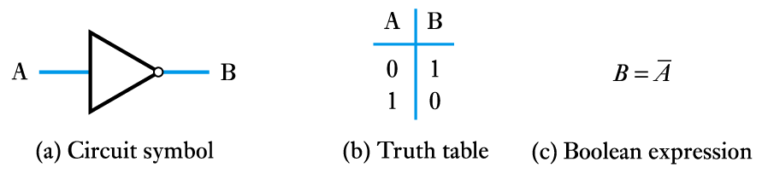
CMOS Inverter
Vdd
PMOS
A
B
NMOS
Vss = Ground

Slide 12
NMOS and PMOS Transistors
NMOS Transistor
Connect source to drain when V_{G} = V_{supply}
PMOS Transistor
Connect source to drain when V_{G} = 0 V
V_{supply}
V_{supply}
V_{supply}
V_{D}
V_{D} = 0V
V_{S} = V_{supply}
V_{G}
V_{G} = V_{Supply}
V_{G} = 0 V
V_{G}
V_{G} = V_{Supply}
V_{G} = 0 V
V_{S} = 0 V
V_{D}
V_{D} = V_{supply}
Closed switch
When V_{G} = V_{supply}
Closed switch
When V_{G} = 0 V
V_{S}: voltage at the source; V_{D}: voltage at the drain;
V_{supply}: max voltage (aka a logical 1)
(ground): min voltage (aka a logical 0)
Adapted from slides prepared by Hakim Weatherspoon of Cornell University

Slide 13
NMOS and PMOS Transistors
NMOS Transistor
Connect source to drain when gate = 1
PMOS Transistor
Connect source to drain when gate = 0
V_{supply}
V_{supply}
V_{supply}
D
D = 0
S = V_{supply}
G
G = 1
G = 0
G
G = 1
G = 0
S = 0V
D
D = 1
Closed switch
When V_{G} = V_{supply}
Closed switch
When V_{G} = 0 V
V_{S}: voltage at the source
V_{D}: voltage at the drain
V_{supply}: max voltage (aka a logical 1)
(ground): min voltage (aka a logical 0)
Adapted from slides prepared by Hakim Weatherspoon of Cornell University

Slide 14
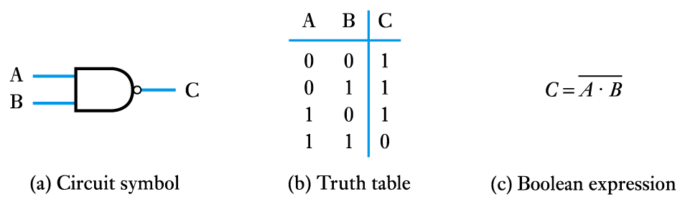
NAND Gate
Vdd
Vdd
A
B
out
B
A
Vss

Slide 15
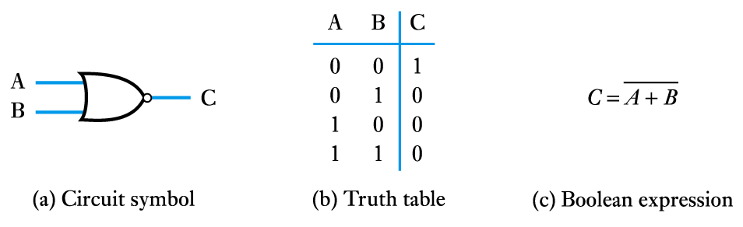
NOR Gate
Vdd
A
B
out
A
B
Vss
Vss
Notes:
Example

Slide 16
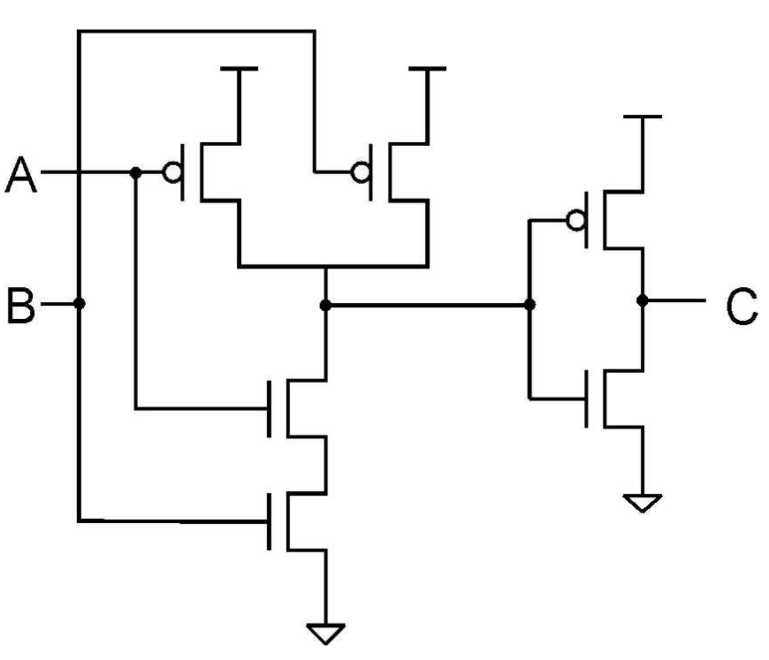
Review question
What is the truth table for

Slide 17
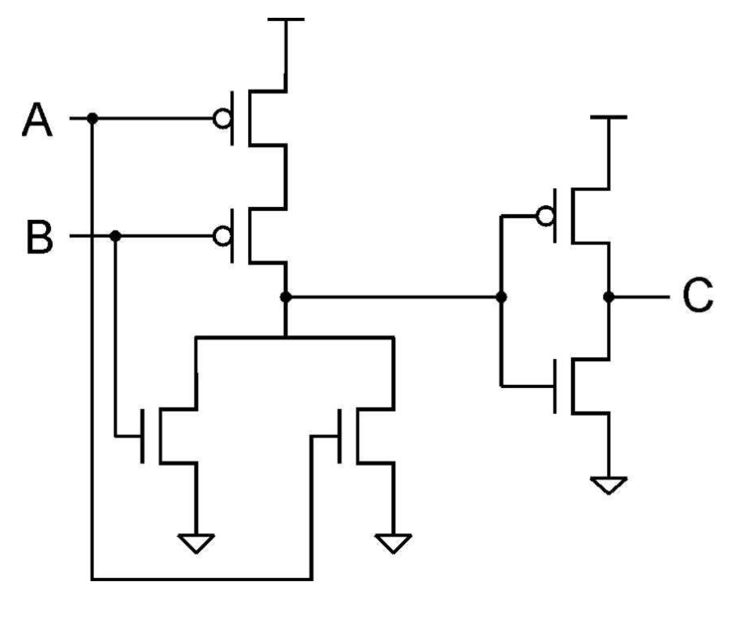
Review question
What is the truth table for

Slide 18
How to design A desired logic function?
Question: How to design a logic circuit to obtain the desired output from given inputs?
We will need
  Truth table (specifying the desired output for each input)
  Boolean function (expressing the output in terms of the input)
  Boolean algebra (used for deriving a Boolean function from a truth table)
  Basic logic gates (implementing a Boolean function)

Slide 19
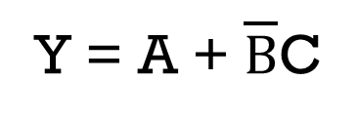
A B C Y
0 0 0 0
0 0 1 1
0 1 0 0
0 1 1 0
1 0 0 1
1 0 1 1
1 1 0 1
1 1 1 1
TruthTable
Boolean
Function
Y = A + $\overline{B}$C
A
Y
Logic
Diagram
B
C

Slide 20
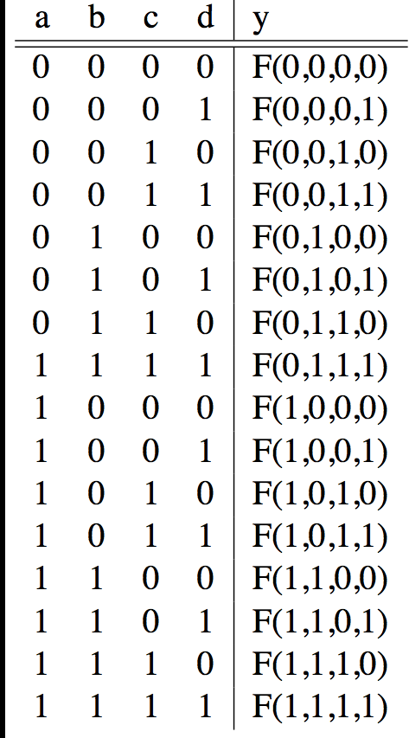
Designing Combinational Logic
A B C D Y
Given a truth table for mapping the 4 inputs to the outputs, how do we design its logic circuit (in terms of a Boolean function or a circuit diagram)?
A
F
B
Y
C
D

Slide 21
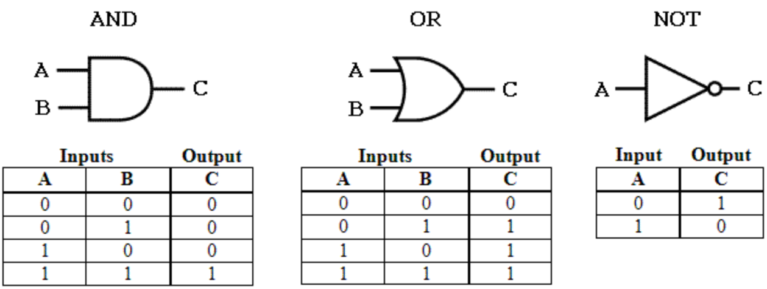
We need some Basic logic gates
The building blocks used to create digital circuits are logic gates. They usually have at most two inputs and one output.

Slide 22
What other basic logic gates?
We consider two inputs and one output.
Hoe many different functions could we have?
F
F₁(0,0)
F₁(0,1)
F₁(1,0)
F₁(1,1)
F₂(0,0)
F₂(0,1)
F₂(1,0)
F₂(1,1)
F?(0,0)
F?(0,1)
F?(1,0)
F?(1,1)
A
Y
…
B

Slide 23
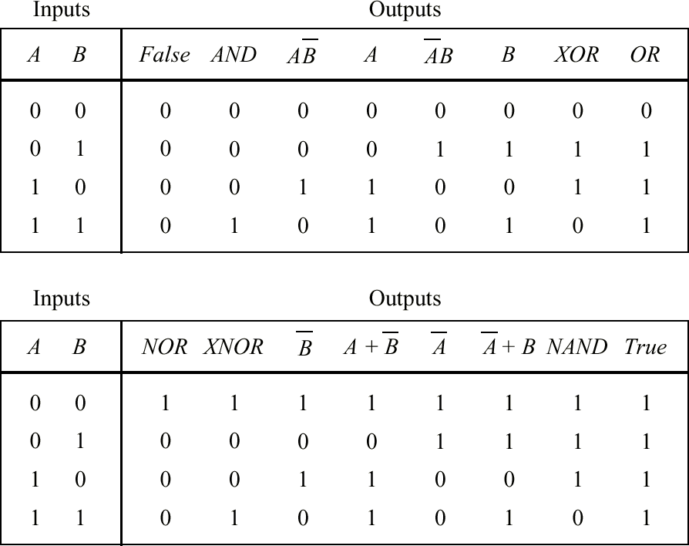
Alt0gether we have

Slide 24
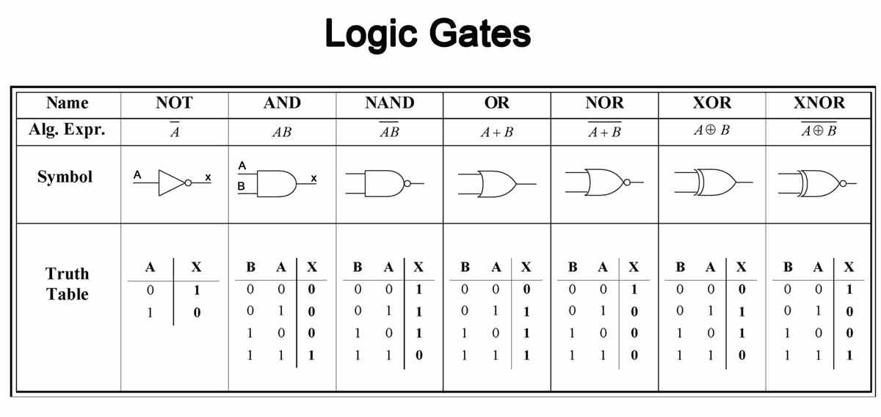

Slide 25
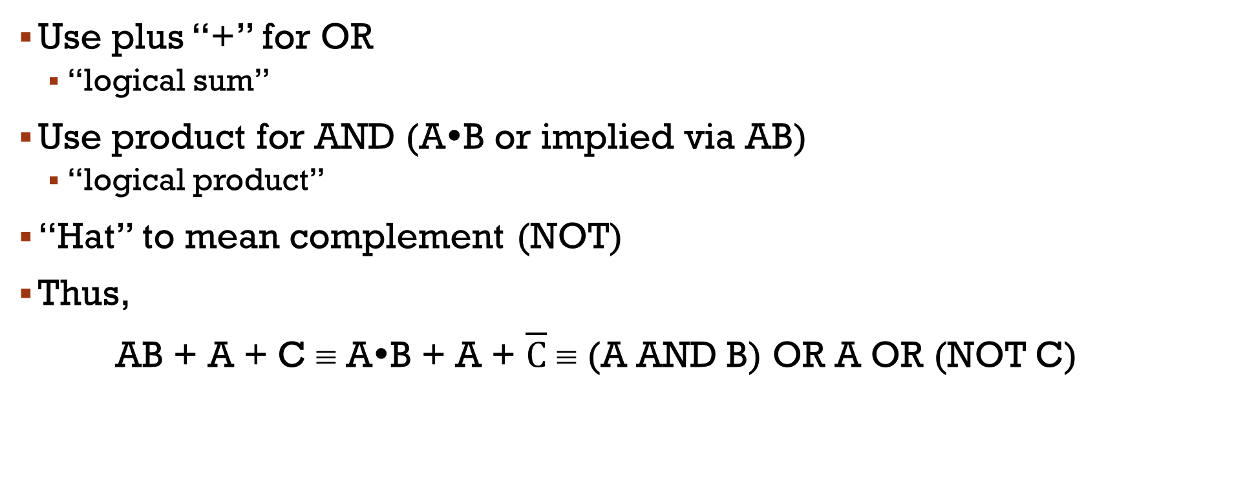
Need Some algebra to manipulate them
Use plus “+” for OR
  “logical sum”
Use product for AND (A•B or implied via AB)
  “logical product”
“Hat” to mean complement (NOT)
Thus,
AB + A + C ≡ A•B + A + $\overline{C}$ ≡ (A AND B) OR A OR (NOT C)

Slide 26
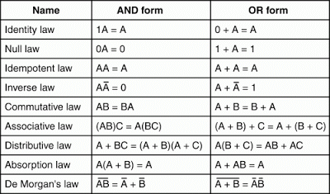
Boolean laws

Slide 27
Boolean laws (cont’d)
For example,
X = (A + B)(A + C)
X = (A + B)A+ (A + B)C (Distributive Law)
X = A + (A + B)C (Absorption Law)
X = A + AC + BC (Distributive Law)
X = A + BC (Absorption Laws)

Slide 28
Review question
Write down the truth table of the logic circuit below. When does this circuit do?
A
B
Out

Slide 29


Review question
Draw a circuit diagram for X = ABC + $\overline{A}$BC + AC + A$\overline{C}$.
Draw a circuit diagram for X = A + BC.
$$\overline{c}$$

Slide 30
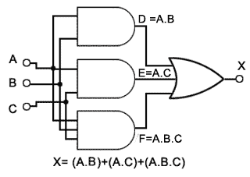
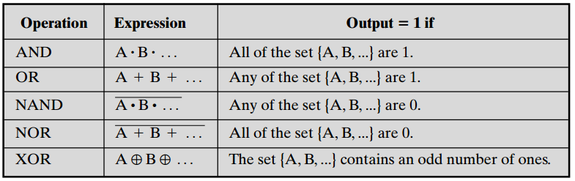
For more than two inputs

Slide 31
Completeness of Functionality
A set of gates that can be used to implement all logical expressions, i.e., functionally complete sets of gates
(AND, OR, NOT):
(AND, NOT):
(OR, NOT):
(NAND)
(NOR)
Self Evident
Can OR be expressed by AND and NOT?
Similar to previous question
?
?

Slide 32
Implementing a desired logic function
Problem: Given a truth table of a desired function, how to derive its Boolean function/logic circuit?
Sum of products
Product of sum
Karnaugh Map (K-map) to simplify the circuit

Slide 33
The Sum-of-Products (SOP) Form
Example: 3 input variables, and the function
takes the majority
F = Item 3 OR Item 5 OR Item 6 OR Item 7
F =

Slide 34
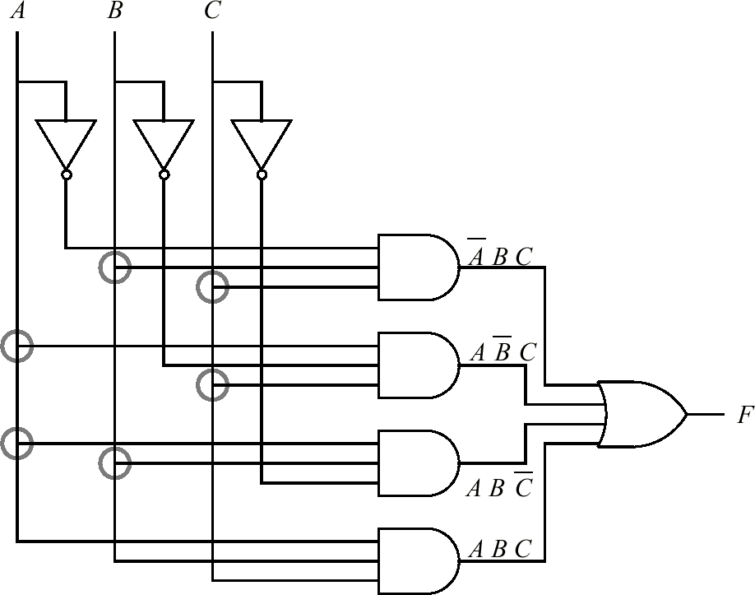
A 2-Level OR-AND gates for SOP

Slide 35
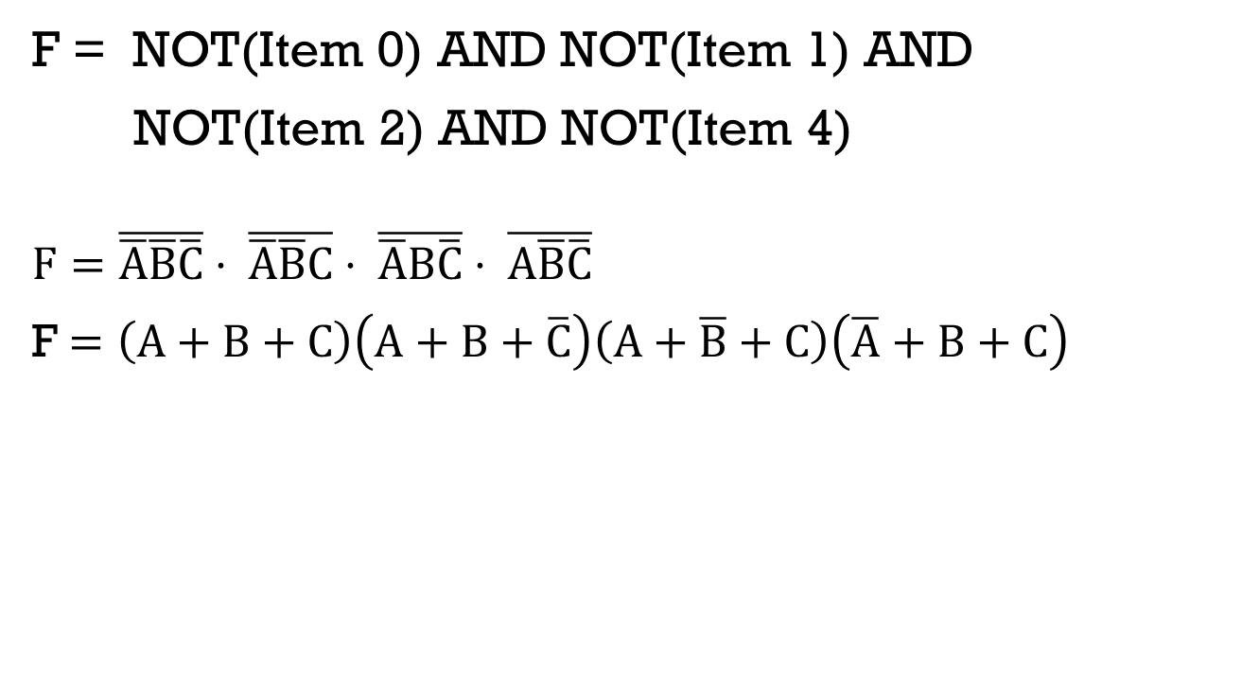
The Product-of-Sum (POS) Form
F = NOT(Item 0) AND NOT(Item 1) AND
NOT(Item 2) AND NOT(Item 4)
$$F=\overline{\overline{A}\overline{B}\overline{C}}⋅ \overline{\overline{A}\overline{B}C}⋅ \overline{\overline{A}B\overline{C}}⋅ \overline{A\overline{B}\overline{C}}$$
F$=\left(A+B+C\right)\left(A+B+\overline{C}\right)\left(A+\overline{B}+C\right)\left(\overline{A}+B+C\right)$

Slide 36
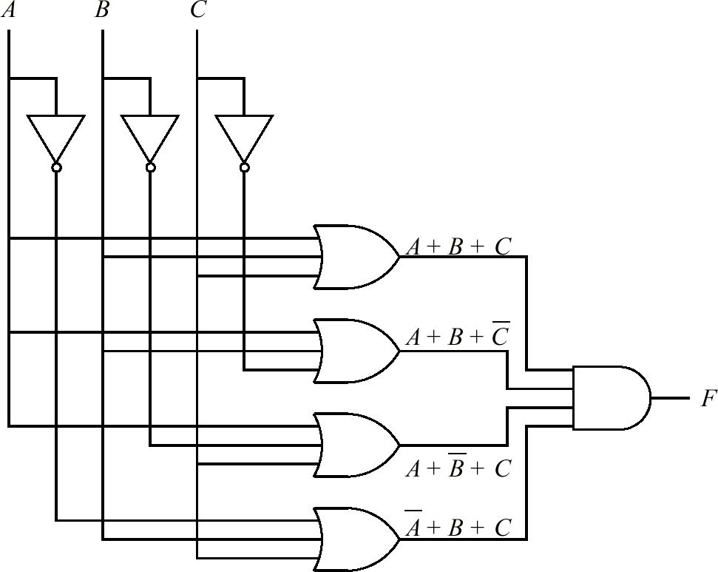
A 2-Level OR-AND gates for POS

Slide 37
Choice of 2-level gate Types
Simplification:
  The less gates used the cheaper
  Shorter expressions
Cost Consideration:
  Manufacturing less types of gates in one a surface is easier than different kinds on the same chip
  More types are less reliable too
No choice of gates: Might have to use certain available single type or ready to use types:
  NAND, NOR

Slide 38
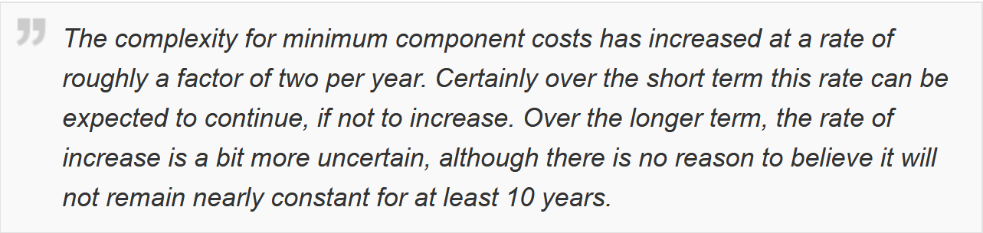
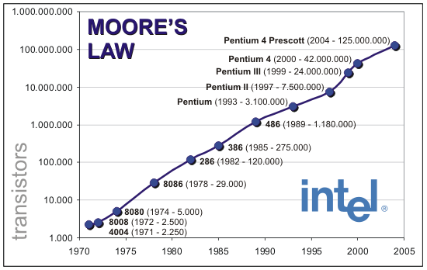
Moore’s Law

Slide 39
Karnaugh Maps
      How does one find the most efficient equation?
          Manipulate algebraically until…?
          Use Karnaugh maps (optimize visually)
          Use a software optimizer
          For large circuits
          Decomposition & reuse of building blocks

Slide 40
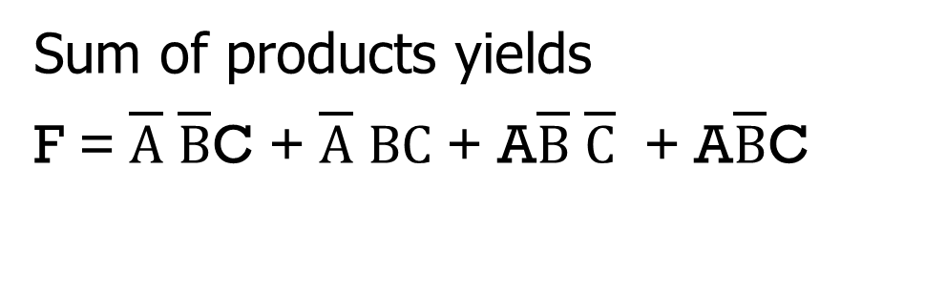
Minimization with Karnaugh maps (1)
A | B | C | F
0 | 0 | 0 | 0
0 | 0 | 1 | 1
0 | 1 | 0 | 0
0 | 1 | 1 | 1
1 | 0 | 0 | 1
1 | 0 | 1 | 1
1 | 1 | 0 | 0
1 | 1 | 1 | 0
Sum of products yields
F = $\overline{A}$ $\overline{B}$C + $\overline{A}$ $BC$ + A$\overline{B}$ $\overline{C}$ + A$\overline{B}$C

Slide 41
Minimization with Karnaugh maps (2)
A | B | C | F
0 | 0 | 0 | 0
0 | 0 | 1 | 1
0 | 1 | 0 | 0
0 | 1 | 1 | 1
1 | 0 | 0 | 1
1 | 0 | 1 | 1
1 | 1 | 0 | 0
1 | 1 | 1 | 0
Karnaugh maps identify which inputs are (ir)relevant to the output
AB
C
00 01 11 10
0
0 | 0 | 0 | 1
1 | 1 | 0 | 1
1

Slide 42
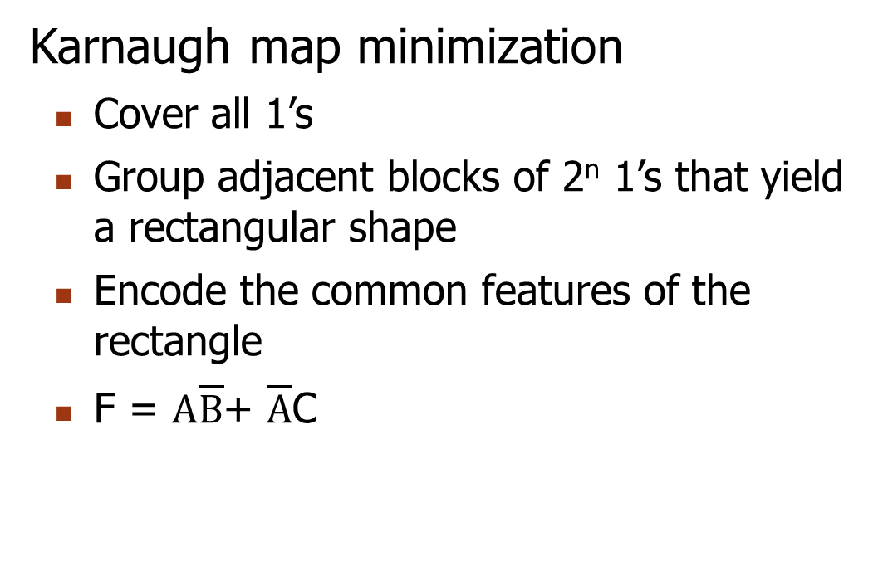
Minimization with Karnaugh maps (2)
A | B | C | F
0 | 0 | 0 | 0
0 | 0 | 1 | 1
0 | 1 | 0 | 0
0 | 1 | 1 | 1
1 | 0 | 0 | 1
1 | 0 | 1 | 1
1 | 1 | 0 | 0
1 | 1 | 1 | 0
Karnaugh map minimization
Cover all 1’s
Group adjacent blocks of 2^{n} 1’s that yield a rectangular shape
Encode the common features of the rectangle
F = $A\overline{B}$+ $\overline{A}$C
AB
C
00 01 11 10
0
0 | 0 | 0 | 1
1 | 1 | 0 | 1
1

Slide 43

Karnaugh Minimization Tricks (1)
AB
C
00 01 11 10
The minterms can overlap
F =
The minterms can span 2, 4, 8 or more cells
F =
0
0 | 1 | 1 | 1
0 | 0 | 1 | 0
1
AB
C
00 01 11 10
0
1 | 1 | 1 | 1
0 | 0 | 1 | 0
1

Slide 44

Karnaugh Minimization Tricks (2)
AB
CD
00 01 11 10
The map wraps around
  F =
  F =
00
0 | 0 | 0 | 0
1 | 0 | 0 | 1
1 | 0 | 0 | 1
0 | 0 | 0 | 0
01
11
10
AB
CD
00 01 11 10
00
1 | 0 | 0 | 1
0 | 0 | 0 | 0
0 | 0 | 0 | 0
1 | 0 | 0 | 1
01
11
10

Slide 45
Review question
Consider the table on the next page for converting binary coded decimal (BCD) to Gray Code. Apply SOP and K-map to obtain the Boolean functions for G0, G1, G2, and G3.

Slide 46
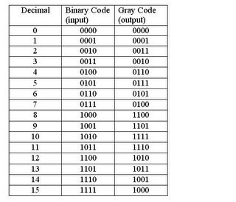

Slide 47
Conclusions
Digital circuits are built from a small number of gates, or even a single type of gates.
The gates can be built by two types of CMOS transistors which serve as voltage-driven switches.
Sum of products or products of sum can be used to obtain Boolean function from a given truth table.
K-map can be applied to reduce the number of gates required to implement a truth table.

Slide 48
Reading
Read B1-B3 in David Patterson and John Hennessy, Computer Organization and Design, 5th edition, Morgan Kaufmann, 2014.
Read 11.1-11.3 in William Stallings, Computer organization and architecture: Designing for performance, 9th edition, Prentice Hall, 2013.

Slide 49
acknowledgements
This set of slides are prepared mainly based on
  The slides prepared by K. Asanovic & V. Stojanovic for CS61C at UC/Berkeley (http://inst.eecs.Berkeley.edu/~cs61c/sp15)
  Prof. Qin Lu’s slides from http://www4.comp.polyu.edu.hk/~csluqin/comp2421/

Slide 50
End

