Slide 1
2. Instruction sets II
Rocky K. C. Chang
Version 0.1, 25 September 2017

Slide 2
Goals of this lecture
Understand the hardware support for procedures.
Understand the two kinds of registers according to whether they are preserved across procedures.
Able to use stack to store spill registers.
Able to translate procedure calls to assembly code.

Slide 3
Six Fundamental Steps in Calling a Function
Put parameters in a place where function can access them.
Transfer control to function.
Acquire (local) storage resources needed for function.
Perform desired task of the function.
Put result value in a place where calling program can access it and restore any registers that the function has used.
Return control to point of origin, since a function can be called from several points in a program.

Slide 4
MIPS registers for function calls
$a0–$a3: four argument registers to pass parameters
$v0–$v1: two value registers to return values
$ra (register 31): one return address register to return to the point of origin
Notes:
$at – assembler temporary register, used for pseudo instructions

Slide 5
Instruction Support for Functions (1/4)
... sum(a,b);... /* a,b:$s0,$s1 */ int sum(int x, int y) { return x+y; }
address (shown in decimal) 1000 1004 1008 1012 1016 … 2000 2004
C
M I P S
In MIPS, all instructions are 4 bytes, and stored in memory just like data. So here we show the addresses of where the programs are stored.

Slide 6
Instruction Support for Functions (2/4)
... sum(a,b);... /* a,b:$s0,$s1 */ int sum(int x, int y) { return x+y; }
address (shown in decimal) 1000 add $a0,$s0,$zero # x = a 1004 add $a1,$s1,$zero # y = b 1008 addi $ra,$zero,1016 # $ra=1016 1012 j sum # jump to sum 1016 … # next instruction … 2000 sum: add $v0,$a0,$a1 2004 jr $ra # jump register instruction
C
M I P S

Slide 7
Instruction Support for Functions (3/4)
... sum(a,b);... /* a,b:$s0,$s1 */ int sum(int x, int y) { return x+y; }
2000 sum: add $v0,$a0,$a1 2004 jr $ra # new instruction
C
M I P S
Question: Why use jr here? Why not use j?
Answer: sum might be called by many places, so we can’t return to a fixed place. The calling proc to sum must be able to say “return here” somehow.

Slide 8
Instruction Support for Functions (4/4)
Single instruction to jump and save return address: jump and link (jal)
Before:
1008 addi $ra,$zero,1016 # $ra=1016
1012 j sum # goto sum
After: 1008 jal sum # $ra=1012,goto sum
Why have a jal?
Make the common case fast: function calls very common.
Don’t have to know where code is in memory with jal!

Slide 9
Function calling and return (1/2)
Invoke function: jump and link instruction (jal)
jal X # X is a label for a function
Return from function: jump register instruction (jr)
jr $ra
For example,
jal X # call the function
# the next instruction
…
X: # start of the function
…
jr $ra # end of the function

Slide 10
Function calling and return (2/2)
The calling program (caller)
$a0-$a3←parameters
Use jal X to invoke the function at address X.
$ra←PC+4 (each instruction is of 4 bytes)
PC holds the address of the current address being executed.
The called program (callee)
After performing the function, invokejr $ra: PC←$ra.
Notes:
PC+4

Slide 11
Using more registers
Besides the 4 argument and 2 return value registers, any registers (e.g., $s0-$s7 and $t0-$t7) used by the function should be recovered after the function call.
Using stack: last-in-first-out queue (e.g., stack of plates)
Push: placing data onto stack
Pop: removing data from stack
Stack in memory, so need a register to point to it.
$sp (register 29) is the stack pointer in MIPS
Convention is grow from high to low addresses
Push decrements $sp, Pop increments $sp

Slide 12
Example
int leaf_example (int g, int h, int i, int j)
{
int f;
f = (g + h) – (i + j);
return f;
}
Parameter variables g, h, i, and j in argument registers $a0, $a1, $a2, and $a3; and f in $s0
We also need one temporary register $t0

Slide 13
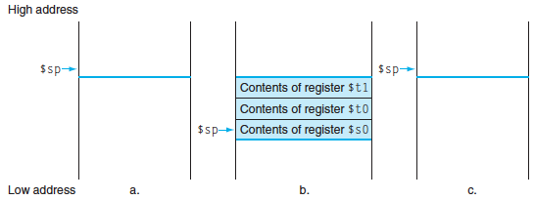
Stack Before, During, After Function
Need to save old values of $s0 and $t0.
Contents of $t0
Contents of $s0

Slide 14
MIPS Code for leaf_example
addi $sp,$sp,-8 # adjust stack for 2 items
sw $t0, 4($sp) # save $t0 for use afterwards
sw $s0, 0($sp) # save $s0 for use afterwards
add $s0,$a0,$a1 # f = g + h
add $t0,$a2,$a3 # t0 = i + j
sub $v0,$s0,$t0 # return value (g + h) – (i + j)
lw $s0, 0($sp) # restore register $s0 for caller
lw $t0, 4($sp) # restore register $t0 for caller
addi $sp,$sp,8 # adjust stack to delete 2 items
jr $ra # jump back to calling routine
Better yet, temporary registers do not need to be preserved across a function call. So we can drop the sw and lw for $t0.

Slide 15
Review questions

Slide 16
Nested procedures (1/2)
The previous example is a leaf function which does not call another function.
For a non-leaf function, say A, it calls another function B.
$a0←a parameter
jal A
Within function A:
$a0←a parameter
jal B
Problem: Conflict over the use of $a0 as well as $ra, and so are other registers used within A that need to be accessed after calling B.
Notes:
Save $ra on the stack

Slide 17
Nested Procedures (2/2)
The solution is similar to saving the saved registers in a stack in the previous example.
The caller saves the argument registers in the stack.
The callee saves $ra in the stack and restore it before returning.
That is, the callee now saves both the saved registers that it is going to use and $ra.
What other registers need to be saved and restored?

Slide 18
Preservation of registers (1/3)
To reduce expensive loads and stores from spilling and restoring registers, MIPS divides registers into two categories:
Preserved across function call
Caller can rely on values being unchanged
$ra, $sp, $gp, $fp, “saved registers” $s0- $s7
Not preserved across function call
Caller cannot rely on values being unchanged
Return value registers $v0,$v1, Argument registers $a0-$a3, “temporary registers” $t0-$t9

Slide 19
Preservation of registers (2/3)

Slide 20
Preservation of registers (3/3)
For caller A
It does not need to worry about the preserved registers.
For the nonpreserved registers that it is going to use after calling B, it must store them in a stack and restore it after the call.
For callee B
For the nonpreserved registers, it does not need to do anything.
For the preserved registers, it must first store them in the stack and restore them before return.

Slide 21
Review questions

Slide 22
Example (1/2)
How do we compile this?
int sumSquare(int x, int y) { return mult(x,x)+ y; }

Slide 23
Example (2/2)
# assume we have already passed the two parameters (x and y) to
# $a0 and $a1, respectively.
sumSquare: addi $sp,$sp,-8 # space on stack sw $ra, 4($sp) # save return addr sw $a1, 0($sp) # save y add $a1,$a0,$zero # prepare the second parameter for multi() jal mult # call mult() lw $a1, 0($sp) # restore y add $v0,$v0,$a1 # mult()+y lw $ra, 4($sp) # get return addr addi $sp,$sp,8 # restore stack jr $ra mult: ...

Slide 24
Allocating Space on Stack
C has two storage classes: automatic and static
Automatic variables are local to function and discarded when function exits
Static variables exist across exits from and entries to procedures
Use stack for automatic (local) variables that don’t fit in registers
Procedure frame or activation record: segment of stack with saved registers and local variables
Some MIPS compilers use a frame pointer ($fp) to point to first word of frame

Slide 25
Review questions

Slide 26
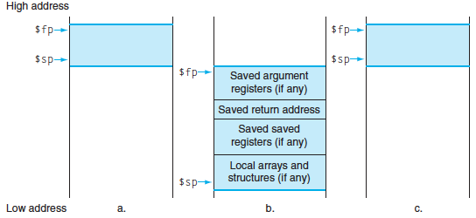
Stack Before, During, After Call

Slide 27
Basic Structure of a Function
Prologue
entry_label: addi $sp,$sp, -framesize sw $ra, framesize-4($sp) # save $ra save other regs if need be
...
restore other regs if need be lw $ra, framesize-4($sp) # restore $ra addi $sp,$sp, framesize jr $ra
Body (call other functions…)
Epilogue

Slide 28
Basic structure of a function call
Setup the arguments:
The first four arguments (arg0-arg3) are passed in registers $a0-$a3
Remaining arguments are pushed onto the stack (in reverse order arg5 is at the top of the stack).
Save caller-saved registers
Save registers $t0-$t9 if they contain live values at the call site.
Execute a jal instruction.

Slide 29
Where is the Stack in Memory?
Stack starts in high memory and grows down
Hexadecimal (base 16) : 7fff fffc_{hex}
MIPS programs (text segment) in low end
0040 0000_{hex}
Static data segment (constants and other static variables) above text for static variables
MIPS convention global pointer ($gp) points to static
Heap above static for data structures that grow and shrink ; grows up to high addresses
E.g., malloc in C, new in Java

Slide 30
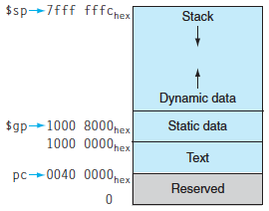
MIPS Memory Allocation

Slide 31
Conclusion (1/2)
Functions called with jal, return with jr $ra.
The stack is your friend: Use it to save anything you need. Just leave it the way you found it!
Instructions we know so far…
Arithmetic: add, addi, sub, addu, addiu, subu
Memory: lw, sw, lb, sb
Decision: beq, bne, slt, slti, sltu, sltiu
Unconditional Branches (Jumps): j, jal, jr
Registers we know so far
All of them (except for 3)!
$a0-$a3 for function arguments, $v0-$v1 for return values
$sp, stack pointer, $fp frame pointer, $ra return address

Slide 32
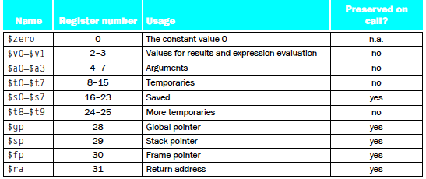
Conclusion (1/2)

Slide 33
Reading
Read 2.8 in David Patterson and John Hennessy, Computer Organization and Design, 5th edition, Morgan Kaufmann, 2014.

Slide 34
acknowledgements
This set of slides are prepared mainly based on
The slides prepared by K. Asanovic & V. Stojanovic for CS61C at UC/Berkeley (http://inst.eecs.Berkeley.edu/~cs61c/sp15)

Slide 35
End

