Slide 1
2. The von neumann model
Rocky K. C. Chang, 12 September 2017
Version 0.1

Slide 2
Goals of this lecture
Understand the concept of stored program.
Understand the main components in the von Newmann model and their interrelationship.
Understand how high-level program fragment can be represented in instruction sets.
Understand how instructions are executed by the CPU.

Slide 3
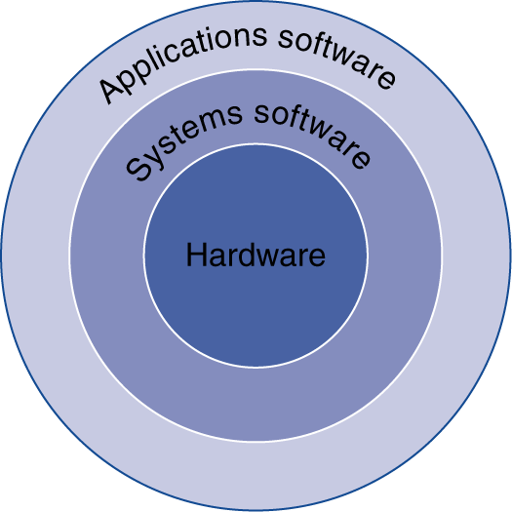
Below Your Program
Application software
Written in high-level language (HLL)
System software
Compiler: translates HLL code to machine code
Operating System: service code
Handling input/output
Managing memory and storage
Scheduling tasks & sharing resources
Hardware
Processor, memory, I/O controllers

Slide 4
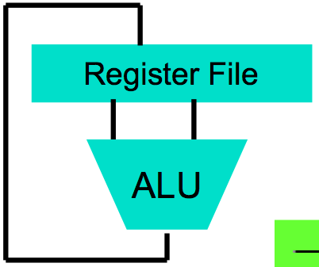
From C programs to execution
temp = v[k];
v[k] = v[k+1];
v[k+1] = temp;
High Level Language Program (e.g., C)
Compiler
Anything can be represented as a number, i.e., data or instructions
lw $t0, 0($2)
lw $t1, 4($2)
sw $t1, 0($2)
sw $t0, 4($2)
Assembly Language Program (e.g., MIPS)
Assembler
0000 1001 1100 0110 1010 1111 0101 1000
1010 1111 0101 1000 0000 1001 1100 0110
1100 0110 1010 1111 0101 1000 0000 1001
0101 1000 0000 1001 1100 0110 1010 1111
Machine Language Program (MIPS)
Machine Interpretation
Hardware Architecture Description (e.g., block diagrams)
Architecture Implementation
Logic Circuit Description (Circuit Schematic Diagrams)
Source: Slides by K. Asanovic & V. Stojanovic for CS61C at UC/Berlekey

Slide 5
From C programs to execution
Compiler: Source code → assembly language (may be skipped) → machine code
Assembler: Assembly code → machine code
Machine code consists of instructions understood by the CPU
Each instruction is executed by CPU
Data processing (arithmetic, logic)
Data storage
Data movement
Control/management

Slide 6
An example
temp = v[k];
v[k] = v[k+1];
v[k+1] = temp;
lw $t0, 0($2)
lw $t1, 4($2)
sw $t1, 0($2)
sw $t0, 4($2)
0000 1001 1100 0110 1010 1111 0101 1000
1010 1111 0101 1000 0000 1001 1100 0110
1100 0110 1010 1111 0101 1000 0000 1001
0101 1000 0000 1001 1100 0110 1010 1111

Slide 7
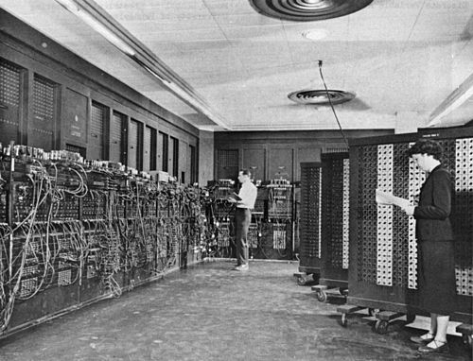
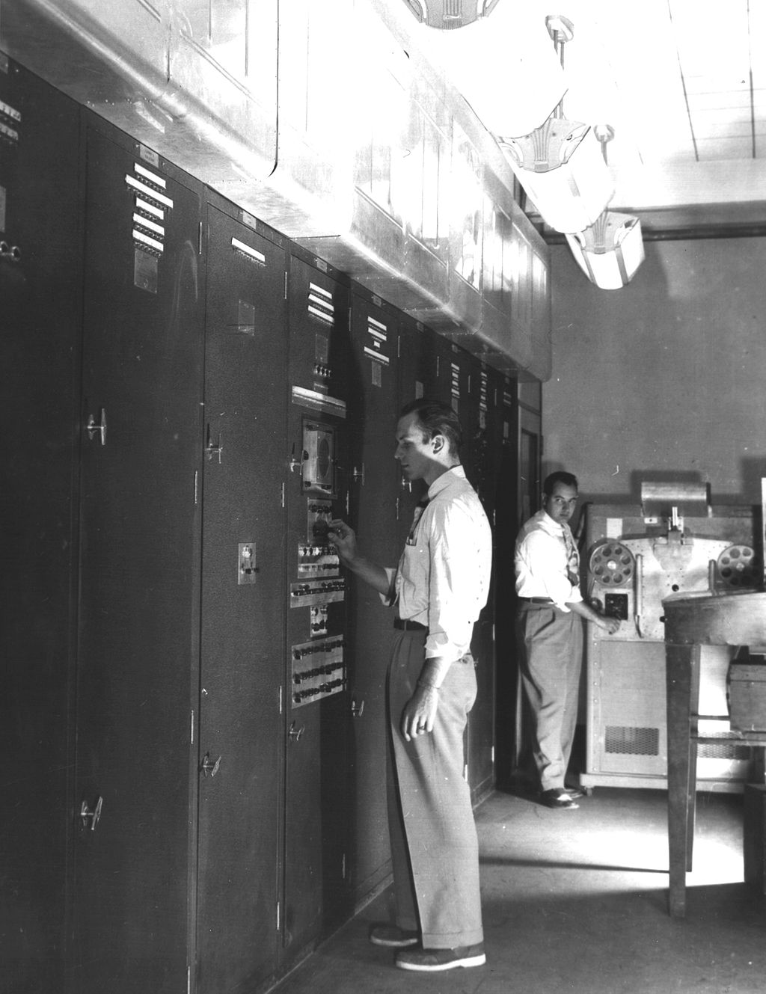
The Stored Program Computer
1943: ENIAC
Presper Eckert and John Mauchly -- first general electronic computer.
Hard-wired program -- settings of dials and switches.
1944: Beginnings of EDVAC
Among other improvements, includes program stored in memory
1945: John von Neumann
wrote a report on the stored program concept, known as the First Draft of a Report on EDVAC
The basic structure proposed in the draft became known as the “von Neumann machine” (or model).
a memory, containing instructions and data
a processing unit, for performing arithmetic and logical operations
a control unit, for interpreting instructions

Slide 8
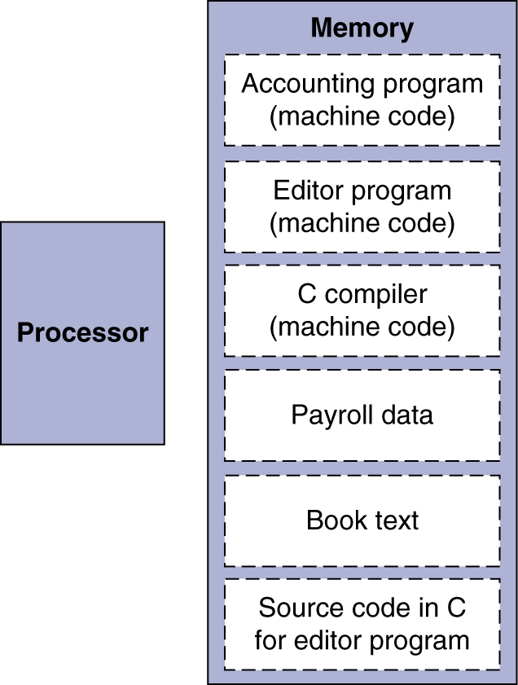
Stored-Program Computer
Instructions represented in binary, just like data
Instructions and data stored in memory
Programs can operate on programs
e.g., compilers, linkers, …
Binary compatibility allows compiled programs to work on different computers
Standardized ISAs
Source: David Patterson and John Hennessy, Computer Organization and Design, 5th edition, Morgan Kaufman, 2014.

Slide 9
Everything is now addressable
Since all instructions and data are stored in memory, everything has a memory address: instructions, data words
both branches and jumps use these
C pointers are just memory addresses: they can point to anything in memory
Unconstrained use of addresses can lead to nasty bugs; up to you in C; limited in Java by language design
One register keeps address of instruction being executed: Program Counter (PC)

Slide 10
instructions
The instruction is the fundamental unit of work.
Specifies two things:
opcode: operation to be performed
operands: data/locations to be used for operation
An instruction is encoded as a sequence of bits (Just like data!)
Often, but not always, instructions have a fixed length, such as 16 or 32 bits.
Control unit interprets instruction: generates sequence of control signals to carry out operation.
Operation is either executed completely, or not at all.
A computer’s instructions and their formats is known as its Instruction Set Architecture (ISA).
Opcode

Slide 11
Example: Add instruction
Each instruction is 16 bit long and has a four-bit opcode, bits [15:12].
Eight registers (R0-R7) for temporary storage.
ADD instruction: Sources and destination of ADD are registers.
Data are assumed loaded into registers Src1 and Src2.
“Add the contents of R2 to the contents of R6, and store the result in R6.”

Slide 12
Example: LOAD (LDR) Instruction
Load (LDR) instruction -- read data from memory
Base + offset mode:
Add offset to base register -- result is memory address
Load from memory address into destination register
“Add the value 6 to the contents of R3 to form a memory address. Load the contents stored in that address to R2.”

Slide 13
Example: STORE (STR) Instruction
Store (STR) instruction -- store data to memory
Base + offset mode:
Add offset to base register -- result is memory address
Store data from the source register to the memory address
STR
SR
“Add the value 6 to the contents of R3 to form a memory address. Store the contents in R2 to that address.”
0 1 1 1

Slide 14
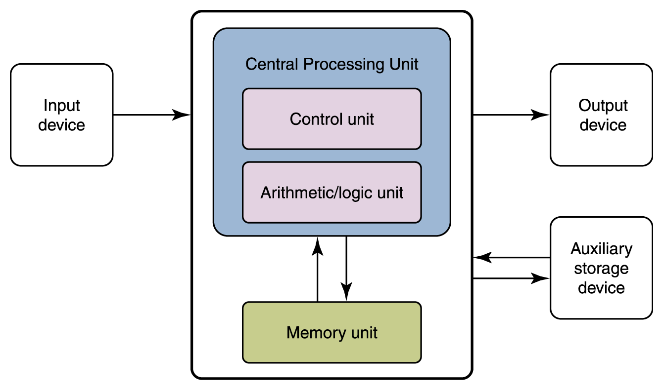
The von Neumann model

Slide 15
Flow of Information
The parts are connected to one another by a collection of wires called a bus.

Slide 16
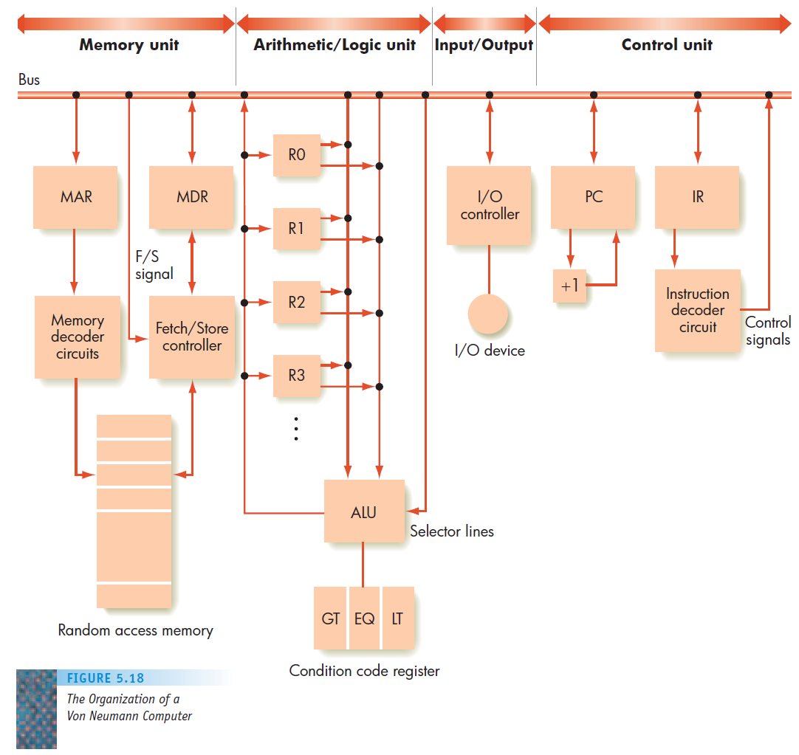
The three elements
Memory: Store and retrieve instructions and data.
Processor: Houses two separate components:
The control unit: repeating the three tasks:
Fetch an instruction from memory
Decode the instruction
Execute the instruction
The arithmetic/logic unit (ALU): Perform mathematical and logical operations.
Input/Output (I/O) Units: Handle communication with the outside world.
Source: M. Schneider and J. Gersting, Invitation to Computer Science, 5th edition, Course Technology, 2010.

Slide 17
Memory Subsystem
Memory, also called RAM (Random Access Memory)
Consist of many memory cells (storage units) of a fixed size. Each cell has an address associated with it: 0, 1, …
All accesses to memory are to a specified address. A cell is the minimum unit of access (fetch/store a complete cell).
The time it takes to fetch/store a cell is the same for all cells.
When the computer is running, both
Program
Data (variables)
are stored in the memory.

Slide 18
RAM
N
0000000000000001
1 bit
Need to distinguish between
the address of a memory cell and the content of a memory cell
Memory width (W):
How many bits is each memory cell, typically one byte (=8 bits)
Address width (N):
How many bits used to represent each address, determines the maximum memory size = address space.
If address width is N-bits, then address space is 2^{N} (0,1,...,2^{N}-1).
0
1
2
...
2^{N}
2^{N}-1
W

Slide 19
Memory Size / Speed
Memory sizes:
Kilobyte (KB) = 2¹⁰ = 1,024 bytes ~ 1 thousand
Megabyte(MB) = 2²⁰ = 1,048,576 bytes ~ 1 million (10⁶) bits
Gigabyte (GB) = 2³⁰ = 1,073,741,824 bytes ~ 1 billion (10⁹) bits
Terabyte (TB) = 2⁴⁰ = …
Memory Access Time (read from/ write to memory)
50-75 nanoseconds (1 nsec. = 0.000000001 sec.)
RAM is
volatile (can only store when power is on)
relatively expensive

Slide 20
Operations on Memory
Fetch (address):
Fetch a copy of the content of memory cell with the specified address.
Non-destructive, copies value in memory cell.
Store (address, value):
Store the specified value into the memory cell specified by address.
Destructive, overwrites the previous value of the memory cell.
The memory system is interfaced via:
Memory Address Register (MAR)
Memory Data Register (MDR)
Fetch/Store signal

Slide 21
Structure of the Memory Subsystem
Fetch (address)
Load address into MAR.
Decode the address in MAR.
Copy the content of memory cell with specified address into MDR.
Store (address, value)
Load the address into MAR.
Load the value into MDR.
Decode the address in MAR
Copy the content of MDR into memory cell with the specified address.
MAR
MDR
F/S
Memory
decoder
circuit
Fetch/Store
controller
...

Slide 22
Review questions
If memory address is of n bits, and each computer word stored in the memory is of 32 bits, how many words can be stored in the memory?
If each computer word is of 64 bits and the memory is designed to accommodate 2^{m} words, how many bits are needed for the memory addresses?
How much memory can be addressed by a 32/64-bit machine?

Slide 23
Input/Output Subsystem
Handles devices that allow the computer system to:
Communicate and interact with the outside world
Screen, keyboard, printer, ...
Store information (mass-storage)
Hard-drives, floppies, CD, tapes, …
Mass-Storage Device Access Methods:
Direct Access Storage Devices (DASDs)
Hard-drives, floppy-disks, CD-ROMs, ...
Sequential Access Storage Devices (SASDs)
Tapes (for example, used as backup devices)

Slide 24
I/O Controllers
Speed of I/O devices is slow compared to RAM
RAM ~ 50 nsec.
Hard-Drive ~ 10msec. = (10,000,000 nsec)
Solution:
I/O Controller, a special purpose processor:
Has a small memory buffer, and a control logic to control I/O device (e.g. move disk arm).
Sends an interrupt signal to CPU when done read/write.
Data transferred between RAM and memory buffer.
Processor free to do something else while I/O controller reads/writes data from/to device into I/O buffer.

Slide 25
Structure of the I/O Subsystem
Interrupt signal (to processor)
Data from/to memory
I/O controller
I/O Buffer
Control/Logic
I/O device

Slide 26
The ALU Subsystem
The ALU (Arithmetic/Logic Unit) performs
mathematical operations (+, -, x, /, …)
logic operations (=, <, >, and, or, not, ...)
In today's computers integrated into the CPU
Consists of:
Circuits to do the arithmetic/logic operations.
Registers (fast storage units) to store intermediate computational results.
Bus that connects the two.

Slide 27
Structure of the ALU
R0
R1
Registers:
Very fast local memory cells, that store operands of operations and intermediate results.
CCR (condition code register), a special purpose register that stores the result of <, = , > operations
ALU circuitry:
Contain an array of circuits to do mathematical/logic operations.
Bus:
Data path interconnecting the registers to the ALU circuitry.
R2
Rn
ALU circuitry
GT
EQ
LT

Slide 28
The Control Unit
Program is stored in memory
as machine language instructions, in binary
The task of the control unit is to execute programs by repeatedly:
Fetch from memory the next instruction to be executed.
Decode it, that is, determine what is to be done.
Execute it by issuing the appropriate signals to the ALU, memory, and I/O subsystems.
Continue until the HALT instruction

Slide 29
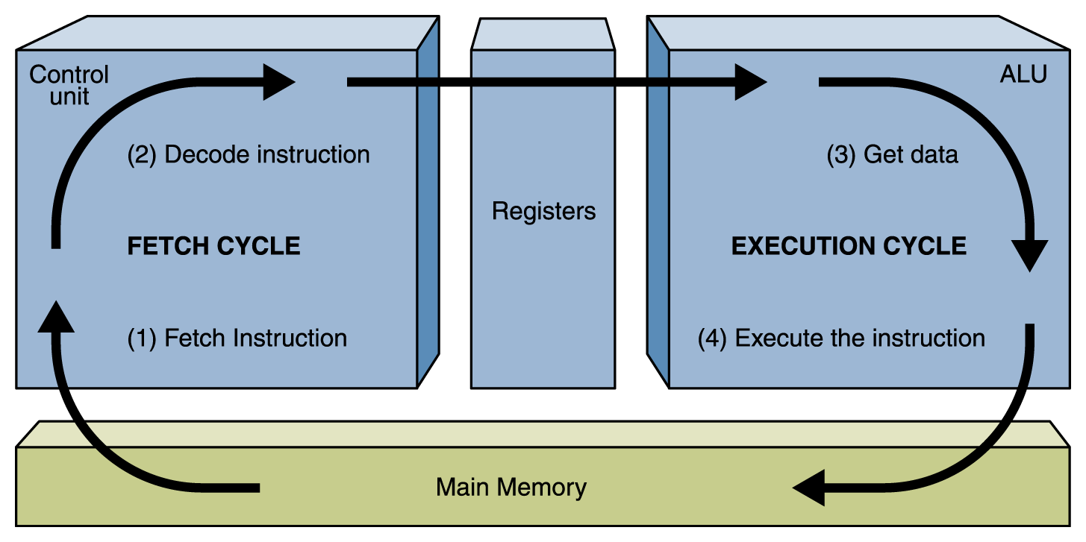
The fetch-decode-execute cycle

Slide 30
Structure of the Control Unit
PC (Program Counter):
store the address of next instruction to fetch
IR (Instruction Register):
store the instruction fetched from memory
Instruction Decoder:
Decode instruction and activates necessary circuitry
PC
IR
+1
Instruction
Decoder

Slide 31
A simple example
c ← a + b (using a HLL)
The compiler will compile it into 4 instructions:
Load a into register R1 (LDR R1, 1000)
Load b into register R3 (LDR R3, 1002)
R2 ← R1 + R2 (ADD R2, R1, R2)
Store R2 to c. (STR R2, 1003)
And store their corresponding machine codes in the memory.

Slide 32
A simple example
R0
10
1000 (a)
R1
10
20
1002 (b)
R2
-100
1004 (c)
R3
ALU
LDR R1, 1000
5000
LDR R3, 1002
5002
LDR R1, 1000
ADD R2, R1, R3
5004
IR
5000
STR R2, 1004
5006
PC

Slide 33
A simple example
R0
10
1000 (a)
R1
10
20
1002 (b)
R2
-100
1004 (c)
R3
20
ALU
LDR R1, 1000
5000
LDR R3, 1002
5002
LDR R3, 1002
ADD R2, R1, R3
5004
IR
5002
STR R2, 1004
5006
PC

Slide 34
A simple example
R0
10
1000 (a)
R1
10
20
1002 (b)
R2
30
-100
1004 (c)
R3
20
ALU
LDR R1, 1000
5000
LDR R3, 1002
5002
ADD R2, R1, R3
ADD R2, R1, R3
5004
IR
5004
STR R2, 1004
5006
PC

Slide 35
A simple example
R0
10
1000 (a)
R1
10
20
1002 (b)
30
-100
R2
30
1004 (c)
R3
20
ALU
LDR R1, 1000
5000
LDR R3, 1002
5002
STR R2, 1004
ADD R2, R1, R3
5004
IR
5006
STR R2, 1004
5006
PC

Slide 36
Review questions
Write down the instructions for d ← (a + b) × c, assuming a, b, and c are integers.

Slide 37
Instruction Processing
Fetch instruction from memory
Decode instruction
Evaluate address
Fetch operands from memory
Execute operation
Store result

Slide 38
Instruction Processing: FETCH
F
Load next instruction (at address stored in PC) from memory into Instruction Register (IR).
Load contents of PC into MAR.
Send “read” signal to memory.
Read contents of MDR, store in IR.
Then increment PC, so that it points to the next instruction in sequence.
PC becomes PC+1.
D
EA
OP
EX
S

Slide 39
Instruction Processing: DECODE
F
First identify the opcode.
E.g., in the first four bits of instruction.
A 4-to-16 decoder asserts a control line corresponding to the desired opcode.
Depending on opcode, identify other operands from the remaining bits.
Example:
for LDR, last six bits is offset
for ADD, last three bits is source operand #2
D
EA
OP
EX
S

Slide 40
Instruction Processing: EVALUATE ADDRESS
F
For instructions that require memory access, compute address used for access.
Examples:
add offset to base register (as in LDR)
add offset to PC (or to part of PC)
add offset to zero
D
EA
OP
EX
S

Slide 41
Instruction Processing: FETCH OPERANDS
F
Obtain source operands needed to perform operation.
Examples:
load data from memory (LDR)
read data from register file (ADD)
D
EA
OP
EX
S

Slide 42
Instruction Processing: EXECUTE
F
Perform the operation, using the source operands.
Examples:
send operands to ALU and assert ADD signal
do nothing (e.g., for loads and stores)
D
EA
OP
EX
S

Slide 43
Instruction Processing: STORE
F
Write results to destination. (register or memory)
Examples:
result of ADD is placed in destination register
result of memory load is placed in destination register
for store (STR) instruction, data is stored to memory
write address to MAR, data to MDR
assert WRITE signal to memory
D
EA
OP
EX
S

Slide 44
Changing the Sequence of Instructions
In the FETCH phase, we incremented the Program Counter by 1.
What if we don’t want to always execute the instruction that follows this one?
examples: loop, if-then, function call
Need special instructions that change the contents of the PC.
These are called jumps and branches.
jumps are unconditional -- they always change the PC
branches are conditional -- they change the PC only if some condition is true (e.g., the contents of a register is zero)

Slide 45
Example: JUMP (JMPR) Instruction
Set the PC to the value obtained by adding an offset to a register. This becomes the address of the next instruction to fetch.
“Add the value of 6 to the contents of R3, and load the result into the PC.”
Notes:
This matches the example in the text, but it may be a little confusing because there is no JMPR in the table in Chapter 5. Instead, there’s a JSRR -- bit 11 determines whether to link or not, which determines whether it’s JMPR or JSRR.

Slide 46
Instruction Processing Summary
Instructions look just like data -- it’s all interpretation.
Three basic kinds of instructions:
computational instructions (ADD, AND, …)
data movement instructions (LD, ST, …)
control instructions (JMP, BRnz, …)
Six basic phases of instruction processing:
F → D → EA → OP → EX → S
not all phases are needed by every instruction
phases may take variable number of machine cycles

Slide 47
Driving Force: The Clock
The clock is a signal that keeps the control unit moving.
At each clock “tick,” control unit moves to the next machine cycle -- may be next instruction or next phase of current instruction.
Clock generator circuit:
Based on crystal oscillator
Generates regular sequence of “0” and “1” logic levels
Clock cycle (or machine cycle) -- rising edge to rising edge
“1”
“0”
Machine
Cycle
time→

Slide 48
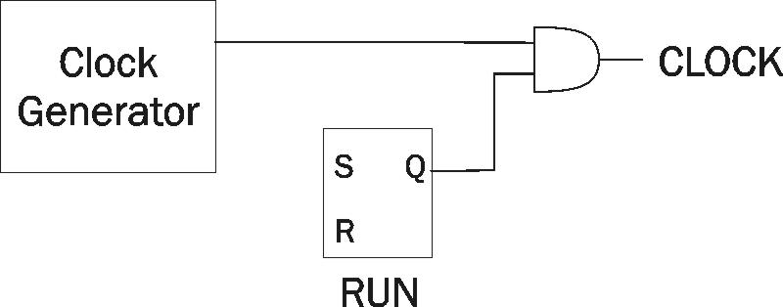
Stopping the Clock
Control unit will repeat instruction processing sequence as long as clock is running.
If not processing instructions from your application, then it is processing instructions from the Operating System (OS).
The OS is a special program that manages processor and other resources.
To stop the computer:
AND the clock generator signal with ZERO
when control unit stops seeing the CLOCK signal, it stops processing

Slide 49
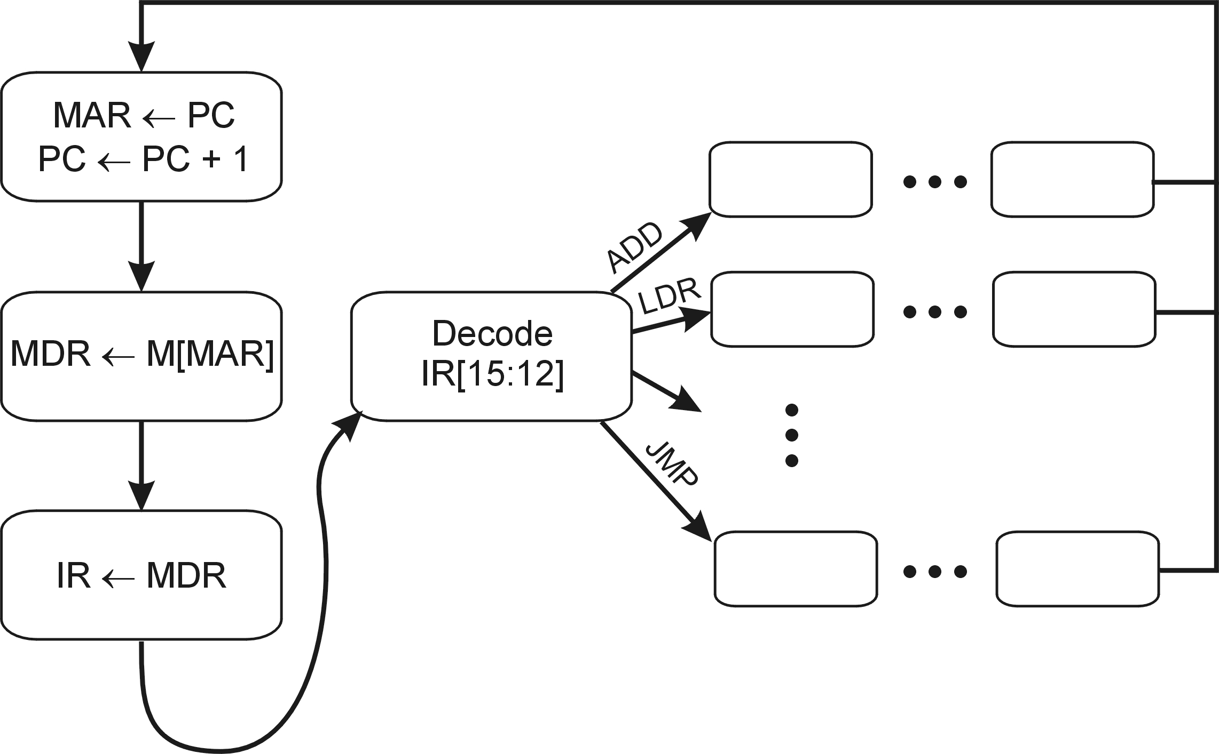
Control unit state diagram
The control unit is a state machine. Here is part of a simplified state diagram for an instruction set:
The fetch phase

Slide 50
Computer Architecture and organization
Instruction set architecture (from Patterson and Hennessy): An abstract interface between the hardware and the lowest-level software that encompasses all the information necessary to write a machine language program that will run correctly, including instructions, registers, memory access, I/O, and so on.
E.g., Intel x86 family, ARM, MIPS
Microarchitecture (from Patterson and Hennessy): The organization of the processor, including the major functional units, their interconnection, and control.
(IEEE/ACM Computer Science Curriculum 2008) The internal implementation of a computer at the register and functional unit level

Slide 51
Conclusions
Memory
Input
Processor
Enable?
Read/Write
Control
Program
Datapath
Address
Bytes
PC
Registers
Write Data
Data
Arithmetic & Logic Unit
(ALU)
ReadData
Output
Processor-Memory Interface
I/O-Memory Interfaces
Source: Slides by K. Asanovic & V. Stojanovic for CS61C at UC/Berlekey
51

Slide 52
Reading
Read 3.1-3.3 in Stallings
(Supplement) Read chapter 5 in M. Schneider and J. Gersting, Invitation to Computer Science, 5th edition, Course Technology, 2010 (available in the Internet).
For your interests:
Intel, ARM: ‘Von Neuman Architecture’ Here to Stay, For Now, Says Bernstein (http://www.barrons.com/articles/intel-arm-von-neuman-architecture-here-to-stay-for-now-says-bernstein-1465242162)
Understanding the MAR and the MDR (https://www.cs.umd.edu/class/sum2003/cmsc311/Notes/Overall/mar.html)

Slide 53
acknowledgements
This set of slides are prepared mainly based on
Chapter 4 in Y. Patt and S. Patel, Introduction to Computing Systems: From Bits and Gates to C and Beyond, second edition, McGraw Hill, 2004.
Chapter 5 in M. Schneider and J. Gersting, Invitation to Computer Science, 5th edition, Course Technology, 2010.
Yngvi Bjornsson, Slides for CMPUT101 Introduction to Computing (Chapter 5.1-5.2).

Slide 54
End

