Slide 1
1. Numbers and their representations
Rocky K. C. Chang, 25 August 2017

Slide 2
Goals of this lecture
Review the number systems.
Understand the class of positional number systems with different radix/base, such as binary, decimal, and hexadecimal.
Know how to convert a number of a given base to its representation under another base.
Understand how integers and real numbers are represented in computers.
Understand how signed and unsigned integers are represented by a computer word.
Understand how real numbers are represented by 32/64-bit computer words.

Slide 3
Number system

Slide 4
Inside computer, everything is a number.

Slide 5
The Decimal System
System based on decimal digits (0, 1, 2, 3, 4, 5, 6, 7, 8, 9) to represent numbers
E.g., 83 means eight tens plus three:
83 = (8 × 10) + 3 × 1
E.g., 4728 means four thousands, seven hundreds, two tens, plus eight:
4728 = (4 × 1000) + (7 × 100) + (2 × 10) + 8 × 1
The decimal system is said to have a base, or radix, of 10.
83 = (8 × 10¹) + (3 × 10⁰)
4728 = (4 × 10³) + (7 × 10²) + (2 × 10¹) + (8 × 10⁰)
Notes:
In everyday life we use a system based on decimal digits (0, 1, 2, 3, 4, 5, 6, 7, 8, 9) to
represent numbers, and refer to the system as the decimal system. Consider what
the number 83 means. It means eight tens plus three:
83 = (8 * 10) + 3
The number 4728 means four thousands, seven hundreds, two tens, plus eight:
4728 = (4 * 1000) + (7 * 100) + (2 * 10) + 8
The decimal system is said to have a base, or radix, of 10. This means that each digit
in the number is multiplied by 10 raised to a power corresponding to that digit’s
position:
83 = (8 * 10¹) + (3 * 10⁰)
4728 = (4 * 10³) + (7 * 10²) + (2 * 10¹) + (8 * 10⁰)

Slide 6
Decimal Fractions
The same principle holds for decimal fractions.
E.g., decimal fraction 0.256 stands for 2 tenths plus 5 hundredths plus 6 thousandths:
0.256 = (2 × 10⁻¹) + (5 × 10⁻²) + (6 × 10⁻³)
Therefore, the integer and fractional part can be expressed in terms of the base and the digit’s position, e.g.,
442.256 = (4 × 10²) + (4 × 10¹) + (2 × 10⁰) + (2 × 10⁻¹) + (5 × 10⁻²) +
(6 × 10⁻³)
Most significant digit: The leftmost digit (carries the highest value)
Least significant digit: The rightmost digit
Notes:
The same principle holds for decimal fractions, but negative powers of 10 are
used. Thus, the decimal fraction 0.256 stands for 2 tenths plus 5 hundredths plus
6 thousandths:
0.256 = (2 * 10⁻¹) + (5 * 10-²) + (6 * 10-³)
A number with both an integer and fractional part has digits raised to both
positive and negative powers of 10:
442.256 = (4 * 10²) + (4 + 10¹) + (2 * 10⁰) + (2 * 10⁻¹) + (5 * 10⁻²)
+ (6 * 10-3)
In any number, the leftmost digit is referred to as the most significant digit,
because it carries the highest value. The rightmost digit is called the least significant
digit. In the preceding decimal number, the 4 on the left is the most significant digit
and the 6 on the right is the least significant digit.

Slide 7
To summarize for decimal numbers
For a decimal number X = . . . d₃d₂d₁d₀.d₋₁d₋₂d₋₃ . . . , its value can be mathematically expressed as a summation:
Notes:
Table 9.1 shows the relationship between each digit position and the value
assigned to that position. Each position is weighted 10 times the value of the position
to the right and one-tenth the value of the position to the left. Thus, positions represent
successive powers of 10. If we number the positions as indicated in Table 9.1,
then position i is weighted by the value 10^{i}.

Slide 8
Positional Number Systems
Each number is represented by a string of digits in which each digit position i has an associated weight r^{i}, where r is the radix or base, of the number system.
The general form of a number in such a system with radix r is
( . . . a₃a₂a₁a₀.a₋₁a₋₂a₋₃ . . . )_{r}
where the value of any digit a_{i} is an integer in the range 0 < a_{i} < r. The dot between a₀ and a₋₁ is called the radix point.
The decimal system is just a particular case in this system.
Notes:
In a positional number system, each number is represented by a string of digits in
which each digit position i has an associated weight r^{i}, where r is the radix, or base,
of the number system. The general form of a number in such a system with radix r is
(. . . a₃a₂a₁a₀.a₋₁a₋₂a₋₃ . . .)_{r}
where the value of any digit a_{i} is an integer in the range 0 < a_{i} < r. The dot between
a₀ and a₋₁ is called the radix point.
The decimal system, then, is a special case of a positional number system with
radix 10 and with digits in the range 0 through 9.

Slide 9
Positional Number Systems
For r = 2 (binary), the possible values are 0 and 1.
E.g., 101011.101101
For r = 8 (octal), the possible values are 0,1,2, …,7.
E.g., 62512.036247, 101011.101101
For r = 16 (hexadecimal), the possible values are 0,1,2,…,9,A,B,C,D,E,F.
E.g., 3048AE8.1320FF, 62512.036247, 101011.101101
We will use this notation---1100100_{two}, 144_{oct}, 100_{ten}, 40_{hex}----to distinguish them whenever necessary.

Slide 10
A number’s decimal value
With the weights of each digit position, we could similarly compute the decimal value of a number of any radix.
For a number X = (. . . a₃a₂a₁a₀.a₋₁a₋₂a₋₃ . . . )_{r} of radix r, its decimal value can be mathematically expressed as a summation:
10110_{two} = 1×2_{ten}⁴ + 0×2_{ten}³ + 1×2_{ten}² + 1×2_{ten}¹ + 0×2_{ten}⁰
= 16_{ten} + 4_{ten} + 2_{ten} = 22_{ten}
(A1)_{hex} = 10_{ten}×16_{ten}¹ + 1×16_{ten}⁰ = 160_{ten} + 1 = 161_{ten}

Slide 11
The same number in different forms
Using base 10 as a reference, a base < 10 is like “expanding” the number and a base > 10 is like “contracting” the number.
Expanding: using more positions (because of a smaller set of values)
Contracting: using less positions (because of a larger set of values)
Say X = 100_{ten}
X can also be expressed as
1100100_{two}
144_{oct}
64_{hex}
Notes:
As an example of another positional system, consider the system with base 7.
Table 9.2 shows the weighting value for positions –1 through 4. In each position, the
digit value ranges from 0 through 6.

Slide 12
Review questions
What is the range of values that a 4-bit decimal number can represent?
What is the range of values that a 4-bit binary number can represent?
What is the range of values that a 4-bit hexadecimal number can represent?

Slide 13
Which form is the best for computers and why?

Slide 14
The Binary System
( . . . b₃b₂b₁b₀.b₋₁b₋₂b₋₃ . . . )₂, where b_{i} = 0,1 (binary digit, or bits)
The digits 1 and 0 in binary notation have the same meaning as in decimal notation:
0_{two} = 0_{ten}
1_{two} = 1_{ten}
For real number, 1001.101_{two} = 2_{ten}³ + 2_{ten}⁰ + 2_{ten}⁻¹ + 2_{ten}⁻³ = 9.625_{ten}
Notes:
In the decimal system, 10 different digits are used to represent numbers with a base
of 10. In the binary system, we have only two digits, 1 and 0. Thus, numbers in the
binary system are represented to the base 2.
To avoid confusion, we will sometimes put a subscript on a number to indicate
its base. For example, 83₁₀ and 4728₁₀ are numbers represented in decimal notation
or, more briefly, decimal numbers. The digits 1 and 0 in binary notation have the
same meaning as in decimal notation:
0₂ = 0₁₀
1₂ = 1₁₀
To represent larger numbers, as with decimal notation, each digit in a binary number
has a value depending on its position:
10₂ = (1 * 2¹) + (0 * 2⁰) = 2₁₀
11₂ = (1 * 2¹) + (1 * 2⁰) = 3₁₀
100₂ = (1 * 2²) + (0 * 2¹) + (0 * 2⁰) = 4₁₀
and so on. Again, fractional values are represented with negative powers of the
radix:
1001.101 = 2³ + 2⁰ + 2⁻¹ + 2⁻³ = 9.625₁₀

Slide 15
decimal integer to binary
Repeated division-by-two method
Example: 12_{ten}
6
3
1
0
2
1 2
2
6
3
1
2
2
1 2
6
2
0
0 (a₀)
0 (a₁)
1 (a₂)
1 (a₃)
This is the last step because the quotient is zero.
12_{ten} = (a₃ a₂ a₁ a₀)_{two} = (1100)_{two}
Source: Prof. Qin Lu’s slides

Slide 16
Why the Repeated division-by-two method works?
Let N_{two} = (a_{n-1}a_{n-2}…a₁a₀)_{two}
M_{ten} = a_{n-1}×2_{ten}^{n-1} + a_{n-2}×2_{ten}^{n-2} + …+ a₁×2_{ten}¹ + a₀×2_{ten}⁰
Dividing M_{ten} by 2, we get
M_{ten} = 2 _{ten} × (a_{n-1}×2_{ten}^{n-2} + a_{n-2}×2_{ten}^{n-3} + …+ a₁×2_{ten}⁰) + a₀
Quotient: a_{n-1}×2_{ten}^{n-2} + a_{n-2}×2_{ten}^{n-3} + …+ a₁×2_{ten}⁰
Reminder: a₀
Repeating the last step for the quotient, we get a₁ as the remainder.
Keep doing that until the quotient is 0 to get (a_{n-1}a_{n-2}…a₁a₀)_{two}.

Slide 17
decimal integer to binary
Convert the following numbers to their binary representation:
256_{ten}
296_{ten}
311_{ten}

Slide 18
Decimal fraction to binary
Repeated multiply-by-two method
Example, N = 0.45_{ten}
0. 4 5
0. 9
0. 8
0. 6
0. 2
X 2
X 2
X 2
X 2
X 2
0. 9(b₋₁ = 0)
1. 8(b₋₂ = 1)
1. 6(b₋₃ = 1)
1. 2(b₋₄ = 1)
0. 4(b₋₅ = 0)
(0.45)_{ten} = (b₋₁b₋₂b₋₃b₋₄b₋₅…)_{two} = (0.01110…)_{two}
Source: Prof. Qin Lu’s slides

Slide 19
Why the Repeated multiply-by-two method works?
Let N_{two} = (0.b₋₁b₋₂b₋₃…)_{two}
M_{ten} = b₋₁×2_{ten}⁻¹ + b₋₂×2_{ten}⁻² + b₋₃×2_{ten}⁻³
Multiplying M_{ten} by 2, we get
M_{ten} = b₋₁ + b₋₂×2_{ten}⁻¹ + b₋₃×2_{ten}⁻² + …
Repeating the last step for the fractional part and get b₋₂.
Keep doing that to get (b₋₁b₋₂b₋₃…)_{two}.

Slide 20
Review questions
Visit http://www.geom.uiuc.edu/~huberty/math5337/groupe/digits.html for the value of Pi.
Let just consider ten places after the radix point: 3.1415926535.
Convert the fractional part to N-bit binary number, what is the accuracy of the binary representation for
N = 5
N = 10
N = 15

Slide 21
Hexadecimal Notation
Problem: How to read the bits in a more compact way?
Binary digits are grouped into sets of four bits, called a nibble
Each possible combination of four binary digits is given a symbol, as follows:
0000 = 0 0100 = 4 1000 = 8 1100 = C
0001 = 1 0101 = 5 1001 = 9 1101 = D
0010 = 2 0110 = 6 1010 = A 1110 = E
0011 = 3 0111 = 7 1011 = B 1111 = F
When used for integers, e.g., 2C_{hex} = (2_{hex}×16_{ten}¹) + (C_{hex}×16_{ten}⁰) = (2_{ten}×16_{ten}¹) + (12_{ten}× 16_{ten}⁰) = 44_{ten}
Notes:
Because of the inherent binary nature of digital computer components, all forms of
data within computers are represented by various binary codes. However, no matter
how convenient the binary system is for computers, it is exceedingly cumbersome
for human beings. Consequently, most computer professionals who must spend time
working with the actual raw data in the computer prefer a more compact notation.
What notation to use? One possibility is the decimal notation. This is certainly
more compact than binary notation, but it is awkward because of the tediousness of
converting between base 2 and base 10.
Instead, a notation known as hexadecimal has been adopted. Binary digits are
grouped into sets of four bits, called a nibble. Each possible combination of four
binary digits is given a symbol.
Because 16 symbols are used, the notation is called hexadecimal, and the 16 symbols
are the hexadecimal digits.

Slide 22
Representation of integers in computers

Slide 23
Integers

Slide 24
Signed and Unsigned Integers
C, C++, and Java have signed integers, e.g., 7, -255, e.g.,
int x, y, z;
C, C++ also have unsigned integers, which are used for addresses, e.g.,
unsigned int x, y, z;
32-bit word can represent 2³² binary numbers.
Unsigned integers in 32-bit word represent 0 to 2³²-1 (4,294,967,295).

Slide 25
Unsigned Integers
0000 0000 0000 0000 0000 0000 0000 0000_{two} = 0_{ten}
0000 0000 0000 0000 0000 0000 0000 0001_{two} = 1_{ten}
0000 0000 0000 0000 0000 0000 0000 0010_{two} = 2_{ten}
... ...
0111 1111 1111 1111 1111 1111 1111 1101_{two} = 2,147,483,645_{ten}
0111 1111 1111 1111 1111 1111 1111 1110_{two} = 2,147,483,646_{ten}
0111 1111 1111 1111 1111 1111 1111 1111_{two} = 2,147,483,647_{ten}
1000 0000 0000 0000 0000 0000 0000 0000_{two} = 2,147,483,648_{ten}
1000 0000 0000 0000 0000 0000 0000 0001_{two} = 2,147,483,649_{ten}
1000 0000 0000 0000 0000 0000 0000 0010_{two} = 2,147,483,650_{ten}
... ...
1111 1111 1111 1111 1111 1111 1111 1101_{two} = 4,294,967,293_{ten}
1111 1111 1111 1111 1111 1111 1111 1110_{two} = 4,294,967,294_{ten}
1111 1111 1111 1111 1111 1111 1111 1111_{two} = 4,294,967,295_{ten}

Slide 26
Signed Integers
Problem: how to represent negative numbers?
We may want ½ numbers <0, ½ numbers >0, and one 0.
Is it possible?
Sign (1 bit) and magnitude (e.g., 0 101 for +5 and 1 101 for -5)
Two zeros
May need an extra step to set the sign bit
Where to put the sign bit?

Slide 27
Ones’ complement
The positive number is represented the same way before.
Let X be a positive number and –X is bitwise complement of X.
Problems:
Two zeros
Need an extra step to subtract a number.
 | + | -
0 | 0000 | 1111
1 | 0001 | 1110
2 | 0010 | 1101
3 | 0011 | 1100
4 | 0100 | 1011
5 | 0101 | 1010
6 | 0110 | 1001
7 | 0111 | 1000

Slide 28
Two’s complement
The positive number is represented the same way before.
The negative numbers are represented by the two's complement of their absolute value.
The two's complement of an N-bit number is defined as the complement with respect to 2^{N}.
 | + | -
0 | 0000 | NA
1 | 0001 | 1111
2 | 0010 | 1110
3 | 0011 | 1101
4 | 0100 | 1100
5 | 0101 | 1011
6 | 0110 | 1010
7 | 0111 | 1001
8 | NA | 1000

Slide 29
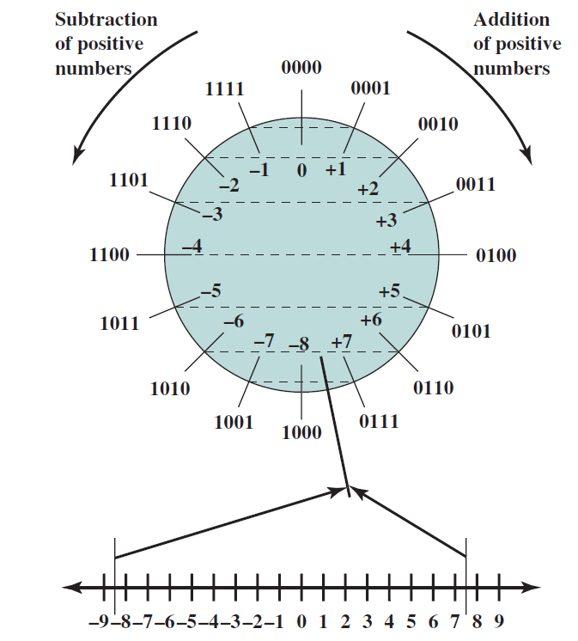
An geometric view of two’s complement integers
Source: Stallings, Computer organization and architecture: Designing for performance, 9th edition, Prentice Hall, 2013.

Slide 30
Two’s complement
Two’s complement treats 0 as positive, so a 32-bit word represents 2³² integers from -2³¹ (–2,147,483,648) to 2³¹-1 (2,147,483,647)
Note: one negative number with no positive version
Every computer uses two’s complement today
The most-significant bit (MSB) indicates the sign, since positive numbers (including 0) always start with 0 and negative numbers 1.
Bit 31 is the most significant; bit 0 is the least significant.
Note that the MSB is not a sign bit.

Slide 31
Two’s-Complement Integers
Sign Bit
0000 0000 0000 0000 0000 0000 0000 0000_{two} = 0_{ten}
0000 0000 0000 0000 0000 0000 0000 0001_{two} = 1_{ten}
0000 0000 0000 0000 0000 0000 0000 0010_{two} = 2_{ten}
... ...
0111 1111 1111 1111 1111 1111 1111 1101_{two} = 2,147,483,645_{ten}
0111 1111 1111 1111 1111 1111 1111 1110_{two} = 2,147,483,646_{ten}
0111 1111 1111 1111 1111 1111 1111 1111_{two} = 2,147,483,647_{ten}
1000 0000 0000 0000 0000 0000 0000 0000_{two} = –2,147,483,648_{ten}
1000 0000 0000 0000 0000 0000 0000 0001_{two} = –2,147,483,647_{ten}
1000 0000 0000 0000 0000 0000 0000 0010_{two} = –2,147,483,646_{ten}
... ...
1111 1111 1111 1111 1111 1111 1111 1101_{two} = –3_{ten}
1111 1111 1111 1111 1111 1111 1111 1110_{two} = –2_{ten}
1111 1111 1111 1111 1111 1111 1111 1111_{two} = –1_{ten}

Slide 32
Making Two’s Complement
For N-bit word, complement to 2_{ten}^{N}
For 4-bit number 5_{ten}=0101_{two}, two’s complement (i.e., -5_{ten}) would be 16_{ten}- 5_{ten}=11_{ten} or 10000_{two} – 0101_{two} = 1011_{two}
A more straightforward approach
Take the bitwise complement of N and then add 1 (1010_{two} + 1_{two}).
N + ones’ complement of N = 2_{ten}^{N} – 1 (e.g., all 1s in binary)
N + two’s complement of N = 2_{ten}^{N}
Thus, two’s complement of N = (ones’ complement of N)_{two} + 1_{two}.

Slide 33
Review questions
For 8-bit word,
What is the largest integer two’s complement can represent?
What is its hexadecimal value?
What is the two’s complement of this largest integer?
What is the smallest integer two’s complement can represent?
What is its hexadecimal value?
What is the two’s complement of this smallest integer?

Slide 34
Two’s-Complement Examples
Assume for simplicity 4 bit width, -8 to +7 represented
3
+2
0011
0010
3
+ (-2)
0011
1110
-3
+ (-2)
1101
1110
5
0101
1
1 0001
-5
1 1011
7
+1
0111
0001
-8
+ (-1)
1000
1111
Carry into MSB =
Carry Out MSB
-8
1000
+7
1 0111
Overflow!
Overflow!
Carry into MSB ≠
Carry Out MSB

Slide 35
converting two’s-complement integer to decimal
For a n-digit number D in two’s complement representation: (d_{n-1}d_{n-2} …d₁d₀)_{two}, the number in decimal is given by
When d_{n-1} = 0 (positive), the number is determined by the summation.
When d_{n-1} = 1 (negative), the number is determined by -2^{n-1} plus the summation.

Slide 36
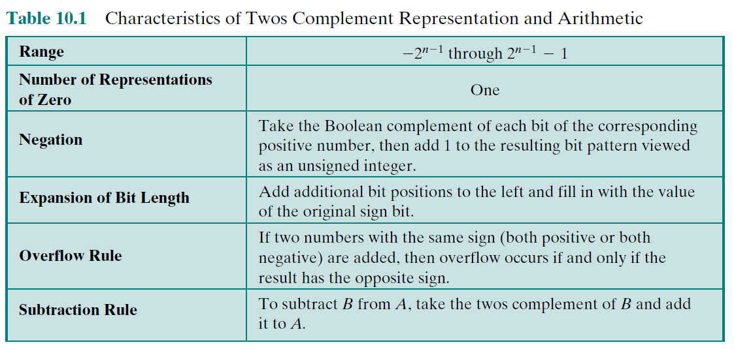
A summary for two’s complement integers
Source: Stallings, Computer organization and architecture: Designing for performance, 9th edition, Prentice Hall, 2013.

Slide 37
Representation of real numbers in computer

Slide 38
Real numbers
A real number is represented by IntegerPart (I) + RadixPoint + FractionalPart (F)
Where to put the radix point?
If it is fixed to a location, the range of data is very limited (not flexible).
For example, there are a total of 8 bits for I and F. (I,F) could be (7,1), (6,2), (5,3) …, (1,7).
Each of this offers different ranges of numbers and precision for the fractional part.
If (I,F) = (4,4)
No problem for 0110.0000 + 0000.0110
But what about 0.0000001 and 1000001.1?

Slide 39
Floating point
Idea: Let the radix point “floating” according to the number.
Write a real number in scientific notation: ±S x B^{±E}.
S: significand (also called mantissa including the sign bit)
B: base
E: exponent
E.g., 9896.54_{ten} = 9.89654_{ten} x 10_{ten}³ (or 9.89654E3_{ten})
E.g., 1110.01_{two} = 1.11001_{two} X 2³ (or 1.11001E3_{two})

Slide 40
Normalizing the significand
Given a real number, there are an infinitely number of ways to express it using the scientific notation.
E.g., 11001.0 can be expressed as …, 1100100.E-2, 110010.E-1, 11001.0E0, 1100.1E1, 110.01E2, ….
A positive (negative) exponent moves the radix point to the right (left) by the absolute value of the exponent.
Need a standard format to simplify the design.
Normalized significand: ±1.xxxxxxx_{two} × 2^{yyyy}
No need to store the MSB
Need to store the sign bit and the bits after the radix point
Note that 0 cannot be represented.
Therefore, we will use 1.1001E4 for the example above.

Slide 41
Floating Point Standard
Defined by IEEE Std 754-1985
Developed in response to divergence of representations
Portability issues for scientific code
Now almost universally adopted
How to strike the “right” balance between range and precision?
Two representations
Single precision (32-bit)
Double precision (64-bit)

Slide 42
IEEE Floating-Point Format
single: 8 bits double: 11 bits
single: 23 bits double: 52 bits
S: sign bit (0 => non-negative, 1 => negative)
Sign and magnitude
Normalize significand: 1.0 ≤ |significand| < 2.0
Always has a leading pre-binary-point 1 bit, so no need to represent it explicitly (hidden bit)
Significand is Fraction with the “1.” restored.
S
Exponent
Fraction

Slide 43
IEEE Floating-Point Format (cont’d)
The exponent could be negative, 0, or positive.
How to represent it?
Two’s complement is not easy to compare.
Use one that preserves the original order (0000 < 0001 < 0010 < …).
Using a bias (Single: bias = 127; Double: bias = 1203)
The Exponent is an unsigned number.
The actual exponent value is Exponent subtracted by the bias.
For single-precision, the range of exponent value is between -127 (0 – 127) and 128 (255 – 127).

Slide 44
IEEE Floating-Point Format (cont’d)
By labelling the 32 bits in the single-precision by (b₃₁b₃₀…b₁b₀)_{two}, the binary representation of a floating-point number is
Its decimal value is given by
where

Slide 45
Floating-Point Example
Represent –0.75
–0.75 = (–1)¹ × 1.1_{two} × 2^{–1}
S = 1
Fraction = 1000…00_{two}
Exponent = –1 + bias
Single: –1 + 127 = 126 = 01111110_{two}
Double: –1 + 1023 = 1022 = 01111111110_{two}
Single: 1011111101000…00
Double: 1011111111101000…00

Slide 46
Floating-Point Example
What number is represented by the single-precision float
11000000101000…00?
S = 1
Fraction = 01000…00_{two}
Exponent = 10000001_{two} = 129
x = (–1)¹ × (1 + .01_{two}) × 2^{(129 – 127)}
= (–1) × 1.25 × 2²
= –5.0

Slide 47
Review questions
What is the real number represented by the single-precision float below?
00111110001000000000000000000000
What is the single-precision float of 111.111_{ten}?

Slide 48
Single-Precision Range
Exponents 00000000 and 11111111 reserved
Smallest value
Exponent: 00000001 ⇒ actual exponent = 1 – 127 = –126
Fraction: 000…00 ⇒ significand = 1.0
±1.0 × 2^{–126} ≈ ±1.2 × 10^{–38}
Largest value
exponent: 11111110 ⇒ actual exponent = 254 – 127 = +127
Fraction: 111…11 ⇒ significand ≈ 2.0
±2.0 × 2⁺¹²⁷ ≈ ±3.4 × 10⁺³⁸

Slide 49
Double-Precision Range
Exponents 0000…00 and 1111…11 reserved
Smallest value
Exponent: 00000000001 ⇒ actual exponent = 1 – 1023 = –1022
Fraction: 000…00 ⇒ significand = 1.0
±1.0 × 2^{–1022} ≈ ±2.2 × 10^{–308}
Largest value
Exponent: 11111111110 ⇒ actual exponent = 2046 – 1023 = +1023
Fraction: 111…11 ⇒ significand ≈ 2.0
±2.0 × 2⁺¹⁰²³ ≈ ±1.8 × 10⁺³⁰⁸

Slide 50
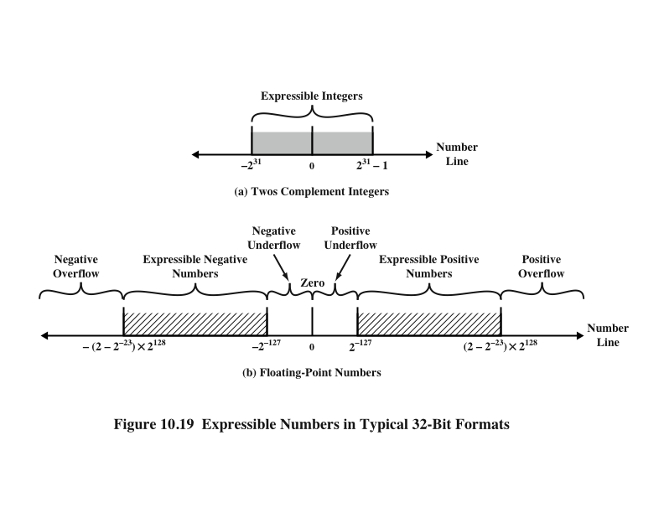
Expressible numbers
Source: Stallings, Computer organization and architecture: Designing for performance, 9th edition, Prentice Hall, 2013.

Slide 51
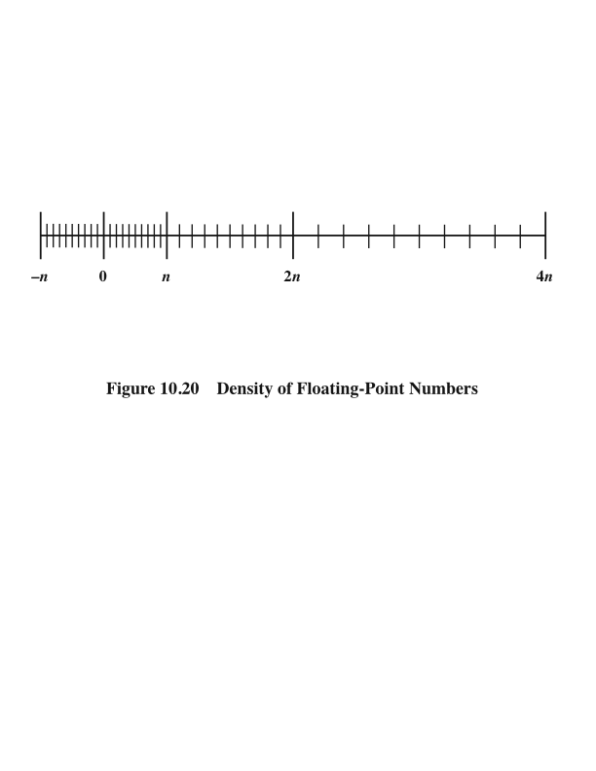
Density of floating-point numbers
Source: Stallings, Computer organization and architecture: Designing for performance, 9th edition, Prentice Hall, 2013.

Slide 52
Infinities and NaNs
Exponent = 000...0, Fraction = 000...0
0_{ten}
Exponent = 111...1, Fraction = 000...0
±Infinity
Can be used in subsequent calculations, avoiding need for overflow check
Exponent = 111...1, Fraction ≠ 000...0
Not-a-Number (NaN)
Indicates illegal or undefined result
e.g., 0.0 / 0.0
Can be used in subsequent calculations

Slide 53
Review questions
Represent 3.1415926535 using single- and double-precision and see how accurately they are to represent this Pi value with 10 decimal places.

Slide 54
Reading
Floating-point representation in section 3.5 in Patterson and Hennessy
Chapters 9,10.2-10.4 in Stallings
Other pointers:
https://en.wikipedia.org/wiki/Single-precision_floating-point_format
https://en.wikipedia.org/wiki/Double-precision_floating-point_format
https://www3.ntu.edu.sg/home/ehchua/programming/java/datarepresentation.html

Slide 55
Acknowledgements
Thanks to all the sources that are referenced in this set of slides.

