Slide 1
0. Course Introduction
Rocky K. C. Chang, 25 August 2017

Slide 2
Something about this course
A lot of design and development for the last 70+ years. What to teach?
The most fundamental features underlying different computer architectures
Covering the “old stuff”, rather the latest technology. Why?
A building block for advanced stuff
Know their limitations
A lot of variation across different models. How to teach?
Stick to one and only one
A lot of terminologies and acronyms.
Keep a list of them along the way
Almost all the content cannot be seen.

Slide 3
What is a computer?
Built by NUDT
16,000 nodes
3,120,000 cores
54,902.4 TFlop/s
17,808 kW
1,024,000 GB
Mainly Intel Xeon E5-2692v2 12C 2.2GHz processors.
Source: https://www.extremetech.com/extreme/209704-chinas-tianhe-2-still-the-fastest-supercomputer-in-the-world-but-the-us-is-catching-up

Slide 4
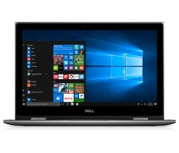
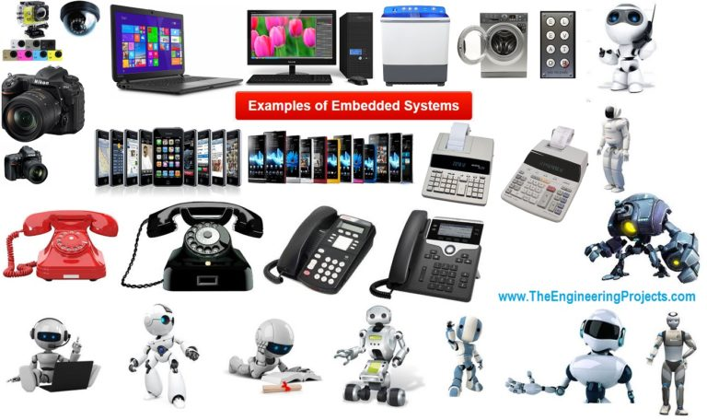
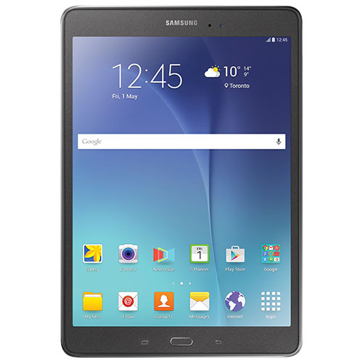
What is a computer?

Slide 5
Anatomy of a PC
Source: http://cdn.computertipsfree.com/wp-content/uploads/computer-inside.jpg

Slide 6
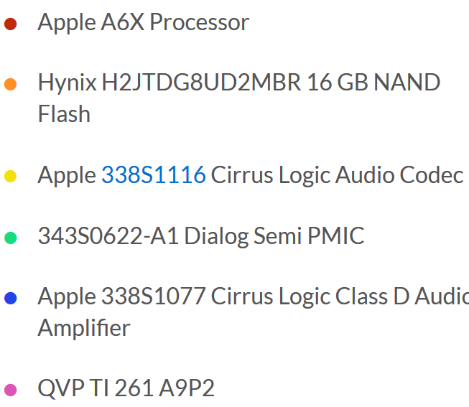
Anatomy of ipad4 (front)
Source: https://www.ifixit.com/Teardown/iPad+4+Wi-Fi+Teardown/11462

Slide 7
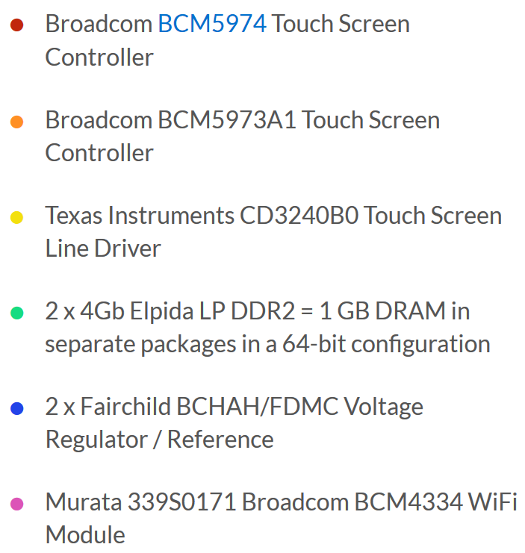
Anatomy of ipad4 (BACK)
Source: https://www.ifixit.com/Teardown/iPad+4+Wi-Fi+Teardown/11462

Slide 8
An abstraction of A computer
Source: https://thecustomizewindows.com/2013/07/von-neumann-architecture-the-reference-model-for-computer/

Slide 9
What is this course about?
What are the main components in a computer system?
How does each component work (CPU, memories, and I/O)?
How are these components work together to solve problems?
How does a computer execute a high-level programming language?
What are the tradeoffs in designing a computer?

Slide 10
A more detailed abstraction
Application (ex: browser)
Software
Operating
Compiler
System
(Mac OSX)
Assembler
Instruction Set
Architecture
Processor
Memory
I/O system
Hardware
Datapath & Control
Digital Design
Circuit Design
transistors
Source: http://inst.eecs.berkeley.edu/~cs61c/su17/

Slide 11
More specifically
Computer Arithmetic
Instruction Sets
Assembly Programming: MIPS
Boolean Algebra and Digital Logic Design
CPU Structure and Function
Arithmetic and Logic Unit, Control Unit, and Registers
Memory Systems
Cache Memory
Internal Memory: RAM, ROM, SRAM, DRAM, …
External Memory: DVD, SD, …

Slide 12
This course
Lecturer: Dr. Rocky K. C. Chang (PQ829, csrchang@comp.polyu.edu.hk)
Office hour: By appointment
Tutor: Mr. Alvin Mak (PQ821, csamak@comp.polyu.edu.hk)
Classes:
Lecture: 8:30-11:20am on Tuesdays in Y305 (50min + 50 min + 50min)
Labs (50min):
Three sessions: 4:30-5:20pm on Mon, 5:30-6:20pm on Mon, 12:30-1:20pm on Wed, and 4:30-5:20pm on Thur
You must attend your own session.
Take attendance
Couse website: www.comp.polyu.edu.hk/~comp2421
Slides
Assignments
Latest timetable

Slide 13
After taking this course,
You will be able to
Identify the main components of a computer system and their interconnection,
Understand how a high-level programming language is translated to the instruction set,
Understand how an assembly language is translated to the instruction set,
Program using the MIPS assembly language,
Understand how the components are implemented with logic gates,
Understand the main functions of a CPU and how they are implemented,
Understand the need for a memory hierarchy,
Understand the mechanics of caches and other levels of memory, and
Understand the mechanics of the common secondary memories.

Slide 14
Textbooks
Two useful books
William Stallings, Computer organization and architecture: Designing for performance, 9th edition, Prentice Hall, 2013.
David Patterson and John Hennessy, Computer Organization and Design, 5th edition, Morgan Kaufman, 2014.
References and supplement
To be supplied on a need basis

Slide 15
Course assessment
Course work (55%)
Assignments (10%)
Laboratories (15%)
Tests (20%)
A mini-project (10%)
Examination (45%)
Open book

Slide 16
My expectations and policies
Attend all lectures and laboratories on time.
Read the covered materials on your own.
Complete your assignments and laboratories yourself and on time.
Policy regarding late submission of works
10% off for every hour late
Policy regarding plagiarism
You will betray your own integrity, whether it will be found out or not!
Both giver and receiver subject to the same penalty below
All the students involved not only will receive 0 marks for this assessment, they will also lose additional, same number of marks from their total assessment marks.
Moreover, we may report the serious cases to the Departmental Learning and Teaching Committee for further disciplinary actions.

Slide 17
Acknowledgements
Thanks to all the sources of the images.

